Slide 1
Observed Stratospheric Temperature Changes during the Satellite Era Dian Seidel, Isaac Moradi, Carl Mears, John Nash, Bill Randel, Roger Saunders, David Thompson, Cheng-Zhi Zou
SPARC Temperature Trends Workshop 9-10 April 2015 Victoria, British Columbia

Slide 2
Motivation
Satellite era now spans 35 years
No major volcanic eruptions since Mt Pinatubo in 1991
Apparent cooling slowdown/cessation since 1994
New Stratospheric Sounding Unit climate data records (CDR)
Thompson et al. (Nature, 2012) identified a “mystery”
Zou et al. (JGR); Nash & Saunders (QJRMS) re-examined SSU CDRs

Slide 3
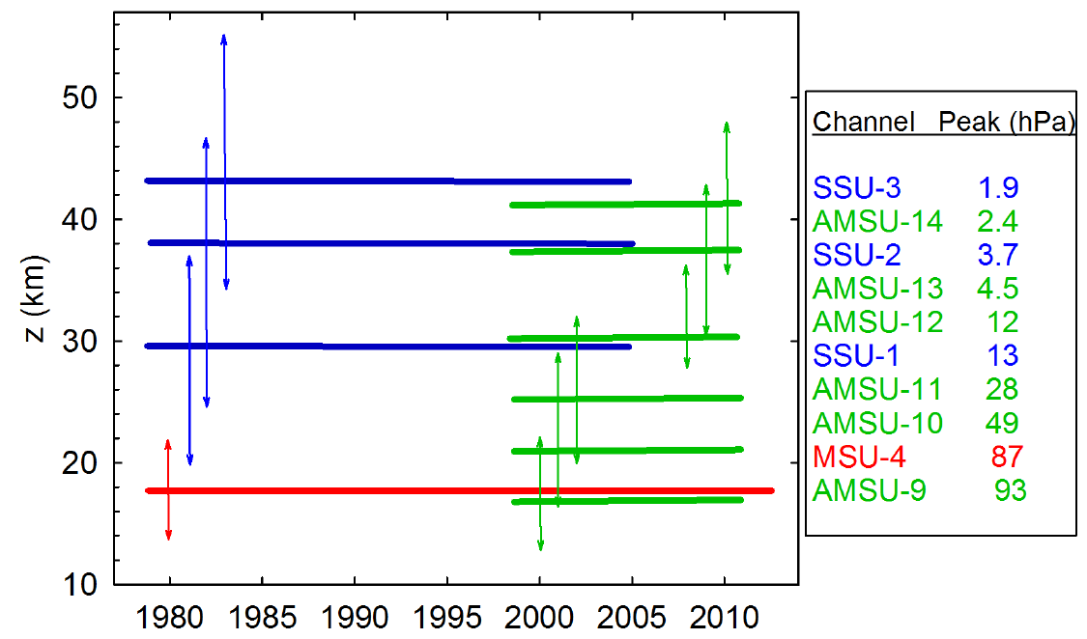
Published stratospheric T CDRs

Slide 4
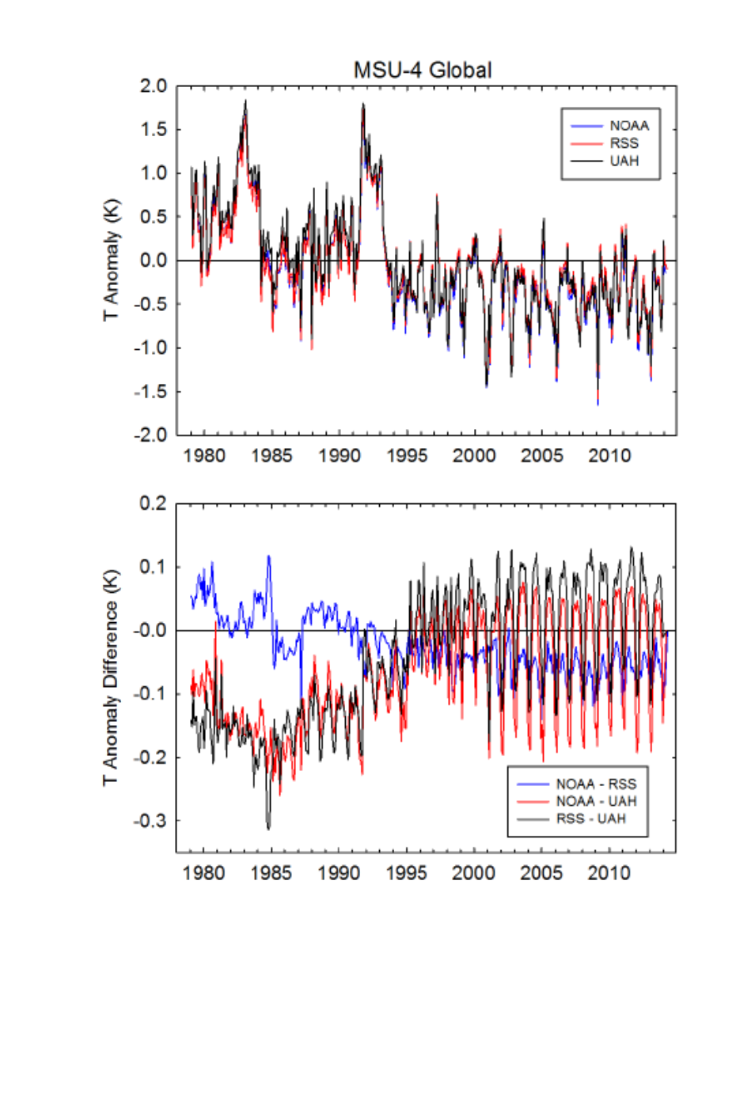
MSU 4 intercomparison – time series
Monthly anomalies 84S-84N Differences
1979-1994 much more variable than 1995-2013
3 carefully-constructed CDRs have nontrivial differences, time-varying biases
NOAA CDR shows more cooling than RSS
UAH CDR shows more cooling than both NOAA and RSS

Slide 5
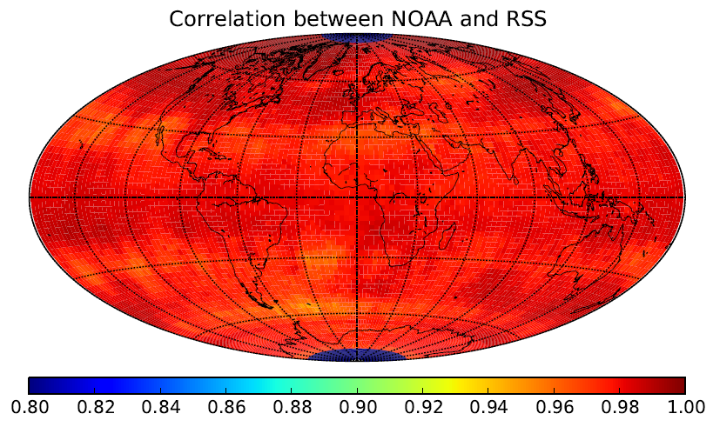
MSU 4 intercomparison - correlations
Of the 3 CDRs, NOAA and RSS are in better agreement
UAH differs most poleward of 30 deg. latitude

Slide 6
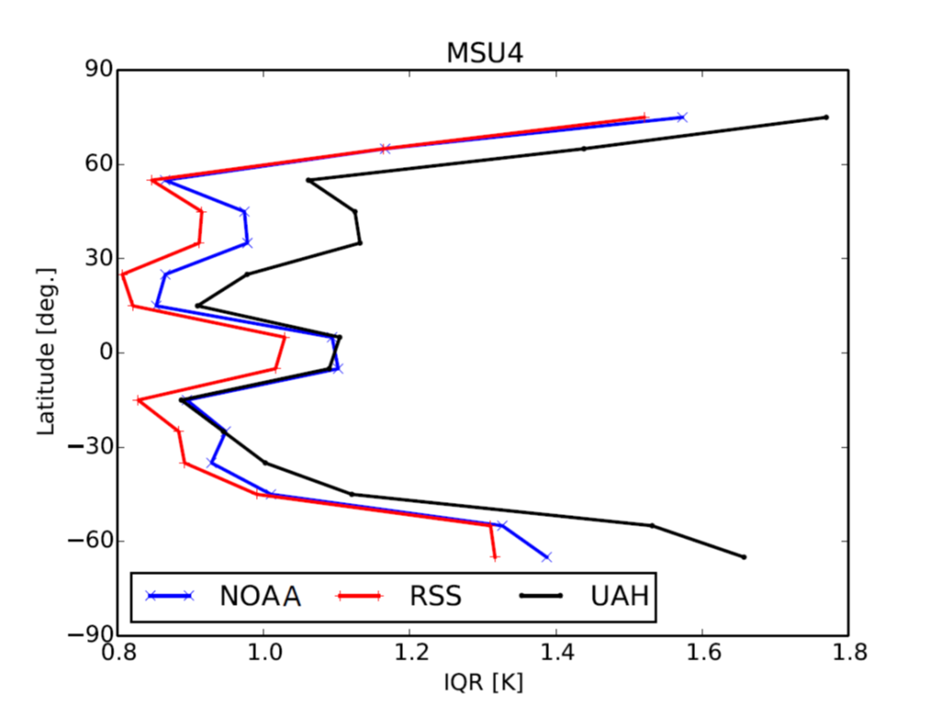
MSU 4 intercomparison – variability
Polar regions are most variable, on interannual scales
Variability differs by up to 20% among the 3 CDRs
Polar variability explains about ½ total variance (EOF analysis result)

Slide 7
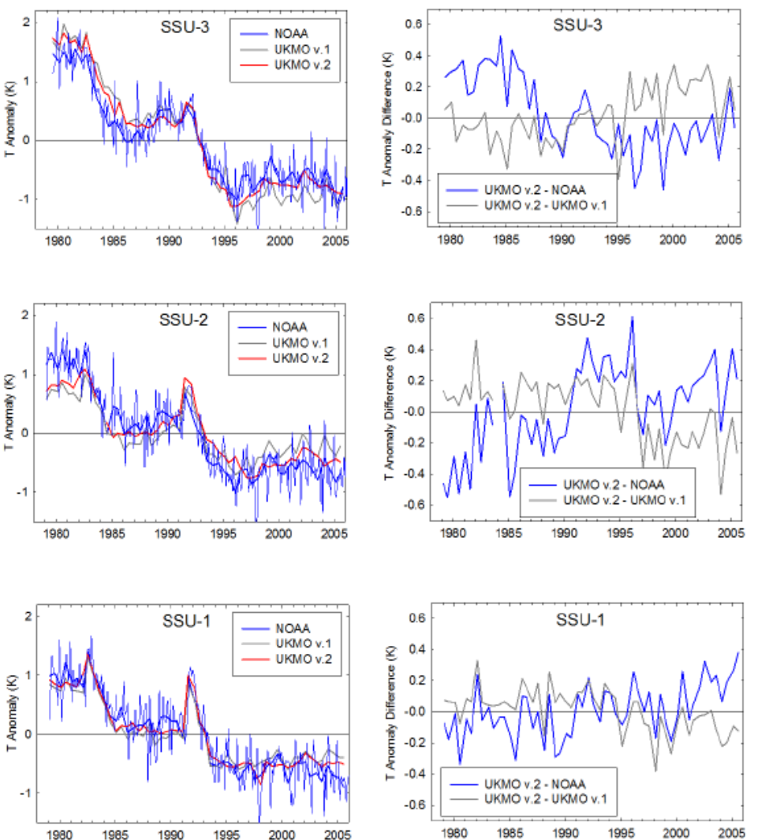
SSU intercomparison – time series
UKMO v.2 SSU CDRs are global, 6-monthly resolution
Time-varying differences remain between 2015 versions of NOAA and UKMO SSU CDRs
No published SSU/AMSU merged CDR
SSU-3
40-50 km
SSU-2
35-35 km
SSU-1
25-35 km

Slide 8
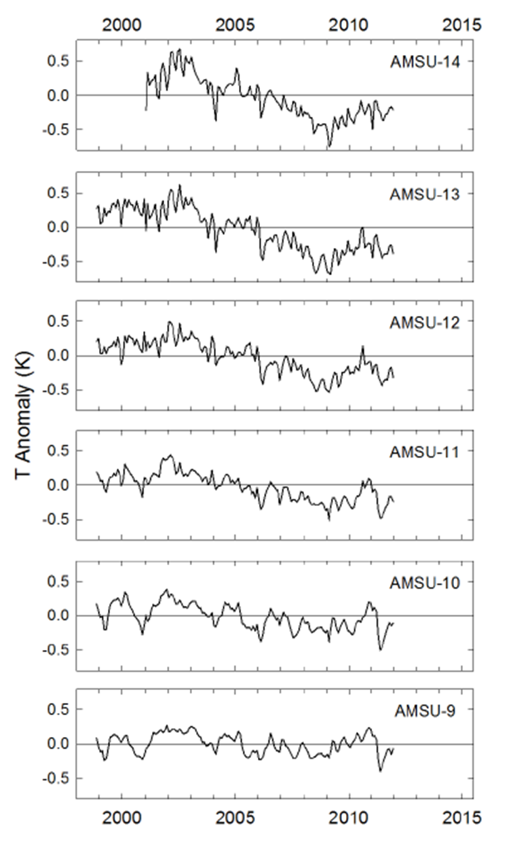
AMSU CDRs – 1999-2011
Cooling at higher altitudes, little change at lower altitudes
Extension of CDRs to present forthcoming
Period of record differs from SSU period:
Little volcanic activity
Unusual solar cycle

Slide 9
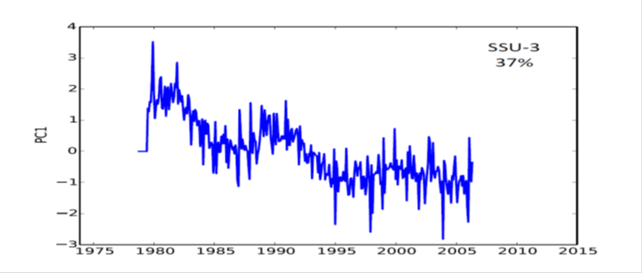
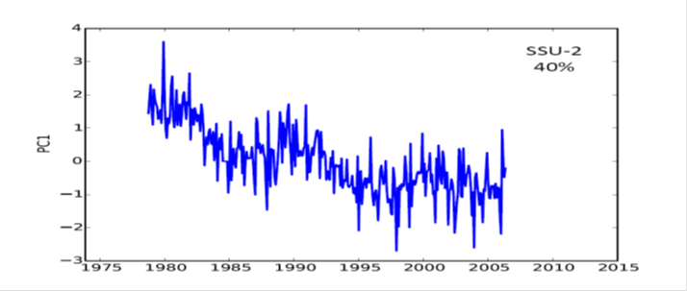
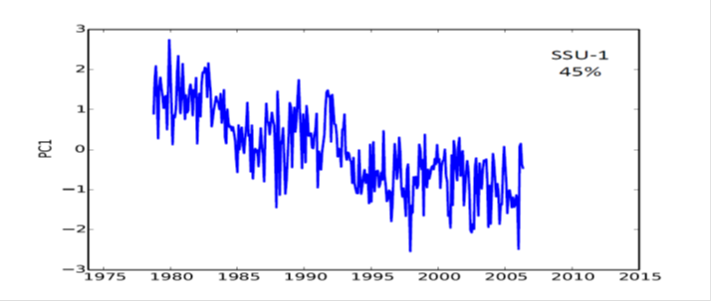
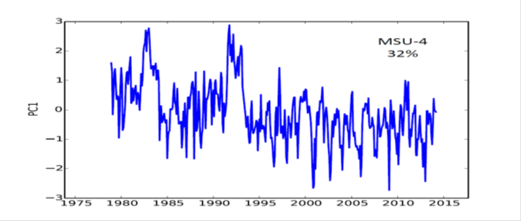
EOF analysis of MSU and SSU CDRs
EOF1 approximately uniform over 50N-50S
Cooling with punctuated warmings in the 1980s, 1990s
PC1 explains ~40% of variance
PC1 resembles stratospheric aerosol variability

Slide 10
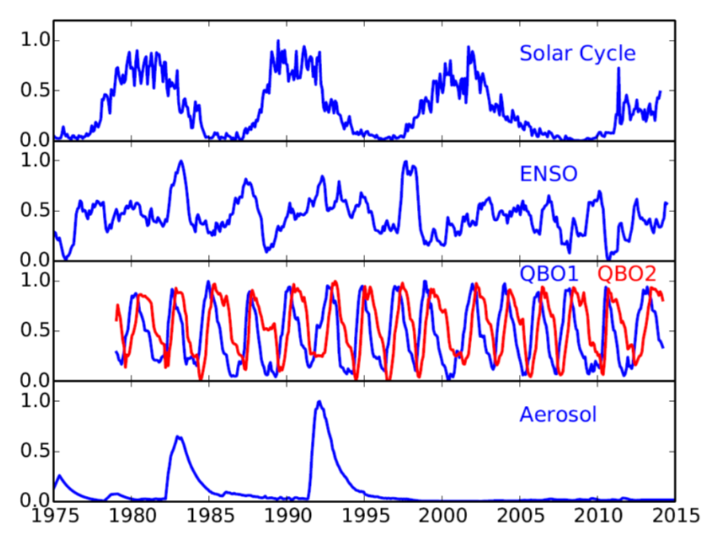
Multiple regression analysis
T’(t) =
a₁ (solar) +
a₂ (ENSO) +
a₃ (QBO1) +
a₄ (QBO2) +
a₅ (stratospheric aerosols) +
a₆ (time) +
residuals

Slide 11
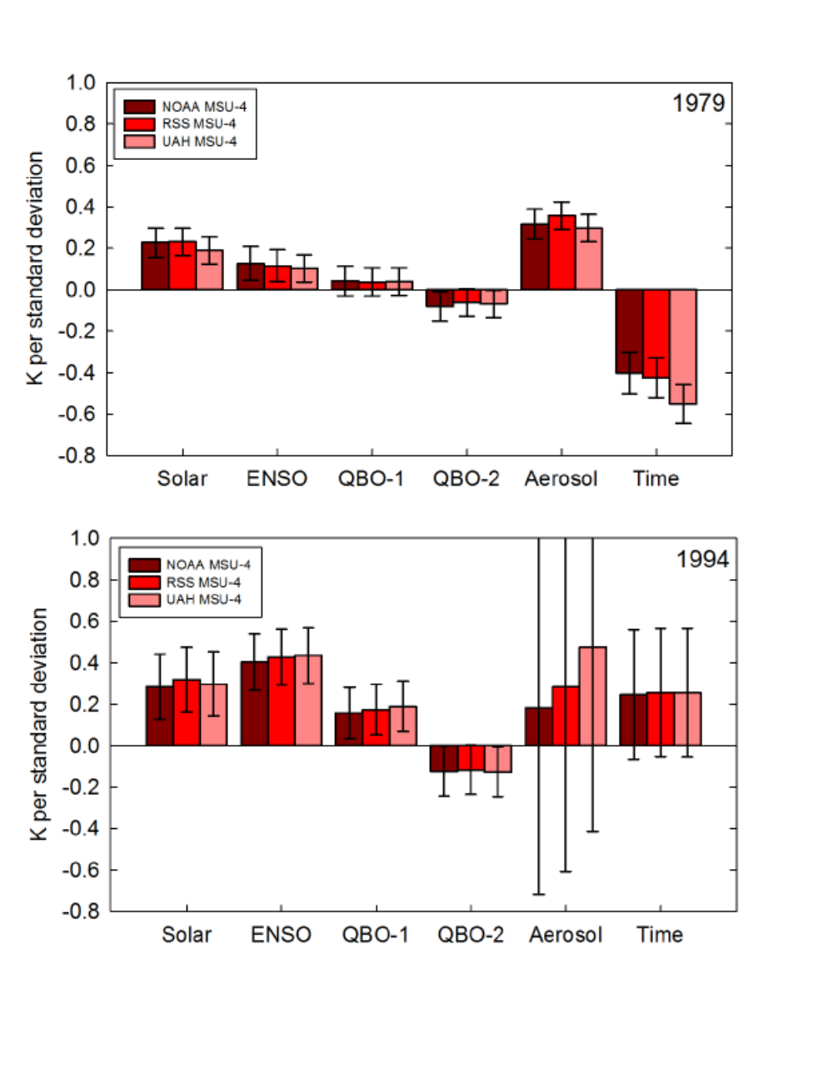
Multiple regression analysis – MSU4
Coefficients consistent among CDRs
Coefficients consistent in sign for both periods, except for trend
Post Pinatubo, aerosol signal is highly uncertain, trend is positive

Slide 12
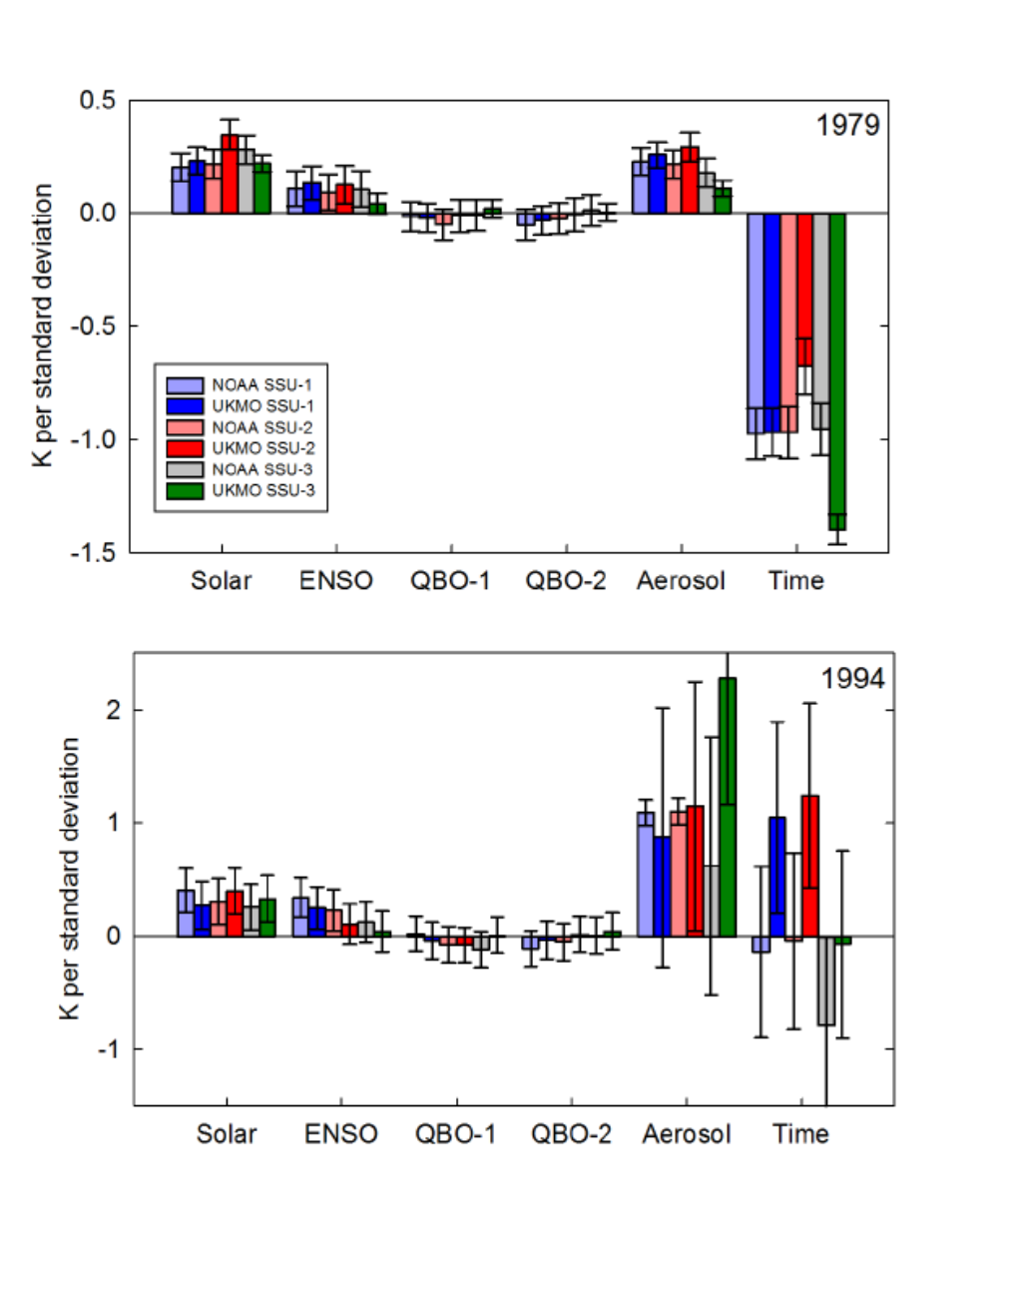
Multiple regression analysis – SSU
Distinct solar, ENSO, aerosol and trend terms (but not QBO) in all channels, both CDRs, for 1979-2005.
Greater uncertainty post-Pinatubo (1994-2005), including mixed trend, but this is a very short record.

Slide 13
Latitudinal structure of regressions
SOLAR COEFFICIENTS TIME COEFFICIENTS
Latitudinal structure a more rigorous test of model simulations

Slide 14
Main Messages
SATELLITE CDRs
New versions of UKMO and NOAA SSU; Differences remain
3 versions of MSU-4; NOAA and RSS agree better than UAH
No merged AMSU-SSU CDR, so no coverage of middle and upper stratosphere for the period 1979-present
STRATOSPHERIC TEMPERATURE
Interannual polar variability dominates (NH > SH), explains ~50% of total variance
Longer-term, larger-scale variations seen in 50S-50N domain
Leading mode (~40% variance) resembles aerosol time series
Aerosol, solar, QBO, ENSO and trend signals (including latitudinal structure) quantified via regression analysis
Aerosol signal more uncertain post-Pinatubo
Evidence of cooling since 1979, possible warming since 1994

Slide 15
Thank you!

Slide 16
SPARC Temperature Trends Activity Pubs
Ramaswamy et al., 2001: Stratospheric temperature trends: Observations and model simulations. Rev. Geophys.
Shine et al. 2003: A comparison of model-predicted trends in stratospheric temperatures. Quart. J. Royal. Meteor. Soc.
Randel et al., 2009: An update of observed stratospheric temperature trends. J. Geophys. Res.
Seidel et al. 2011: Stratospheric temperature trends: Our evolving understanding. Wiley Interdisciplinary Reviews: Climate Change.
Thompson et al. 2012: The mystery of recent stratospheric temperature trends. Nature.

Slide 17
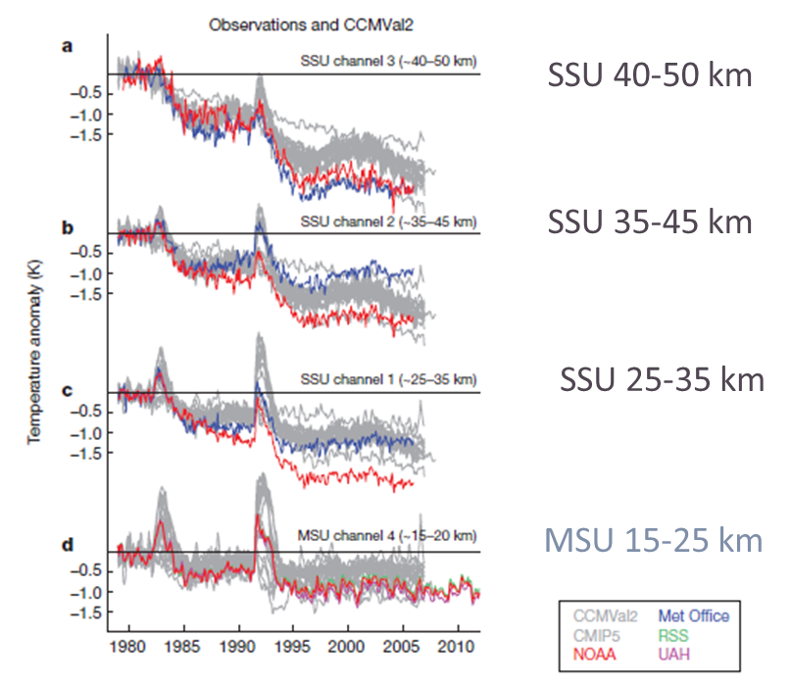
The mystery of recent stratospheric temperature trends (Thompson et al. 2012 Nature)

