Slide 1
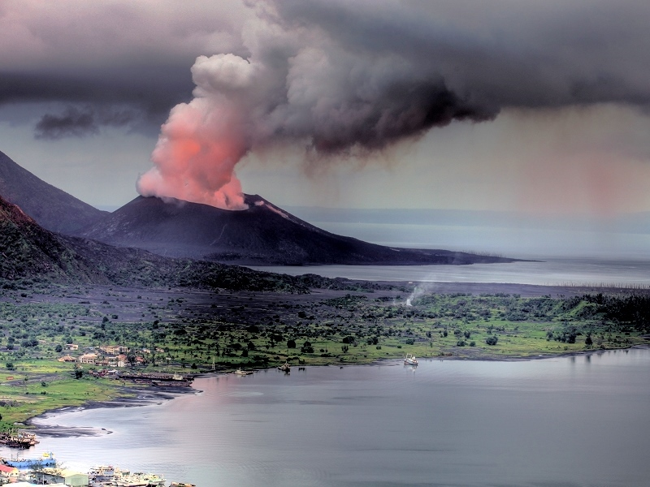
Observed Multi-Variable Signals of Late-20th and Early 21st Century Volcanic Activity
Ben Santer, Susan Solomon, Mark Zelinka, Céline Bonfils, Jeff Painter, David Ridley, John Fyfe, Carl Mears, Jean-Paul Vernier, and Frank Wentz
Meeting of the SPARC Temperature Trends Group, Victoria, Canada
April 9th, 2015
Notes:
It’s an honor and a privilege for me to be able to address you.
The work that I’ll be talking about is not mine alone. I’d like to acknowledge the contributions from my colleagues in the United States and Britain. Their contributions are much greater than the small font size that I’ve used here might indicate!

Slide 2
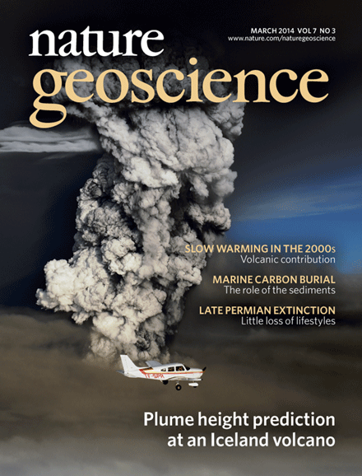
Notes:
It’s an honor and a privilege for me to be able to address you.
The work that I’ll be talking about is not mine alone. I’d like to acknowledge the contributions from my colleagues in the United States and Britain. Their contributions are much greater than the small font size that I’ve used here might indicate!

Slide 3
Structure
New observational analyses
Assessing the statistical significance of volcanic signals
Future work and conclusions
Notes:
Here is an outline of the structure of my talk.
First I’ll discuss some of the key findings of a recent Intergovernmental report that investigated the nature and causes of climate change.
Then I’ll define some terms that I’ll be using in my talk.
Next I’ll try to give you some indication of the principal advances that have been made in our knowledge of the causes of climate change.
Most of the talk will focus on discussion of one example of a so-called “fingerprint” study - a statistical comparison of patterns of climate change in observed data and in model predictions.
Finally, in my concluding remarks, I’ll point out some of the key uncertainties in this type of work, and tell you why I believe that we all have a stake in advancing the science.

Slide 4
New work: Can we see the signatures of early 21st century eruptions in other climate variables?
Mid- to upper tropospheric temperature (MSU TMT; Remote Sensing Systems)
Sea-surface temperature (NOAA ERSST version 3b; National Climatic Data Center)
Rainfall (GPCP; NASA)
Column-integrated water vapor (SSM/I; Remote Sensing Systems)
Notes:
Here is an outline of the structure of my talk.
First I’ll discuss some of the key findings of a recent Intergovernmental report that investigated the nature and causes of climate change.
Then I’ll define some terms that I’ll be using in my talk.
Next I’ll try to give you some indication of the principal advances that have been made in our knowledge of the causes of climate change.
Most of the talk will focus on discussion of one example of a so-called “fingerprint” study - a statistical comparison of patterns of climate change in observed data and in model predictions.
Finally, in my concluding remarks, I’ll point out some of the key uncertainties in this type of work, and tell you why I believe that we all have a stake in advancing the science.

Slide 5
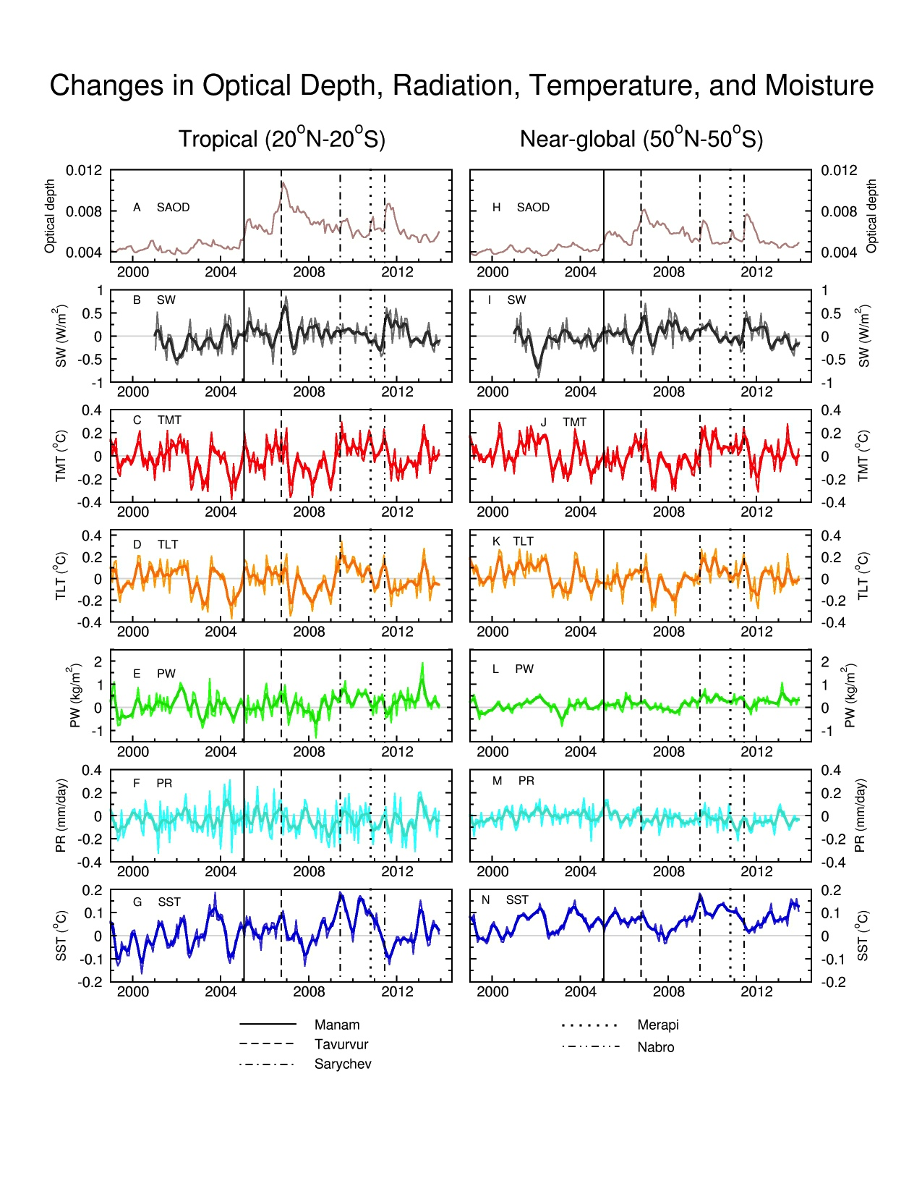
Can we see the signatures of early 21st century eruptions in other variables?
SAOD
SW
TMT
TLT
Water vapor
Rainfall
SST
Notes:
Here is an outline of the structure of my talk.
First I’ll discuss some of the key findings of a recent Intergovernmental report that investigated the nature and causes of climate change.
Then I’ll define some terms that I’ll be using in my talk.
Next I’ll try to give you some indication of the principal advances that have been made in our knowledge of the causes of climate change.
Most of the talk will focus on discussion of one example of a so-called “fingerprint” study - a statistical comparison of patterns of climate change in observed data and in model predictions.
Finally, in my concluding remarks, I’ll point out some of the key uncertainties in this type of work, and tell you why I believe that we all have a stake in advancing the science.

Slide 6
Structure
New observational analyses
Assessing the statistical significance of volcanic signals
Future work and conclusions
Notes:
Here is an outline of the structure of my talk.
First I’ll discuss some of the key findings of a recent Intergovernmental report that investigated the nature and causes of climate change.
Then I’ll define some terms that I’ll be using in my talk.
Next I’ll try to give you some indication of the principal advances that have been made in our knowledge of the causes of climate change.
Most of the talk will focus on discussion of one example of a so-called “fingerprint” study - a statistical comparison of patterns of climate change in observed data and in model predictions.
Finally, in my concluding remarks, I’ll point out some of the key uncertainties in this type of work, and tell you why I believe that we all have a stake in advancing the science.

Slide 7
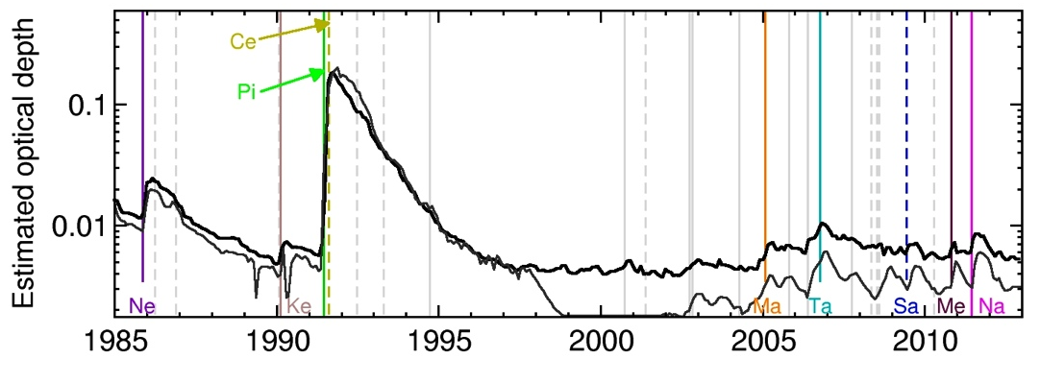
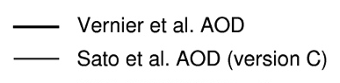
Problem 1: How do we account for non-stationarity of SAOD?
Vernier et al. aerosol optical depth
Sato et al. aerosol optical depth (updated)
Source: Santer et al., Nature Geoscience (2014)
Notes:
Here is an outline of the structure of my talk.
First I’ll discuss some of the key findings of a recent Intergovernmental report that investigated the nature and causes of climate change.
Then I’ll define some terms that I’ll be using in my talk.
Next I’ll try to give you some indication of the principal advances that have been made in our knowledge of the causes of climate change.
Most of the talk will focus on discussion of one example of a so-called “fingerprint” study - a statistical comparison of patterns of climate change in observed data and in model predictions.
Finally, in my concluding remarks, I’ll point out some of the key uncertainties in this type of work, and tell you why I believe that we all have a stake in advancing the science.

Slide 8
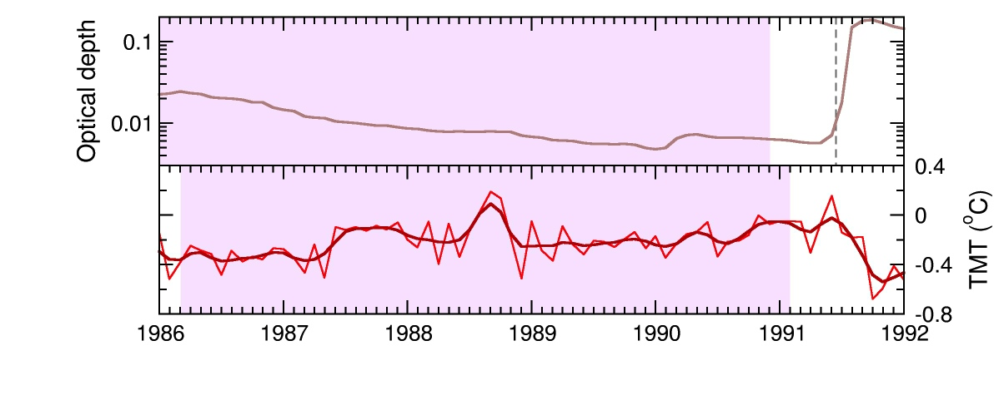
Solution: “Moving window” correlations between 60-month segments of SAOD and temperature
Notes:
Here is an outline of the structure of my talk.
First I’ll discuss some of the key findings of a recent Intergovernmental report that investigated the nature and causes of climate change.
Then I’ll define some terms that I’ll be using in my talk.
Next I’ll try to give you some indication of the principal advances that have been made in our knowledge of the causes of climate change.
Most of the talk will focus on discussion of one example of a so-called “fingerprint” study - a statistical comparison of patterns of climate change in observed data and in model predictions.
Finally, in my concluding remarks, I’ll point out some of the key uncertainties in this type of work, and tell you why I believe that we all have a stake in advancing the science.

Slide 9
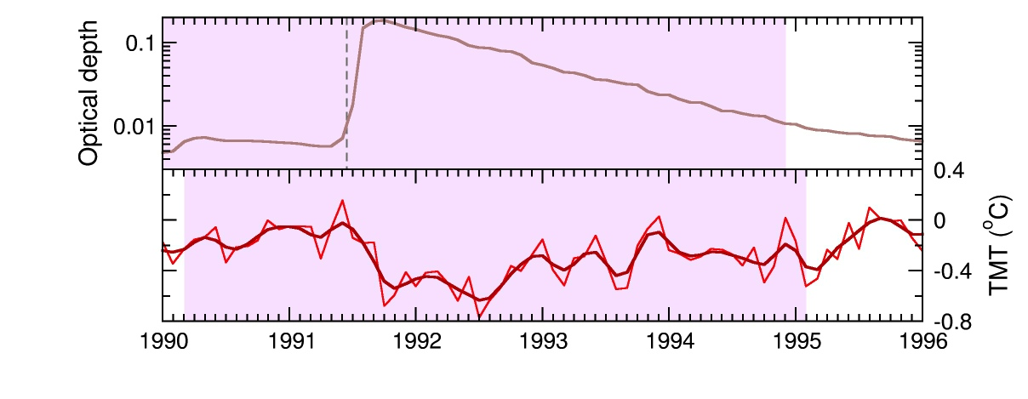
Solution: “Moving window” correlations between 60-month segments of SAOD and temperature
Notes:
Here is an outline of the structure of my talk.
First I’ll discuss some of the key findings of a recent Intergovernmental report that investigated the nature and causes of climate change.
Then I’ll define some terms that I’ll be using in my talk.
Next I’ll try to give you some indication of the principal advances that have been made in our knowledge of the causes of climate change.
Most of the talk will focus on discussion of one example of a so-called “fingerprint” study - a statistical comparison of patterns of climate change in observed data and in model predictions.
Finally, in my concluding remarks, I’ll point out some of the key uncertainties in this type of work, and tell you why I believe that we all have a stake in advancing the science.

Slide 10
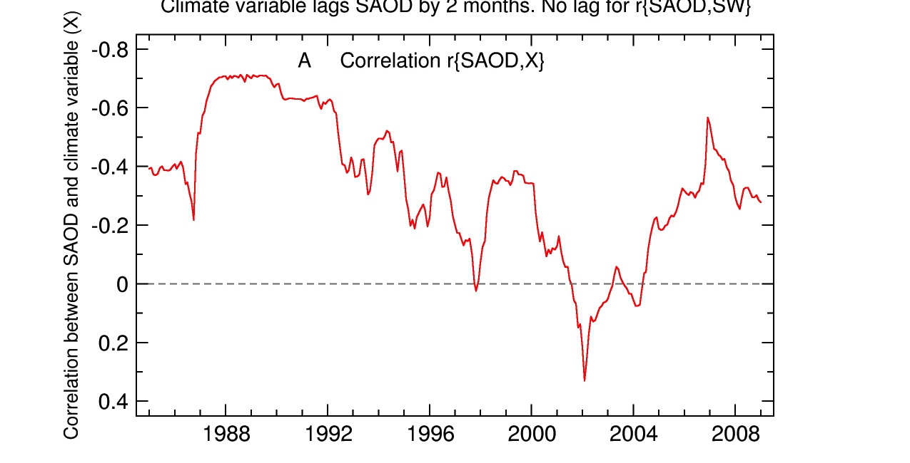
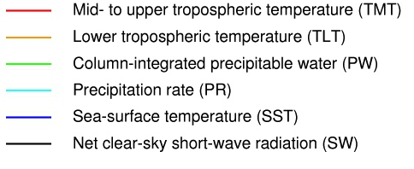
Statistical significance of volcanic climate signals in the tropics (20°N-20°S)
Notes:
Here is an outline of the structure of my talk.
First I’ll discuss some of the key findings of a recent Intergovernmental report that investigated the nature and causes of climate change.
Then I’ll define some terms that I’ll be using in my talk.
Next I’ll try to give you some indication of the principal advances that have been made in our knowledge of the causes of climate change.
Most of the talk will focus on discussion of one example of a so-called “fingerprint” study - a statistical comparison of patterns of climate change in observed data and in model predictions.
Finally, in my concluding remarks, I’ll point out some of the key uncertainties in this type of work, and tell you why I believe that we all have a stake in advancing the science.

Slide 11
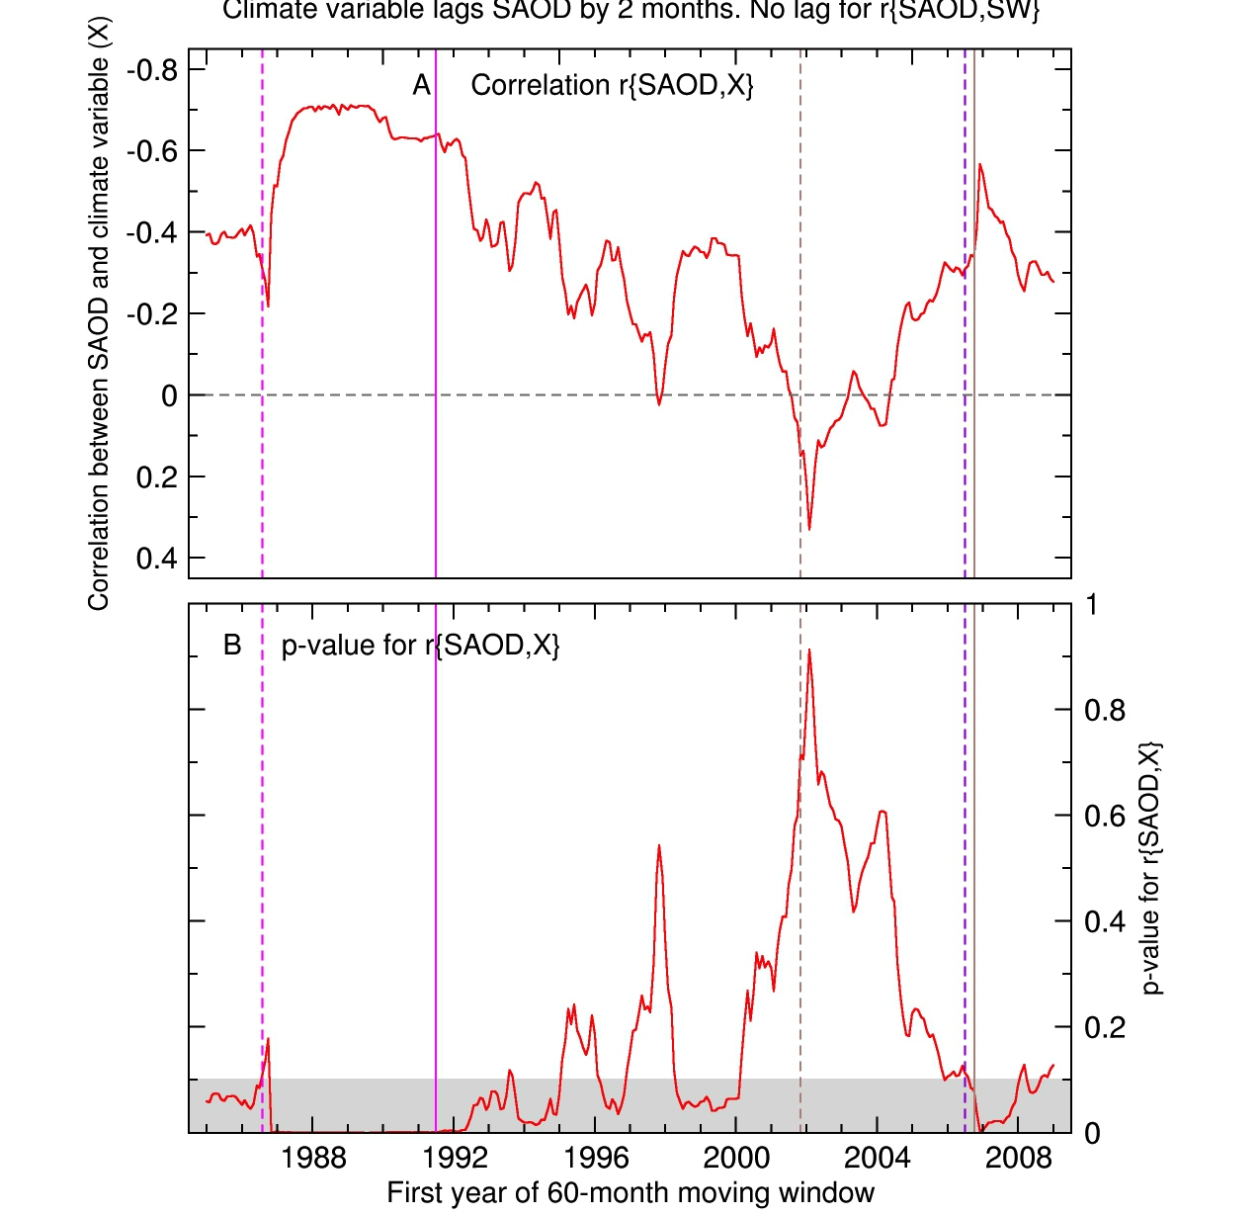
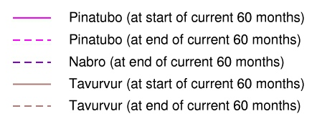
Statistical significance of volcanic climate signals in the tropics (20°N-20°S)
Notes:
Here is an outline of the structure of my talk.
First I’ll discuss some of the key findings of a recent Intergovernmental report that investigated the nature and causes of climate change.
Then I’ll define some terms that I’ll be using in my talk.
Next I’ll try to give you some indication of the principal advances that have been made in our knowledge of the causes of climate change.
Most of the talk will focus on discussion of one example of a so-called “fingerprint” study - a statistical comparison of patterns of climate change in observed data and in model predictions.
Finally, in my concluding remarks, I’ll point out some of the key uncertainties in this type of work, and tell you why I believe that we all have a stake in advancing the science.

Slide 12
Problem 2: Assessing the statistical significance of volcanic climate signals
Calculate r_{i}{SAOD,X}, the correlation between the i^{th} 60-month segment of observed SAOD and X (observed climate data)
Use an AR-1 statistical model to generate many different realizations of synthetic observational climate time series, X_{k}(t)* (k = 1, 2, … 10,000)
Calculate r_{i,k}{SAOD,X*}, the correlation between observed SAOD and X_{k}(t)*. Repeat for each 60-month window and each X_{k}(t)* realization.
Compare the actual correlation, r_{i}{SAOD,X}, with the null distribution of r_{i,k}{SAOD,X*} values
Determine the probability that the actual correlation between aerosol optical depth and the climate variable of interest could be due to chance.
Notes:
Here is an outline of the structure of my talk.
First I’ll discuss some of the key findings of a recent Intergovernmental report that investigated the nature and causes of climate change.
Then I’ll define some terms that I’ll be using in my talk.
Next I’ll try to give you some indication of the principal advances that have been made in our knowledge of the causes of climate change.
Most of the talk will focus on discussion of one example of a so-called “fingerprint” study - a statistical comparison of patterns of climate change in observed data and in model predictions.
Finally, in my concluding remarks, I’ll point out some of the key uncertainties in this type of work, and tell you why I believe that we all have a stake in advancing the science.

Slide 13
Statistical significance of volcanic climate signals in the tropics (20°N-20°S)
Notes:
Here is an outline of the structure of my talk.
First I’ll discuss some of the key findings of a recent Intergovernmental report that investigated the nature and causes of climate change.
Then I’ll define some terms that I’ll be using in my talk.
Next I’ll try to give you some indication of the principal advances that have been made in our knowledge of the causes of climate change.
Most of the talk will focus on discussion of one example of a so-called “fingerprint” study - a statistical comparison of patterns of climate change in observed data and in model predictions.
Finally, in my concluding remarks, I’ll point out some of the key uncertainties in this type of work, and tell you why I believe that we all have a stake in advancing the science.

Slide 14
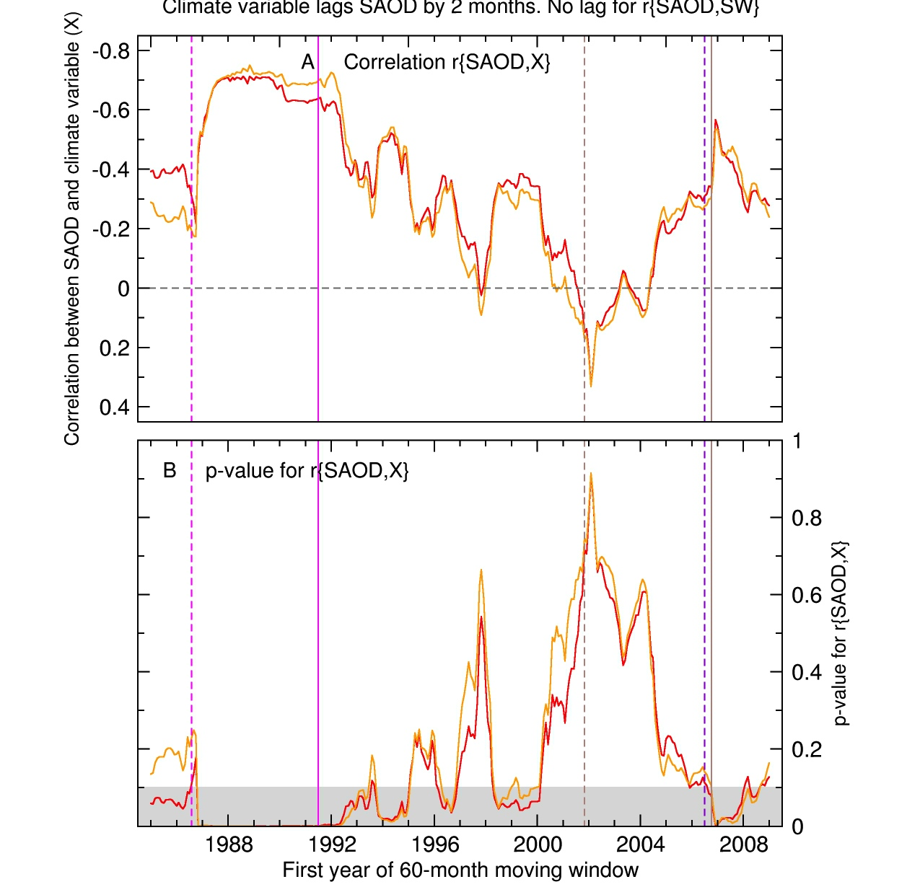
Statistical significance of volcanic climate signals in the tropics (20°N-20°S)
Notes:
Here is an outline of the structure of my talk.
First I’ll discuss some of the key findings of a recent Intergovernmental report that investigated the nature and causes of climate change.
Then I’ll define some terms that I’ll be using in my talk.
Next I’ll try to give you some indication of the principal advances that have been made in our knowledge of the causes of climate change.
Most of the talk will focus on discussion of one example of a so-called “fingerprint” study - a statistical comparison of patterns of climate change in observed data and in model predictions.
Finally, in my concluding remarks, I’ll point out some of the key uncertainties in this type of work, and tell you why I believe that we all have a stake in advancing the science.

Slide 15
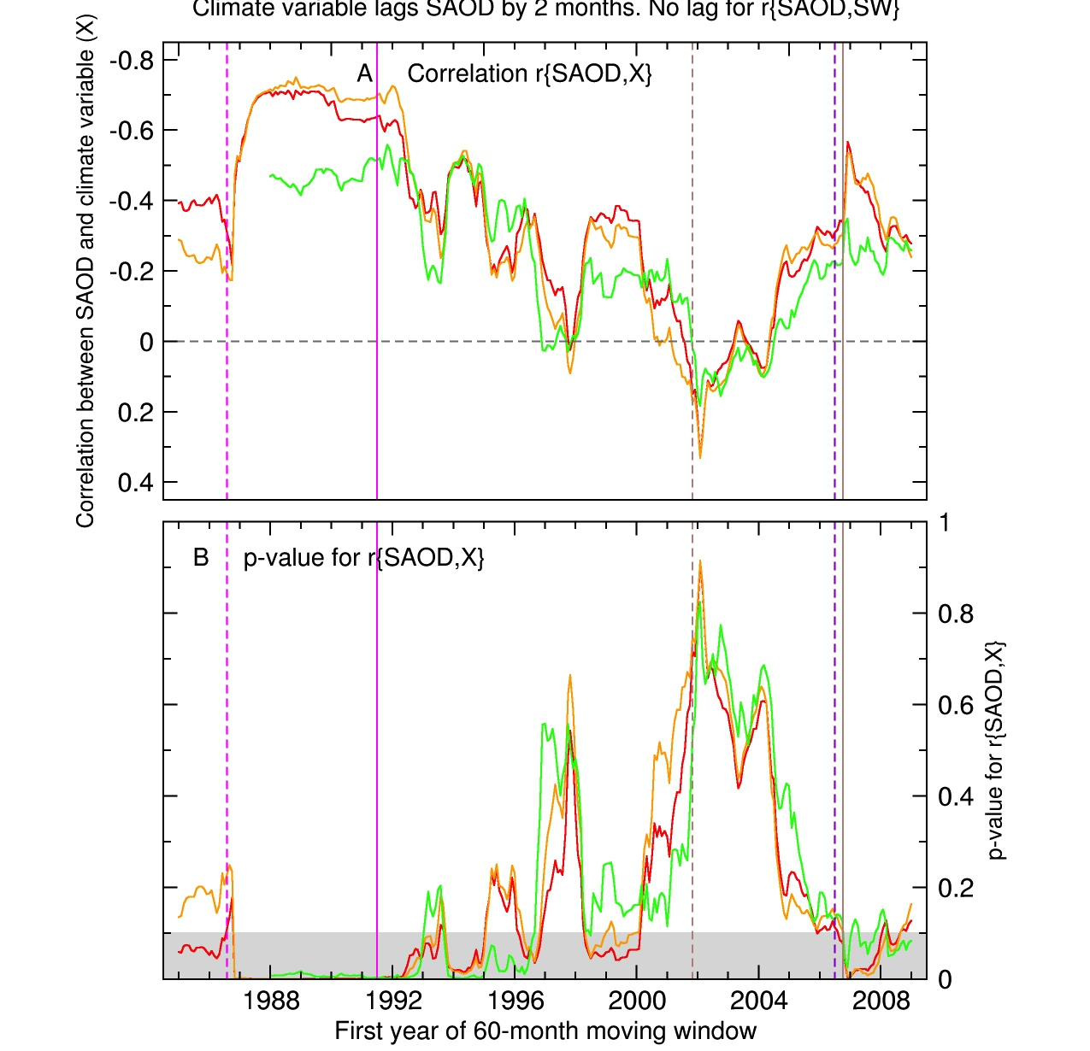
Statistical significance of volcanic climate signals in the tropics (20°N-20°S)
Notes:
Here is an outline of the structure of my talk.
First I’ll discuss some of the key findings of a recent Intergovernmental report that investigated the nature and causes of climate change.
Then I’ll define some terms that I’ll be using in my talk.
Next I’ll try to give you some indication of the principal advances that have been made in our knowledge of the causes of climate change.
Most of the talk will focus on discussion of one example of a so-called “fingerprint” study - a statistical comparison of patterns of climate change in observed data and in model predictions.
Finally, in my concluding remarks, I’ll point out some of the key uncertainties in this type of work, and tell you why I believe that we all have a stake in advancing the science.

Slide 16
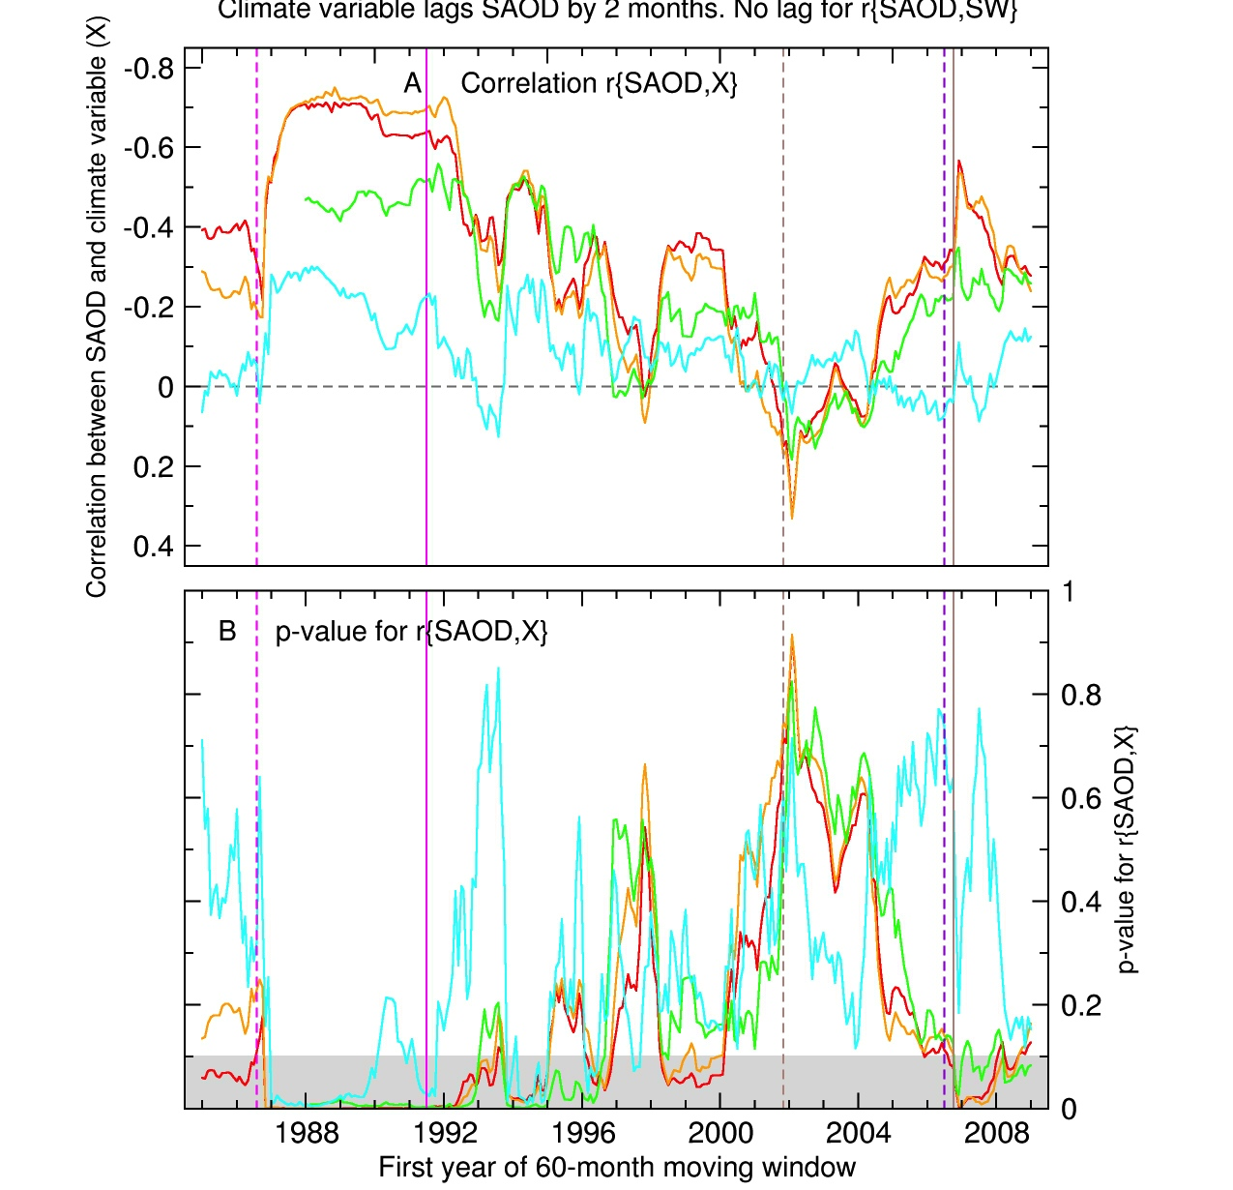
Statistical significance of volcanic climate signals in the tropics (20°N-20°S)
Notes:
Here is an outline of the structure of my talk.
First I’ll discuss some of the key findings of a recent Intergovernmental report that investigated the nature and causes of climate change.
Then I’ll define some terms that I’ll be using in my talk.
Next I’ll try to give you some indication of the principal advances that have been made in our knowledge of the causes of climate change.
Most of the talk will focus on discussion of one example of a so-called “fingerprint” study - a statistical comparison of patterns of climate change in observed data and in model predictions.
Finally, in my concluding remarks, I’ll point out some of the key uncertainties in this type of work, and tell you why I believe that we all have a stake in advancing the science.

Slide 17
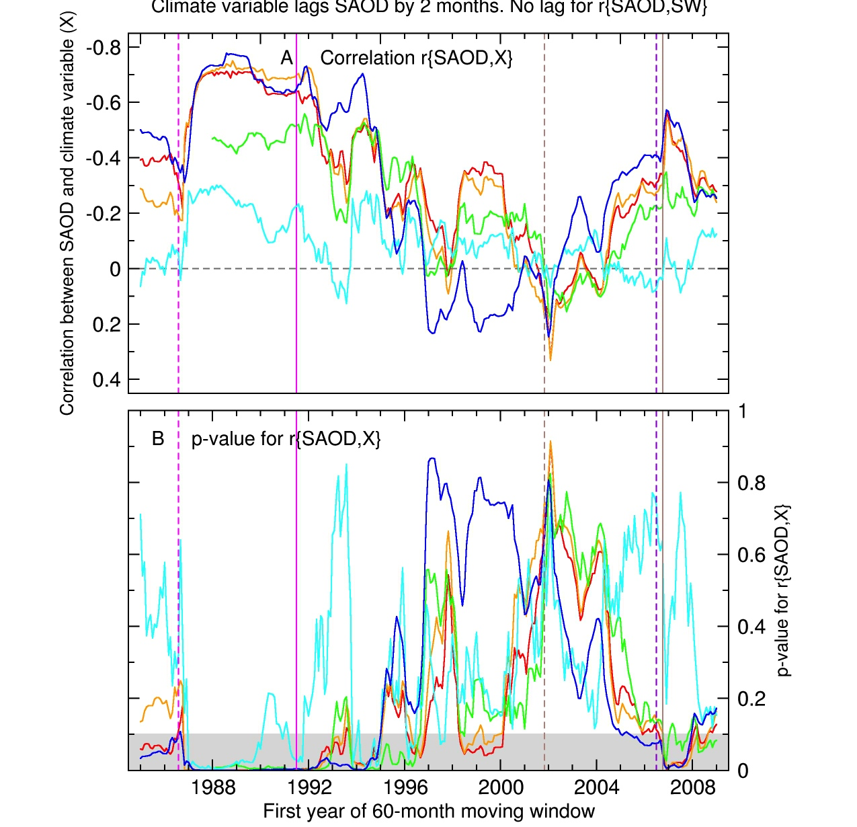
Statistical significance of volcanic climate signals in the tropics (20°N-20°S)
Notes:
Here is an outline of the structure of my talk.
First I’ll discuss some of the key findings of a recent Intergovernmental report that investigated the nature and causes of climate change.
Then I’ll define some terms that I’ll be using in my talk.
Next I’ll try to give you some indication of the principal advances that have been made in our knowledge of the causes of climate change.
Most of the talk will focus on discussion of one example of a so-called “fingerprint” study - a statistical comparison of patterns of climate change in observed data and in model predictions.
Finally, in my concluding remarks, I’ll point out some of the key uncertainties in this type of work, and tell you why I believe that we all have a stake in advancing the science.

Slide 18
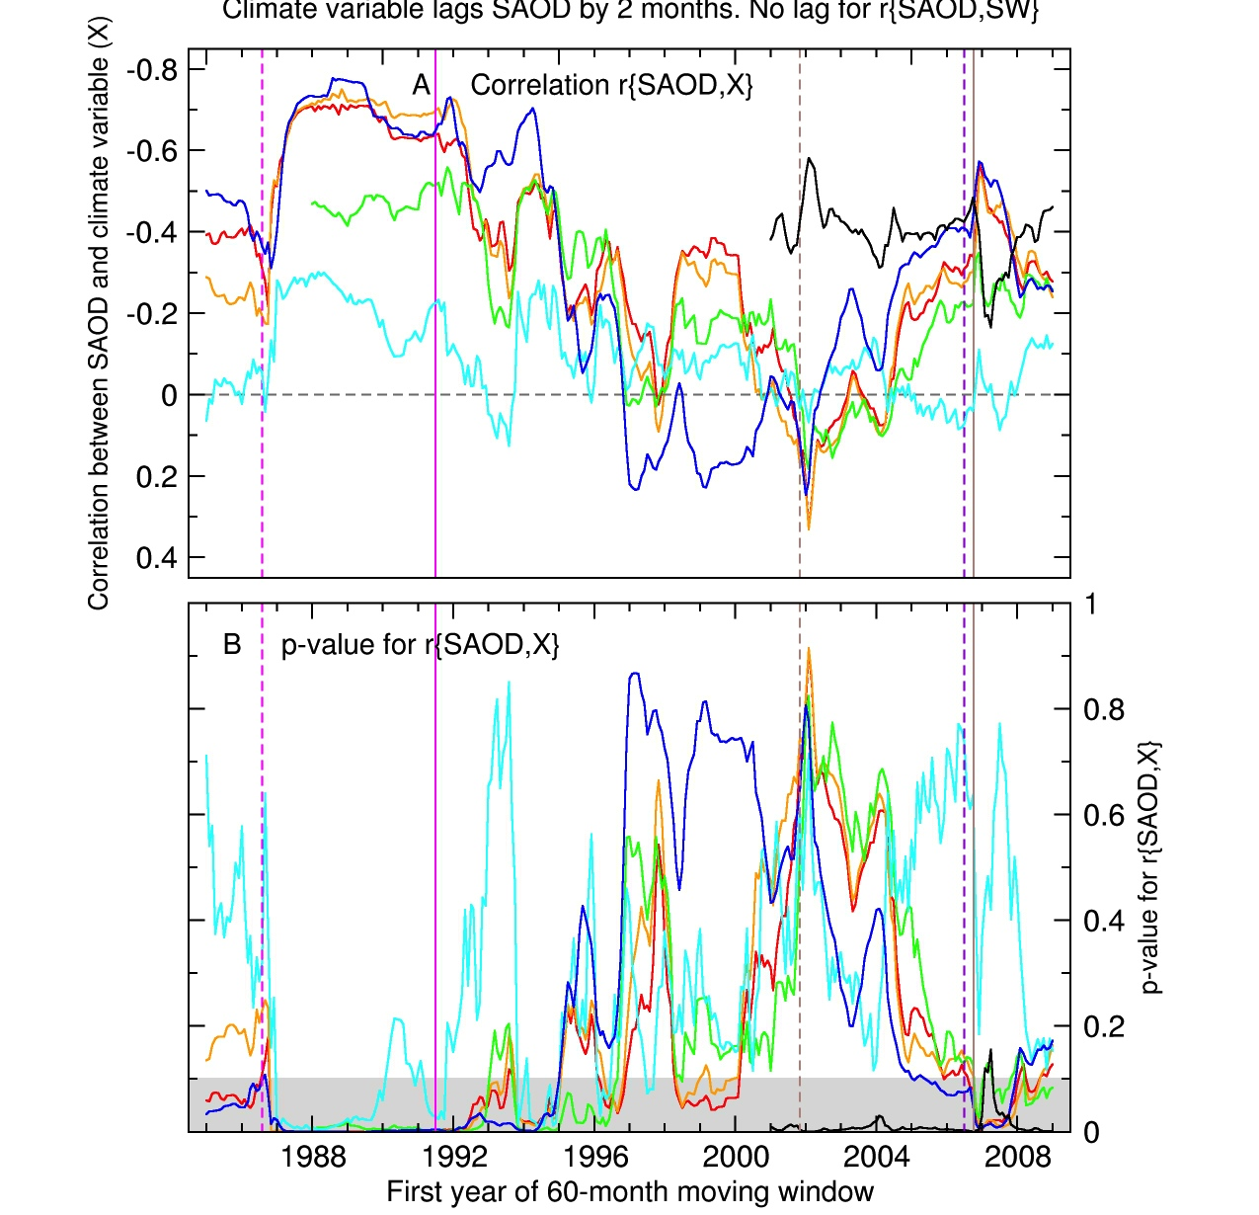
Statistical significance of volcanic climate signals in the tropics (20°N-20°S)
Notes:
Here is an outline of the structure of my talk.
First I’ll discuss some of the key findings of a recent Intergovernmental report that investigated the nature and causes of climate change.
Then I’ll define some terms that I’ll be using in my talk.
Next I’ll try to give you some indication of the principal advances that have been made in our knowledge of the causes of climate change.
Most of the talk will focus on discussion of one example of a so-called “fingerprint” study - a statistical comparison of patterns of climate change in observed data and in model predictions.
Finally, in my concluding remarks, I’ll point out some of the key uncertainties in this type of work, and tell you why I believe that we all have a stake in advancing the science.

Slide 19
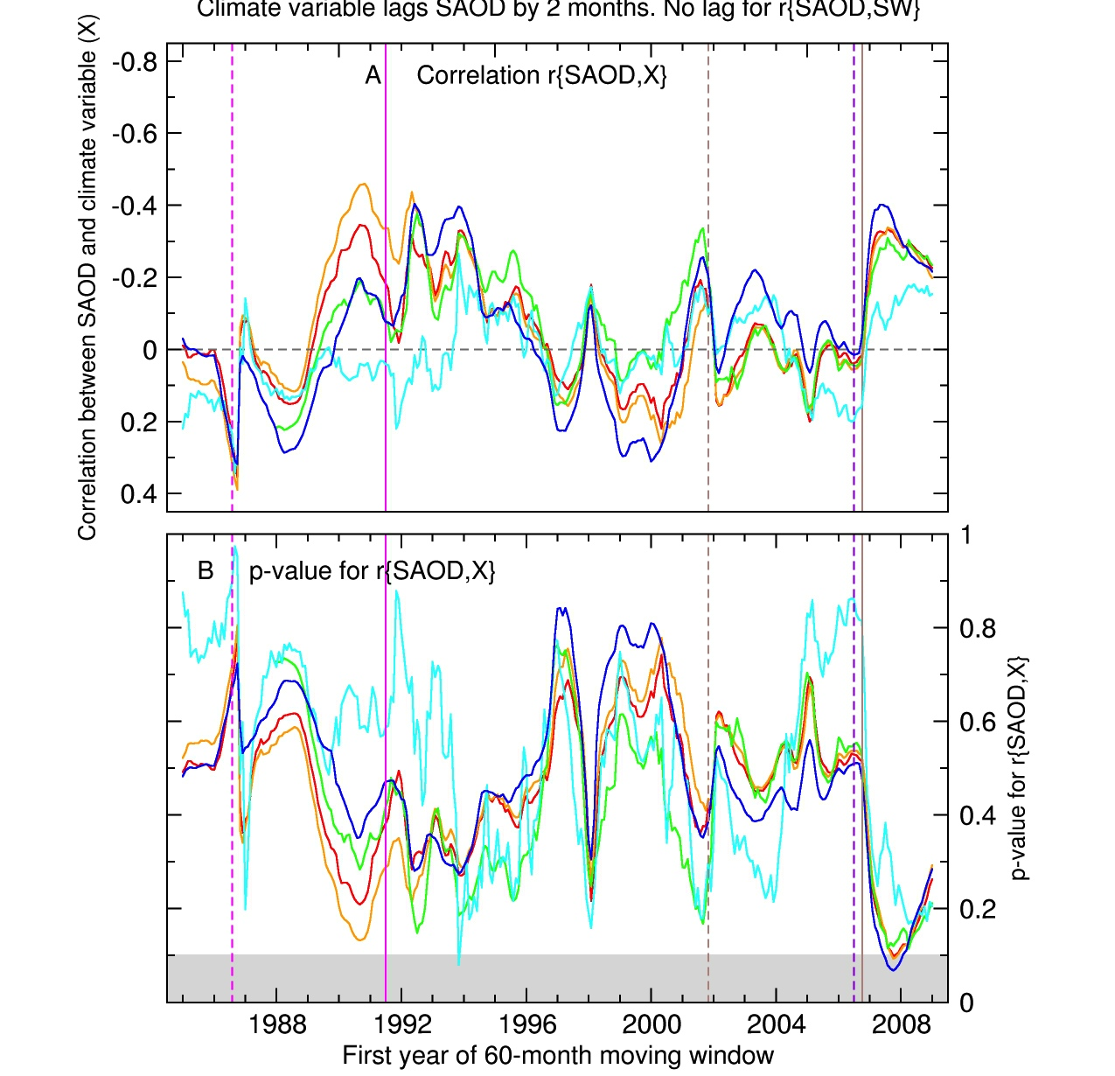
Removing ENSO effects is key to the identification of volcanic climate signals
Notes:
Here is an outline of the structure of my talk.
First I’ll discuss some of the key findings of a recent Intergovernmental report that investigated the nature and causes of climate change.
Then I’ll define some terms that I’ll be using in my talk.
Next I’ll try to give you some indication of the principal advances that have been made in our knowledge of the causes of climate change.
Most of the talk will focus on discussion of one example of a so-called “fingerprint” study - a statistical comparison of patterns of climate change in observed data and in model predictions.
Finally, in my concluding remarks, I’ll point out some of the key uncertainties in this type of work, and tell you why I believe that we all have a stake in advancing the science.

Slide 20
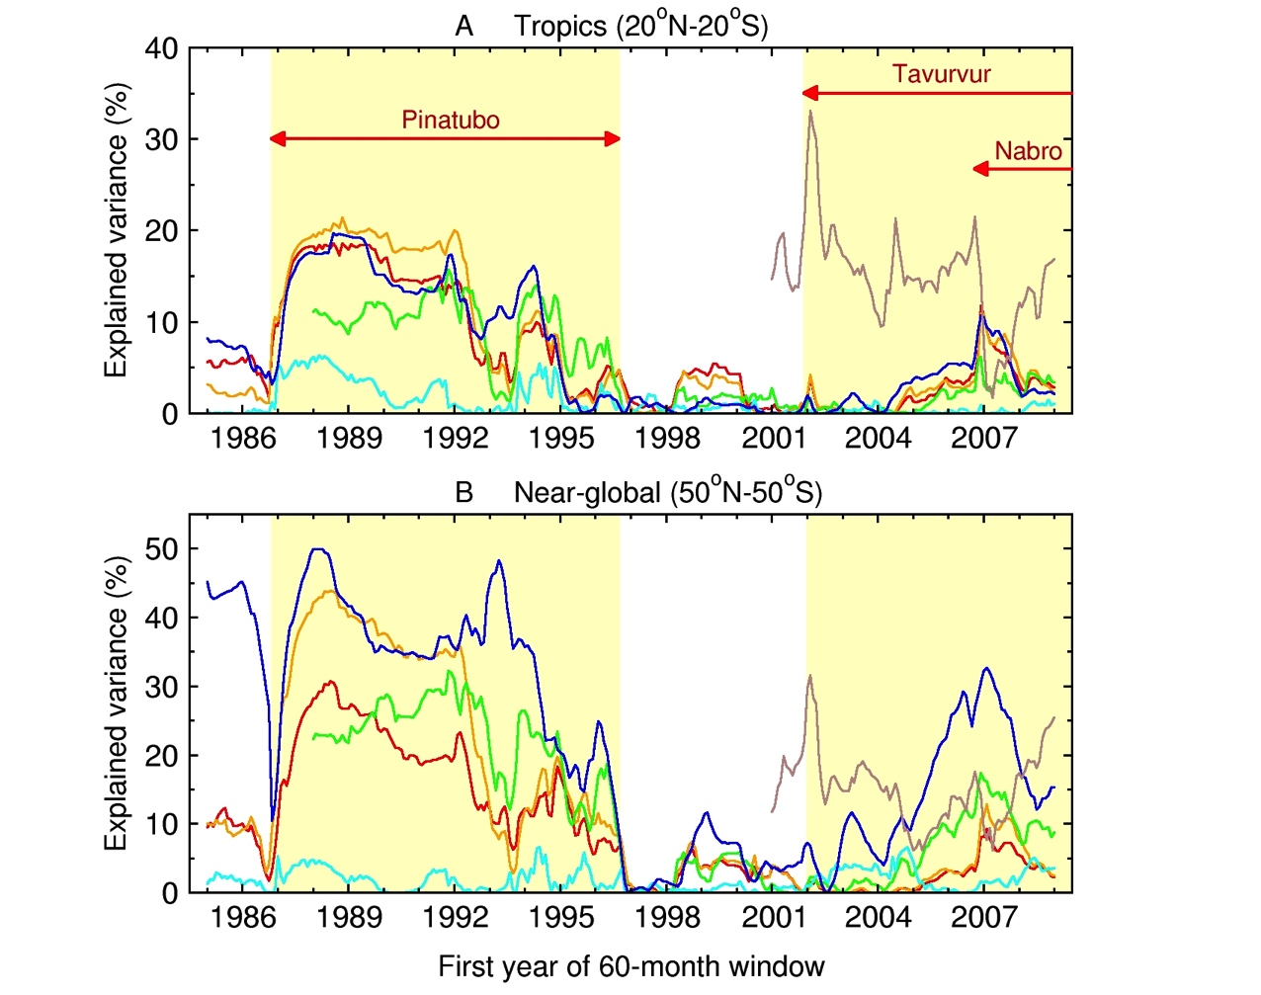
How much of the temporal variance of temperature, moisture, and SW radiation is explained by SAOD?
Notes:
Here is an outline of the structure of my talk.
First I’ll discuss some of the key findings of a recent Intergovernmental report that investigated the nature and causes of climate change.
Then I’ll define some terms that I’ll be using in my talk.
Next I’ll try to give you some indication of the principal advances that have been made in our knowledge of the causes of climate change.
Most of the talk will focus on discussion of one example of a so-called “fingerprint” study - a statistical comparison of patterns of climate change in observed data and in model predictions.
Finally, in my concluding remarks, I’ll point out some of the key uncertainties in this type of work, and tell you why I believe that we all have a stake in advancing the science.

Slide 21
Structure
New observational analyses
Assessing the statistical significance of volcanic signals
Future work and conclusions
Notes:
Here is an outline of the structure of my talk.
First I’ll discuss some of the key findings of a recent Intergovernmental report that investigated the nature and causes of climate change.
Then I’ll define some terms that I’ll be using in my talk.
Next I’ll try to give you some indication of the principal advances that have been made in our knowledge of the causes of climate change.
Most of the talk will focus on discussion of one example of a so-called “fingerprint” study - a statistical comparison of patterns of climate change in observed data and in model predictions.
Finally, in my concluding remarks, I’ll point out some of the key uncertainties in this type of work, and tell you why I believe that we all have a stake in advancing the science.

Slide 22
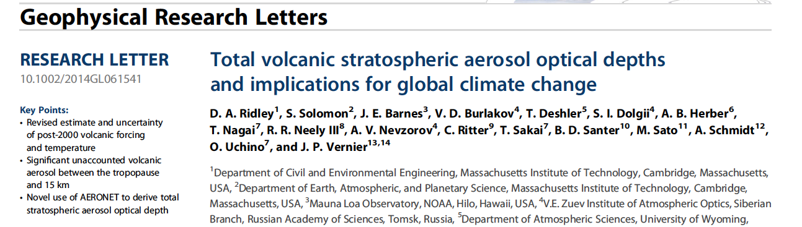
Future work 1: Include effects of volcanic aerosols below 15 km
Global volcanic aerosol forcing since 2000 estimated to be -0.19 ± 0.09 W/m²
This translates into an estimated global cooling of 0.05 to 0.12°C.
Notes:
Here is an outline of the structure of my talk.
First I’ll discuss some of the key findings of a recent Intergovernmental report that investigated the nature and causes of climate change.
Then I’ll define some terms that I’ll be using in my talk.
Next I’ll try to give you some indication of the principal advances that have been made in our knowledge of the causes of climate change.
Most of the talk will focus on discussion of one example of a so-called “fingerprint” study - a statistical comparison of patterns of climate change in observed data and in model predictions.
Finally, in my concluding remarks, I’ll point out some of the key uncertainties in this type of work, and tell you why I believe that we all have a stake in advancing the science.

Slide 23
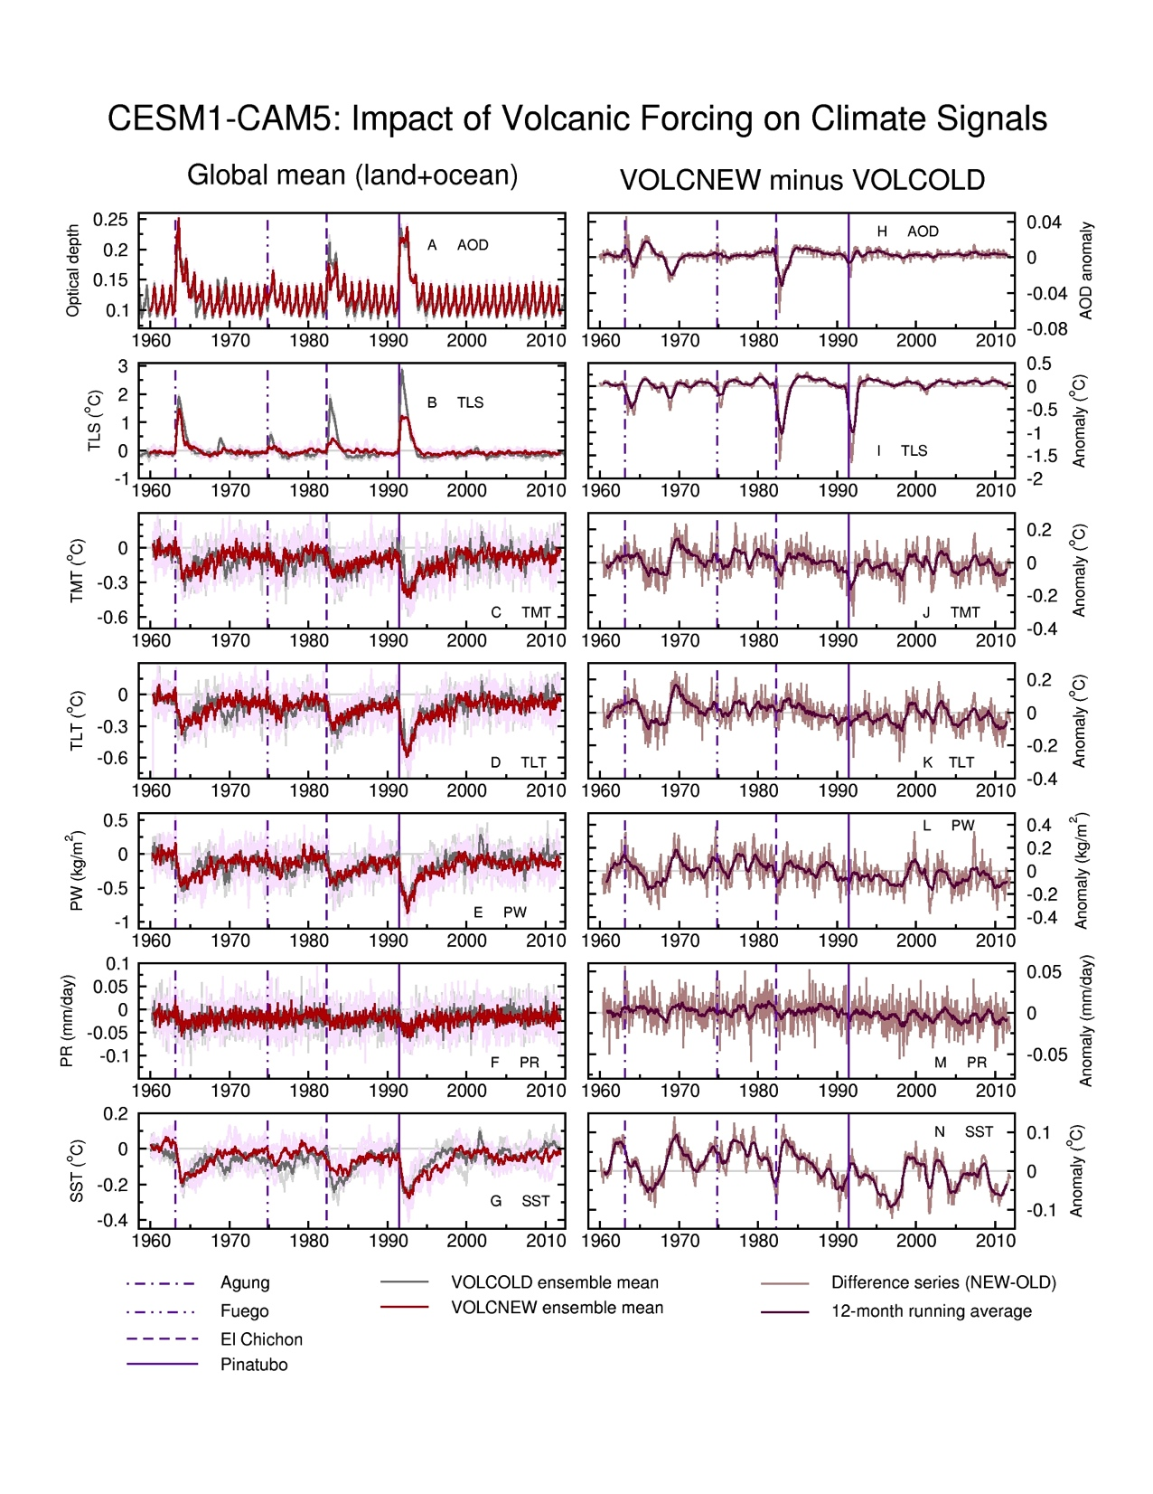
Future work 2: In “CESM world”, explore the impact of uncertainty in volcanic forcing
VOLCOLD = Ammann et al.
volcanic forcing
VOLCNEW = CCMI
volcanic forcing
Work with Ryan Neely, J.-F. Lamarque, and Jerry Meehl
Notes:
Here is an outline of the structure of my talk.
First I’ll discuss some of the key findings of a recent Intergovernmental report that investigated the nature and causes of climate change.
Then I’ll define some terms that I’ll be using in my talk.
Next I’ll try to give you some indication of the principal advances that have been made in our knowledge of the causes of climate change.
Most of the talk will focus on discussion of one example of a so-called “fingerprint” study - a statistical comparison of patterns of climate change in observed data and in model predictions.
Finally, in my concluding remarks, I’ll point out some of the key uncertainties in this type of work, and tell you why I believe that we all have a stake in advancing the science.

Slide 24
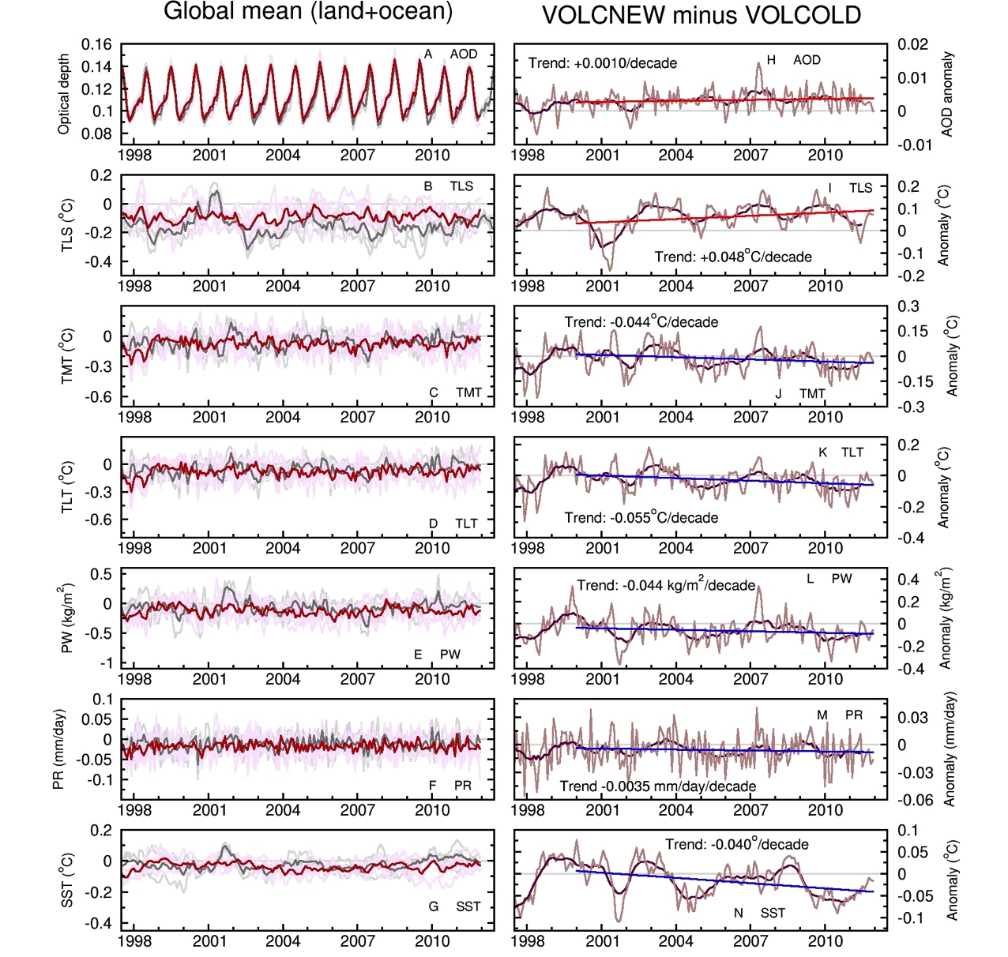
Future work 2: In “CESM world”, explore the impact of uncertainty in volcanic forcing
VOLCOLD = Ammann et al.
volcanic forcing
VOLCNEW = CCMI
volcanic forcing
Work with Ryan Neely, J.-F. Lamarque, and Jerry Meehl
Notes:
Here is an outline of the structure of my talk.
First I’ll discuss some of the key findings of a recent Intergovernmental report that investigated the nature and causes of climate change.
Then I’ll define some terms that I’ll be using in my talk.
Next I’ll try to give you some indication of the principal advances that have been made in our knowledge of the causes of climate change.
Most of the talk will focus on discussion of one example of a so-called “fingerprint” study - a statistical comparison of patterns of climate change in observed data and in model predictions.
Finally, in my concluding remarks, I’ll point out some of the key uncertainties in this type of work, and tell you why I believe that we all have a stake in advancing the science.

Slide 25
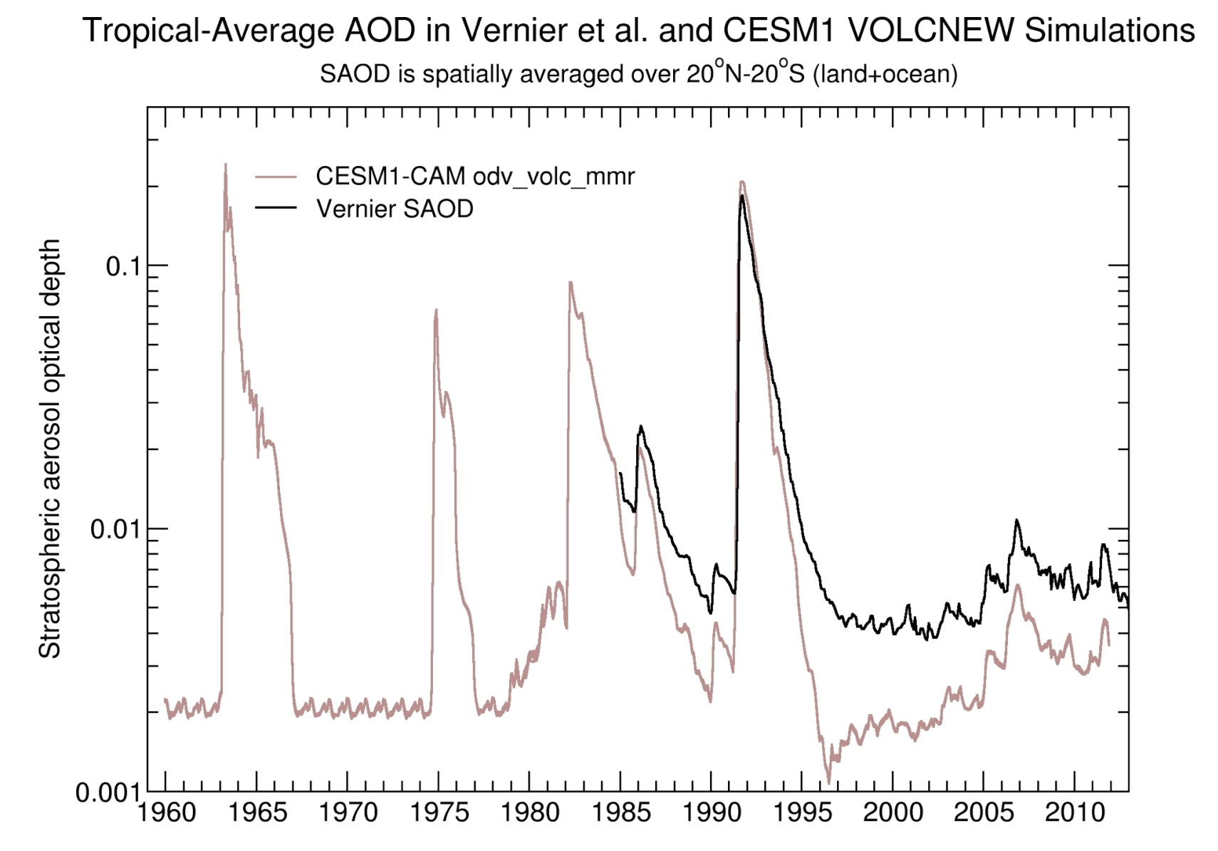
Future work 3: Reduce structural uncertainties in volcanic forcing
Notes:
Here is an outline of the structure of my talk.
First I’ll discuss some of the key findings of a recent Intergovernmental report that investigated the nature and causes of climate change.
Then I’ll define some terms that I’ll be using in my talk.
Next I’ll try to give you some indication of the principal advances that have been made in our knowledge of the causes of climate change.
Most of the talk will focus on discussion of one example of a so-called “fingerprint” study - a statistical comparison of patterns of climate change in observed data and in model predictions.
Finally, in my concluding remarks, I’ll point out some of the key uncertainties in this type of work, and tell you why I believe that we all have a stake in advancing the science.

Slide 26
Conclusions
A multivariate climate signal of late 20th and early 21st century volcanic activity is statistically identifiable in observations:
SST and tropospheric temperature
Column-integrated water vapor
Rainfall
Net clear-sky short-wave radiation at top of the atmosphere
Signals are identifiable for both Pinatubo and for the post-2005 period (except in the case of tropical rainfall, with signal identification for Pinatubo only)
There are still important uncertainties in observational estimates of SAOD
CESM1-CAM5 “volcano only” simulations suggest that uncertainties in SAOD are large enough to have practical implications for detection and attribution work
Systematic errors in volcanic (and other) external forcings affect interpretation of differences between modeled and observed climate changes

