Slide 1
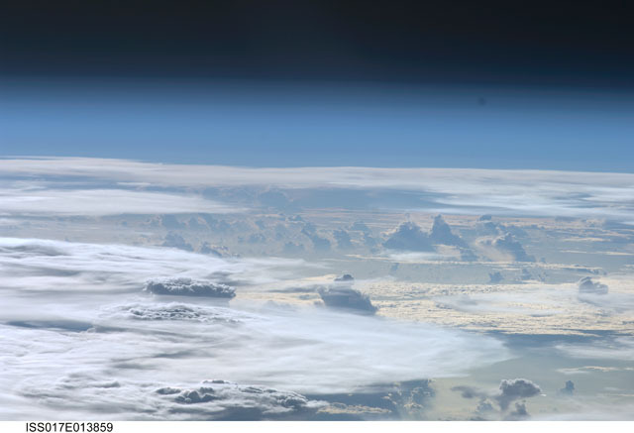
Stratospheric temperature trends from combined
SSU, SABER and MLS measurements
And comparisons to WACCM
Bill Randel, Anne Smith and Cheng-Zhi Zou
NCAR and NOAA

Slide 2
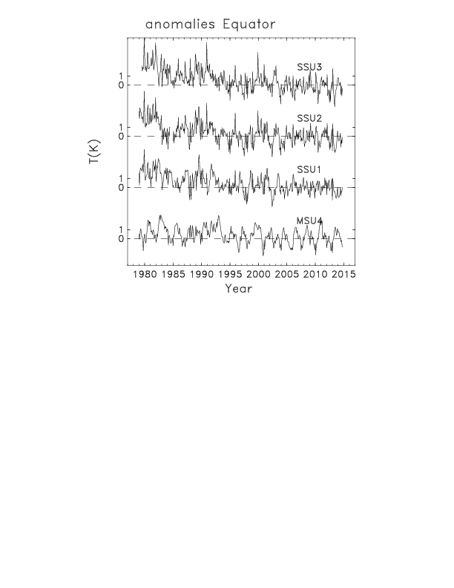
Objective: extend NOAA v2 SSU data record with SABER and MLS observations
SSU 1979- 2006 (April)
SABER 2002 (Feb)-2015 (continuing)
MLS 2004 (Sept)-2015 (continuing)
direct overlap for
Sept 2004 – April 2006

Slide 3
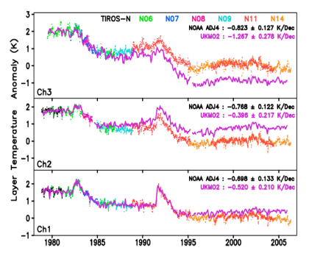
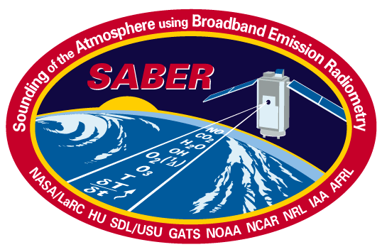
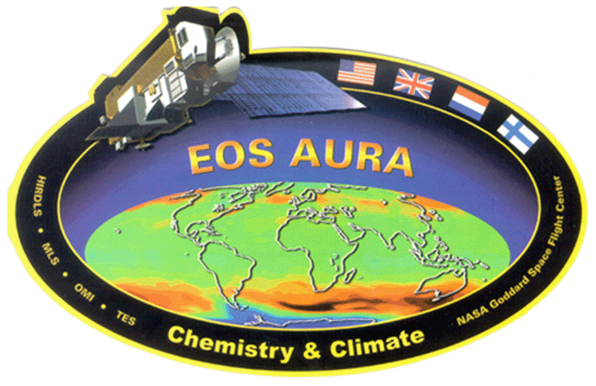
Data details:
SSU: NOAA v2 (Zhou et al, 2014, JGR)
Nadir viewing CO₂ emission radiometers
Recalibrated and merged NOAA operational data
SABER
Limb emission viewing geometry
Broadband radiometry, T(p) derived from CO₂ emissions
Coverage: 50º S – 80º N / 80º S – 50º N (60-day yaw cycles)
Altitudes ~20-100 km; Vertical resolution ~2 km
Aura MLS
Limb emission viewing geometry
T(p) derived from O₂ microwave emissions
Near-global coverage (82º N-S) on a daily basis
Altitudes ~10-90 km; Vertical resolution ~3-4 km

Slide 4
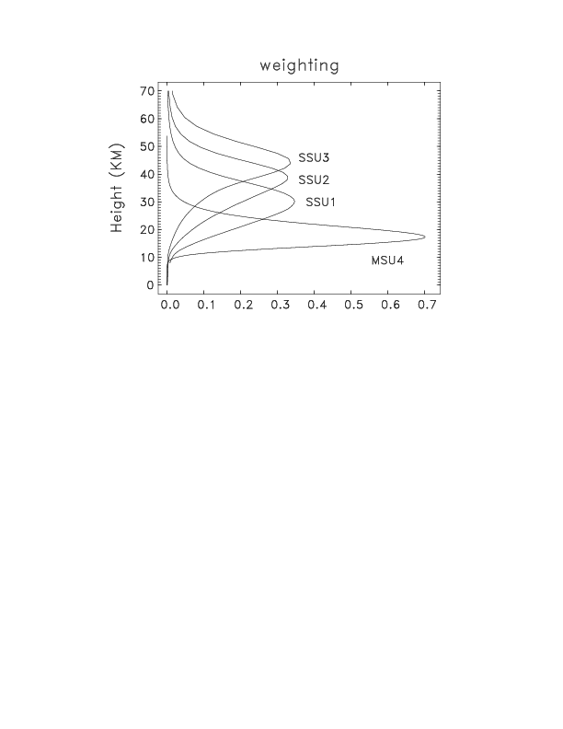
Data analysis details:
1) Construct SSU-equivalent layer temperatures
from SABER and MLS
2) Deseasonalize each data set using:
2002-2006 for SSU
2004-2008 for SABER
2004-2008 for MLS
3) Normalize all anomalies to zero for the overlap
period: Sept. 2004 – April 2006
4) Regression fits using standard multivariate model: (Jan 1979 – Oct. 2014)
linear trend, solar cycle, ENSO, QBO (2 orthogonal terms)
+ volcanic periods omitted from fits (volcanic effects as residuals)

Slide 5
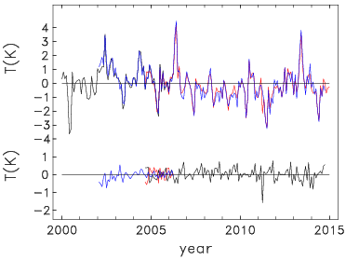
comparison of deseasonalized anomalies:
SSU channel 3 40º S
blue: SABER
black: SSU
red: MLS
differences

Slide 6
time series of anomalies at equator:
combined SSU + MLS

Slide 7
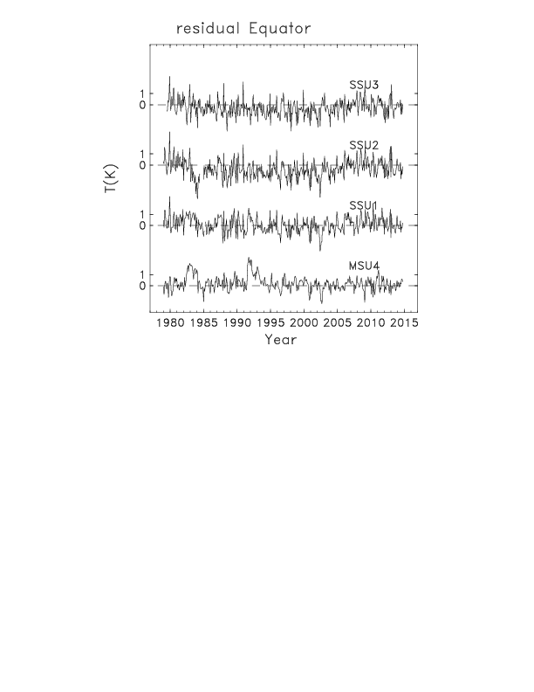
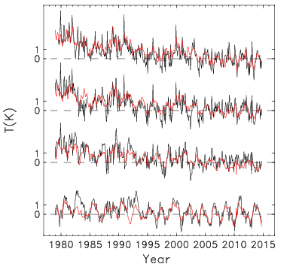
residuals
anomalies (black) and regression fit (red)

Slide 8
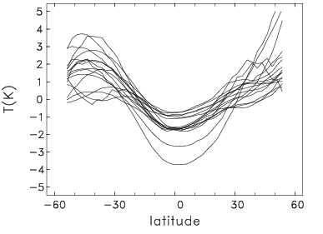
latitudinal structure of residuals for NOAA-8 SSU2:
each curve
shows one month
during 1983-1984
persistent patterns
suggest bias correction
problem for
NOAA-8 SSU2

Slide 9
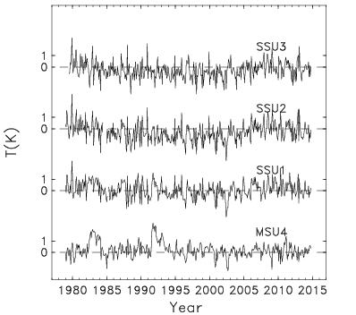
residuals from regression fits (at equator)
original SSU data (v2.0)
revised NOAA-8 SSU2 data (v2.1)

Slide 10
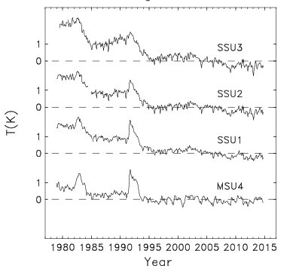
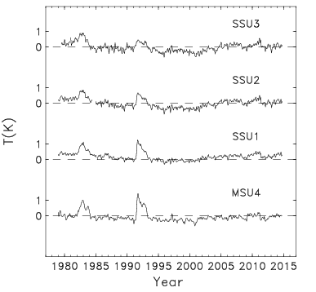
global average anomalies
global residuals
E
P

Slide 11
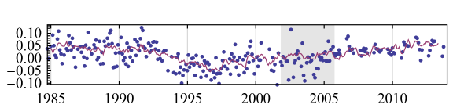
changing temperature trends in the upper stratosphere
in response to ozone
observed ozone in upper stratosphere
Bourassa et al 2014
decrease
pre-1995
increase
post-1995

Slide 12
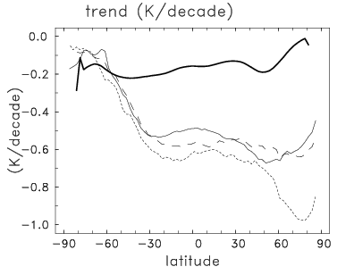
trends vs. latitude (linear trends for 1979-2014):
MSU4
SSU1
SSU3

Slide 13
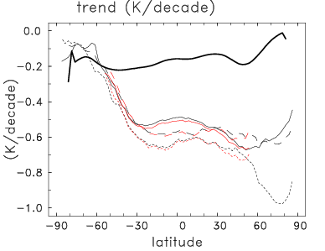
nearly identical results using MLS and SABER:
1979-2014
MSU4
SSU1
SSU3
black: SSU + MLS red: SSU + SABER

Slide 14
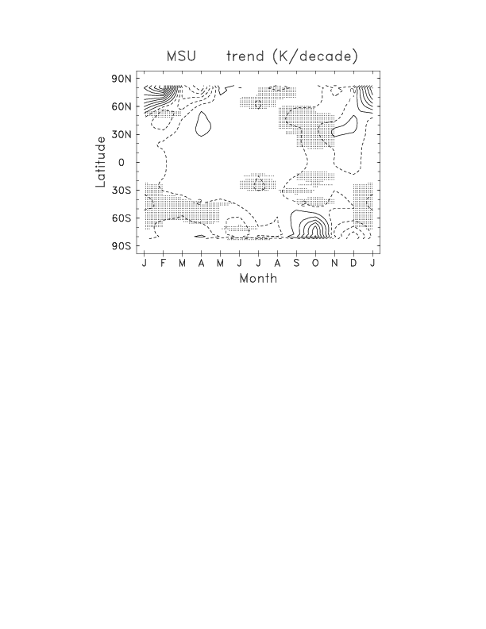
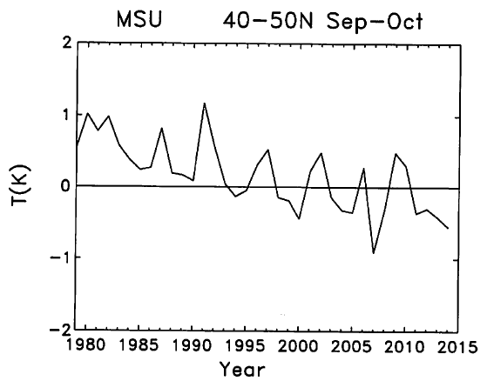
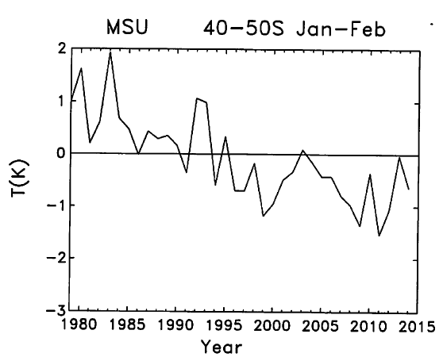
monthly-varying trends
shading = statistically significant
(K/decade)
MSU4
cooling in summer
middle-high
latitudes
-.2

Slide 15
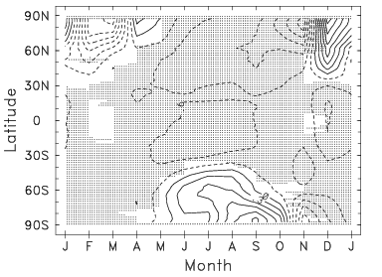
upper stratosphere:
strong cooling in NH summer
SSU2
-.9
-.6
-
-.6
+
warming in Austral winter

Slide 16
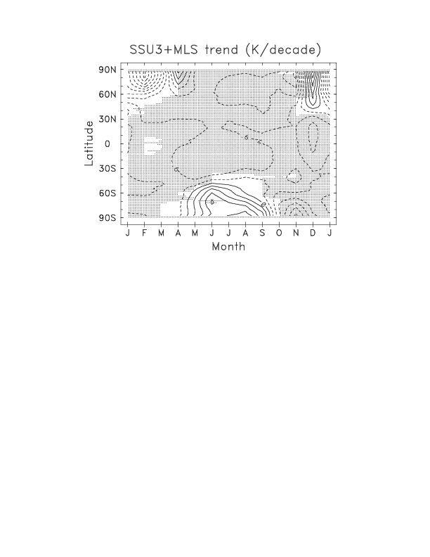
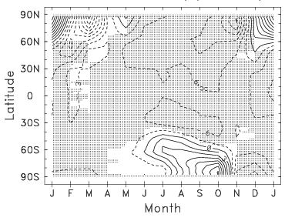
trends in K/decade
SSU3
SSU2
-.9
-.9
-.6
-.6
similar patterns
for al 3 SSU
channels
MSU4
SSU1
-.9
-.2

Slide 17
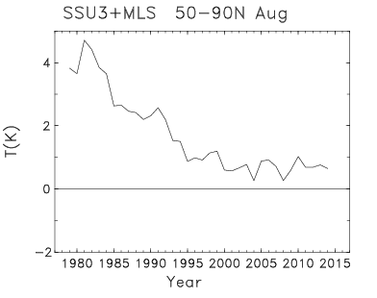
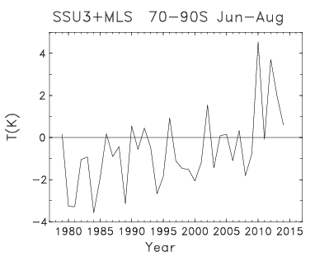
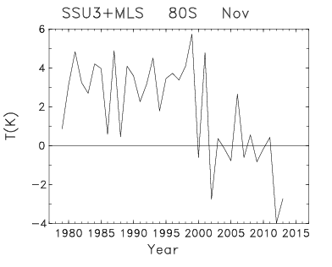
upper stratosphere:
SSU3
- .9

Slide 18
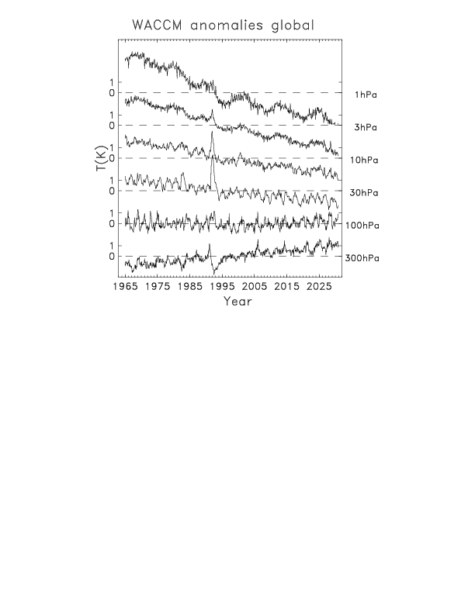
Comparisons with WACCM simulation
CMIP5
RCP6.0

Slide 19
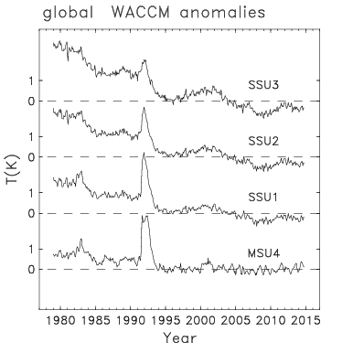
WACCM sampled
like SSU, MSU4
WACCM
observations

Slide 20
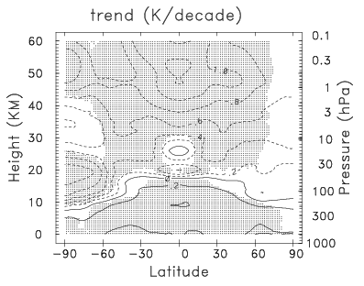
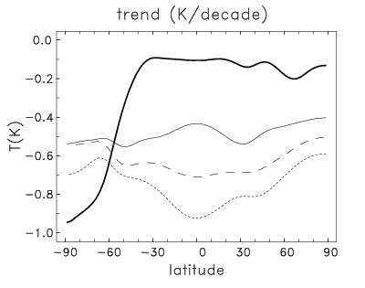
WACCM
1979-2014
WACCM trends
1979-2014
(K/decade)
-1.0
-1.0
-1.0
WACCM
observations
MSU4
MSU4
SSU1
SSU1
SSU3
SSU3

Slide 21
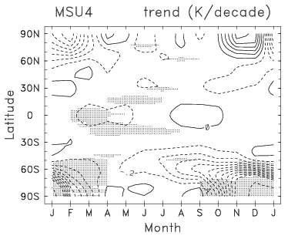
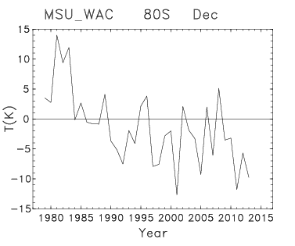
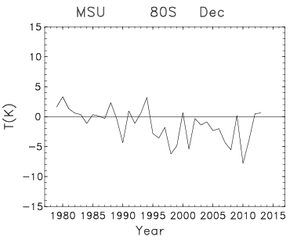
WACCM
MSU4
observations
WACCM
stronger
cooling

Slide 22
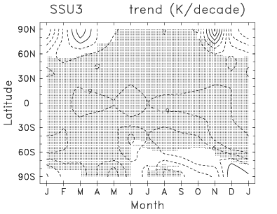
upper stratosphere: SSU3
WACCM
observations
- .6
- .9
- .6
- .9
very different

Slide 23
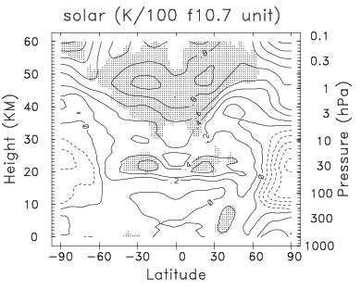
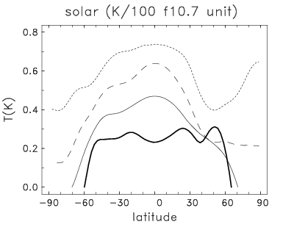
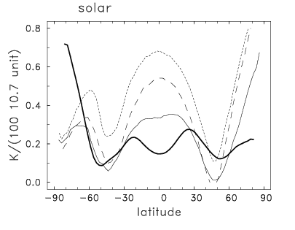
WACCM
solar cycle
WACCM
observations
SSU3
SSU3
MSU4
quite
reasonable
agreement
MSU4

Slide 24
Key points:
SABER and MLS show nearly identical variability (and trends when combined with SSU)
Observed trends for 1979-2014:
Small trends in lower stratosphere
Upper stratosphere: global cooling, except for high latitude SH
Warming in Antarctic winter upper stratosphere (!)
Comparisons with WACCM:
Overall consistent with observations, but:
Much stronger ozone hole cooling in LS
Global cooling in upper stratosphere (no Antarctic winter warming)

Slide 25
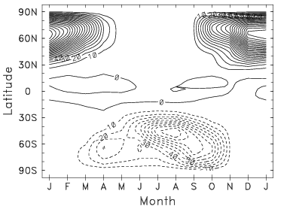
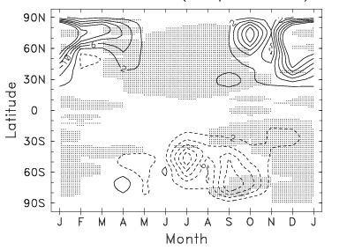
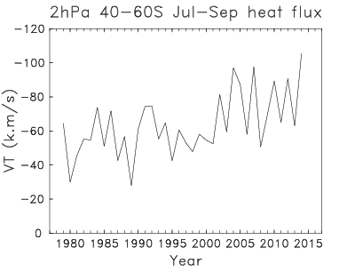
What is causing the wintertime warming over Antartica?
2 hPa wave forcing climatology
increases in wave forcing
from ERAinterim reanalysis
2 hPa wave forcing trends
increasing
wave forcing
??

Slide 26
extra slides

Slide 27
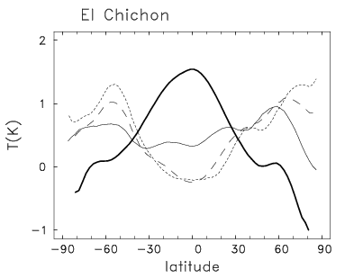
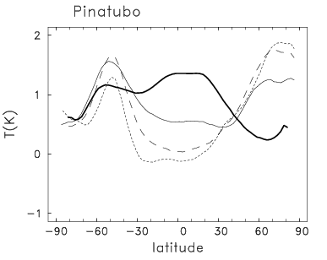
Volcanic signals derived from residuals (avg. of first year after eruption)
MSU4
MSU4
SSU3

Slide 28
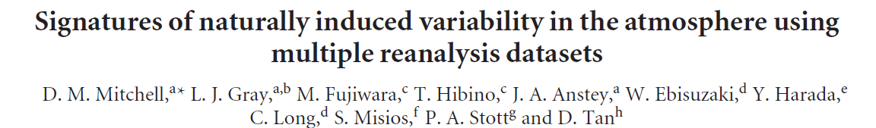
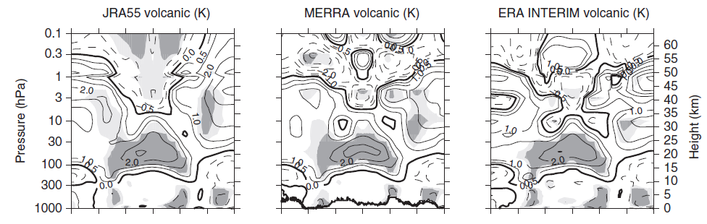
volcanic signal

Slide 29
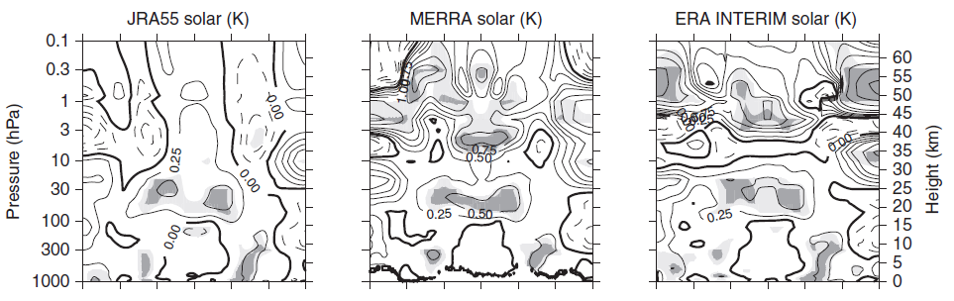
solar signal

Slide 30
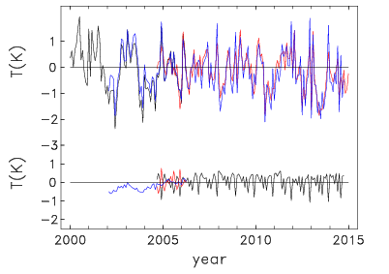
another example:
SSU channel 2 equator
differences

