Slide 1
Retrieving the Stratospheric Diurnal Cycle from AMSU measurements
Carl Mears
Remote Sensing Systems

Slide 2
Why do we care about the diurnal cycle?
Most polar orbiting satellites drift in local measurement time – need estimate of diurnal cycle to adjust for this.
Model validation studies.
Physical understanding

Slide 3
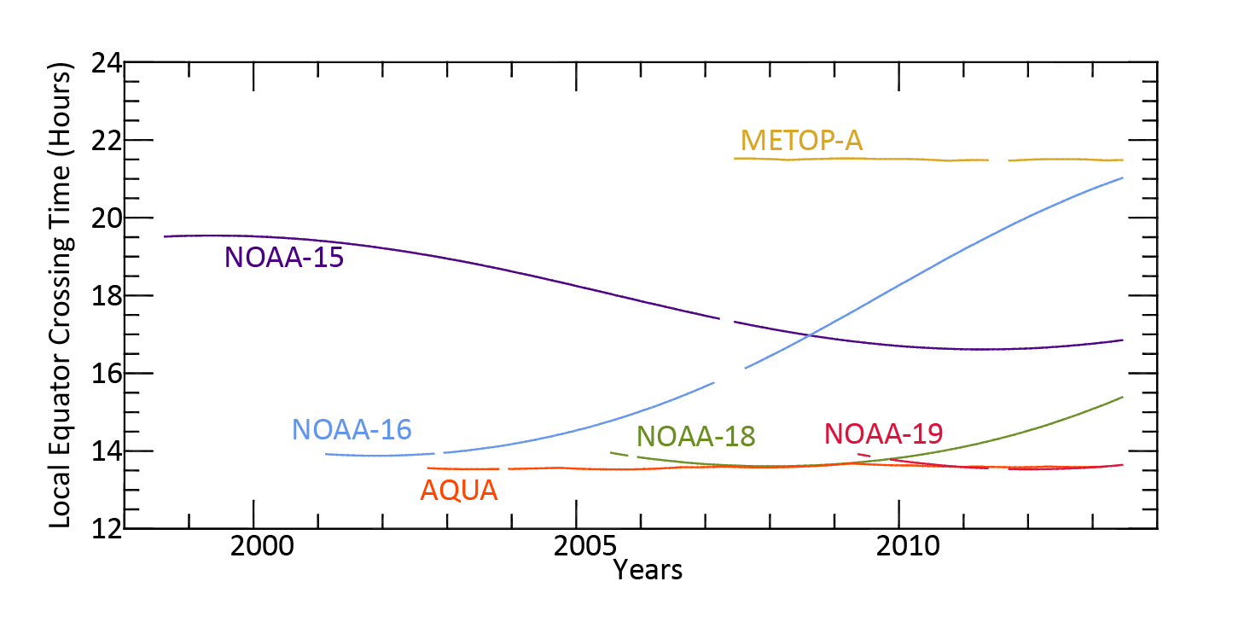
Equator Crossing Times for AMSU

Slide 4
Adjusting AMSU measurements for Diurnal Drift
Currently, I use model based diurnal cycles from CMAM, MERRA, and HADGEM1
Model output used to construct diurnal climatology of atmospheric profiles.
These are used as input to a radiative transfer model to generate synthetic AMSU diurnal cycles for each location and month.

Slide 5
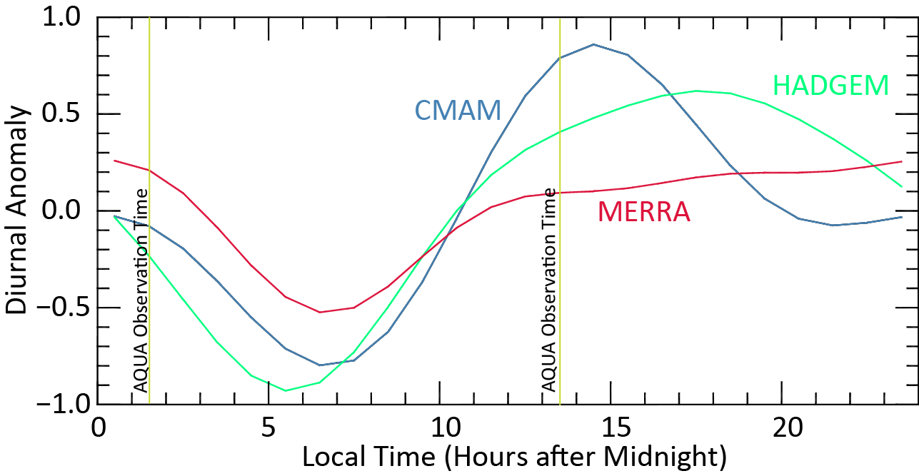
Model-Based Diurnal Cycles
June, July, August averages
Tropical (20S to 20N)
AMSU Channel 13
Clearly, the models do not agree!

Slide 6
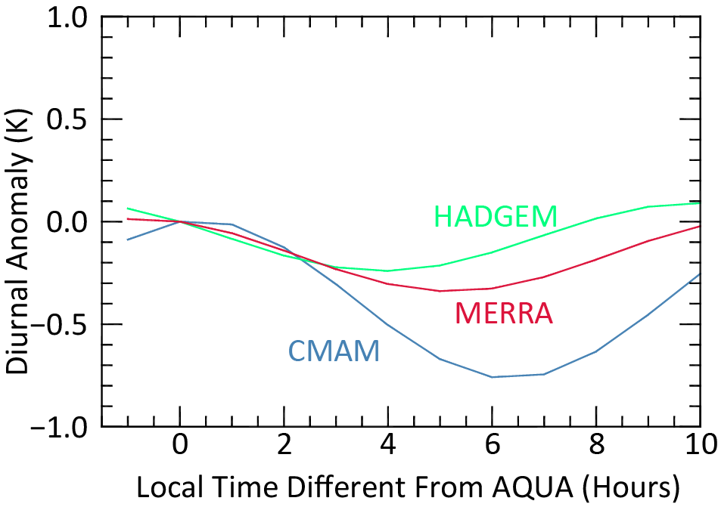
For satellite adjustments, the second harmonic is important
We average the ascending and descending observations
These are made about 12 hours apart, so the focus is on the second harmonic.

Slide 7
Question: Can we use the AMSU observations themselves to find out more about the diurnal cycle?

Slide 8
Equator Crossing Times for AMSU
Most local times are sampled by at least one satellite.

Slide 9
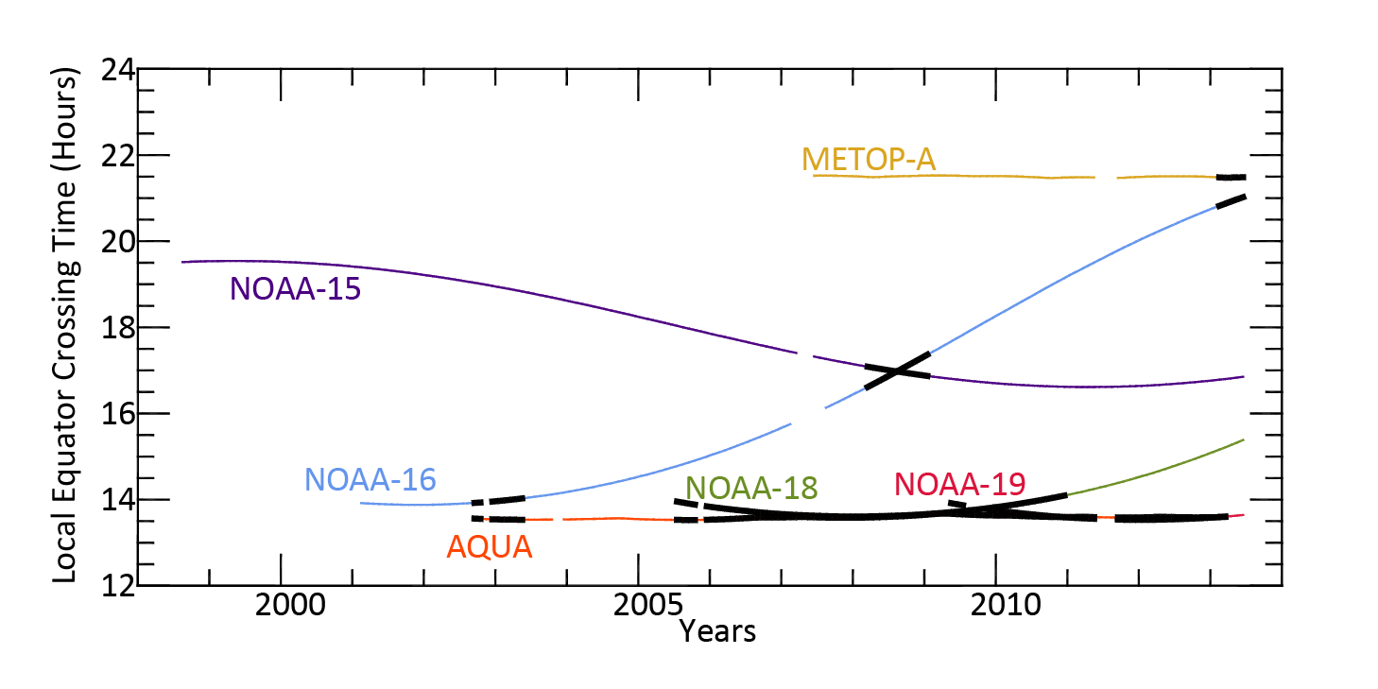
All satellites interconnected with measurements < 30 minutes apart
We can use this to determine and remove intersatellite bias for each channel.

Slide 10
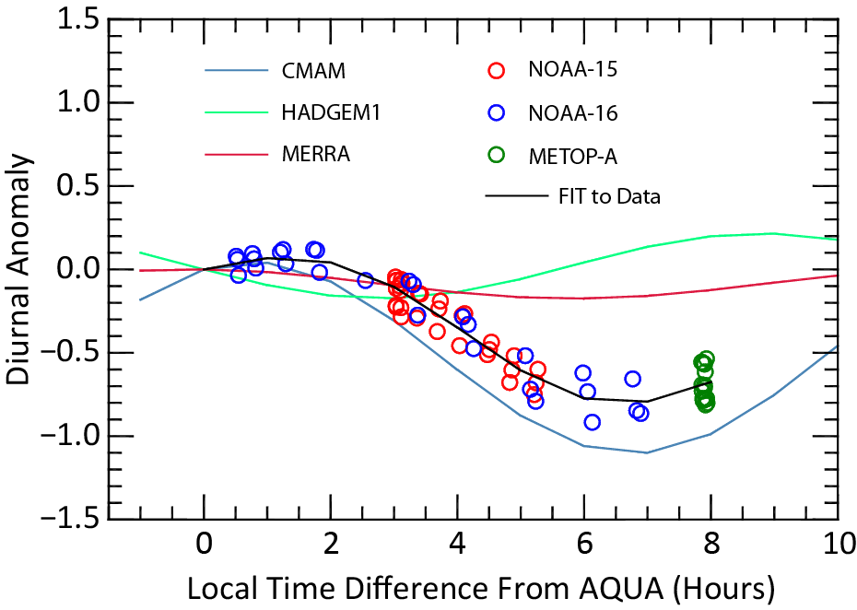
Radiance Difference vs. AQUA as a Function of Local Time
Points are individual monthly differences (Sat – AQUA) for June, July and August for 0 to 5N.
Fit is a harmonic fit to the difference.
No model is correct, but CMAM is a lot better

Slide 11
How to Adjust the Model-Based Adjustments
Repeat the analysis on the last slide for different zonal bands and time of year.
Use the fits to apply further adjustments so that all AMSU measurements correspond to the AQUA measurement time.

Slide 12
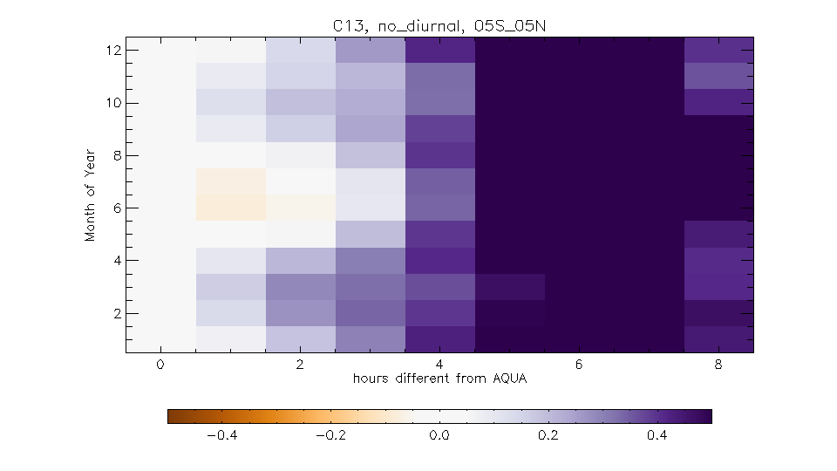
Example Differences from AQUA

Slide 13
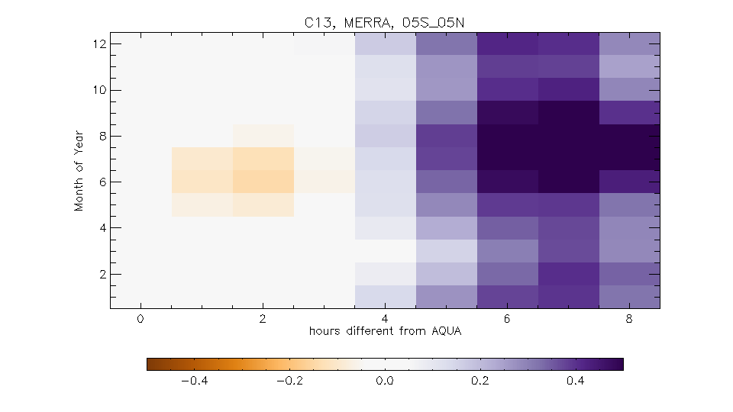
Differences After MERRA Diurnal Adjustment Applied

Slide 14
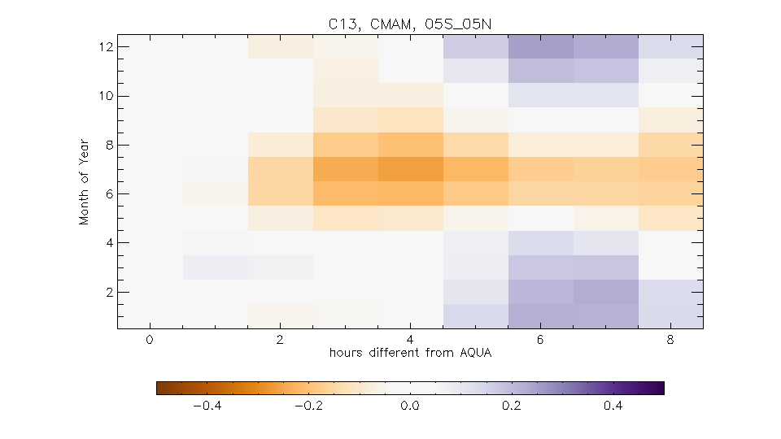
Differences After CMAM Diurnal Adjustment Applied

Slide 15
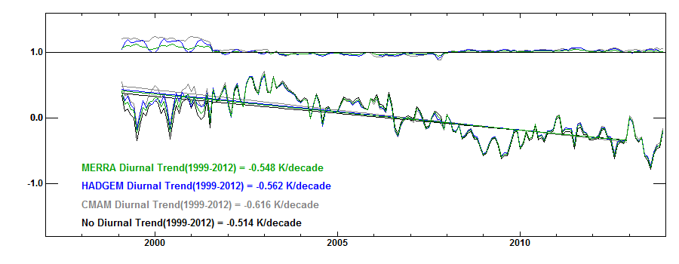
What happens when we use the adjusted AMSU to construct a merged record?
No AMSU-Derived Adjustments
>10% spread in 1999-2012 trends with different model-based adjustments

Slide 16
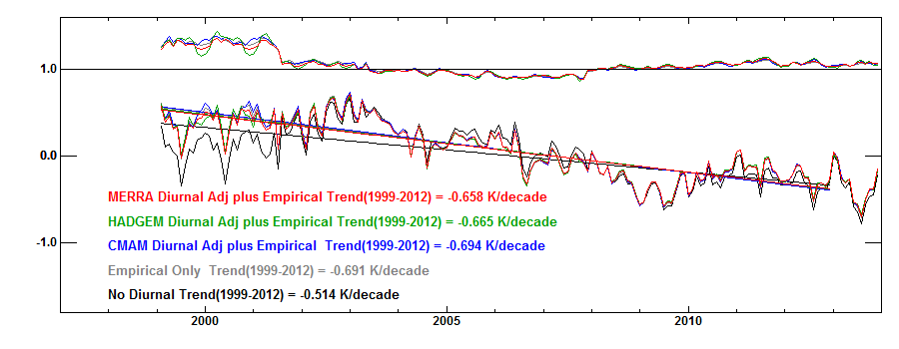
Global Time Series, AMSU 13
With AMSU-Derived Adjustments
<4% spread in 1999-2012 trends with different model-based adjustments
All Trends slightly higher

Slide 17
Status
Analysis Complete For Channel 13
Partially Complete for Channels 9-12,14
Could easily extend to recover the total diurnal cycle (1st + 2nd harmonic)

