Slide 1




SPARC Temperature Trends group meeting
Victoria, BC, Canada, April 9-10, 2015
Past and future temperature trends in EMAC Chemistry-Climate Model simulations
Ulrike Langematz, Stefanie Meul, Sophie Oberländer-Hayn (FU Berlin)
Martin Dameris (DLR Oberpfaffenhofen)
and the ESCiMo consortium

Slide 2

Outline
Comparison of modeled stratospheric temperature changes with observations
Attribution of past stratospheric temperature changes
Drivers of future stratospheric temperature changes
More cold Arctic winters in future?

Slide 3

The Model
EMAC CCM
ECHAM/MESSy Atmospheric Chemistry model (EMAC)
(Jöckel et al., 2006;)
Modular Earth Submodel System (MESSy)
ECHAM5 atmospheric model (Röckner et al., 2006)
Interactive chemistry model MECCA (Sander et al., 2005)
Improved shortwave radiation scheme FUBRad (Nissen et al., 2007, Kunze et al., 2012)
  Resolution: T42 (2.8°x2.8°), L39 or L47 or L90 (top at 0.01 hPa, ~80 km)
  Coupled to MPI-OM ocean model

Slide 4








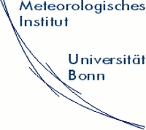





The MESSy Consortium
(Modular Earth Submodel System)
Institute for Hydrobiology and Fisheries Science
Notes:
4

Slide 5
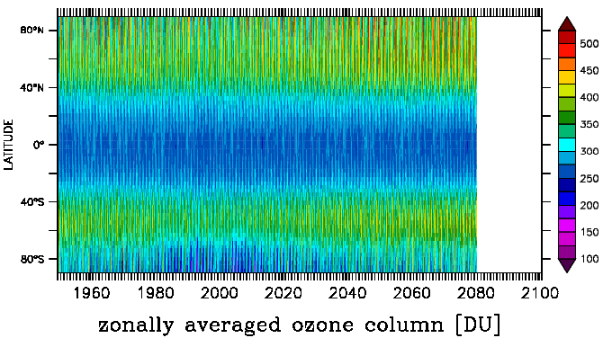











Earth System Chemistry Integrated Modelling
joined activity within the MESSy Consortium
several EMAC simulations 1960 – 2014 – 2100 in various model setups,
(still ongoing) including „nudged“ hind-cast simulations
~ 6 Million CPU-hours at DKRZ
„blizzard“
estimated ~ 2 Peta-Byte raw data
contribution to IGAC/SPARC
Chemistry-Climate Model Initiative
(international inter-comparison)
→ WMO Ozone Assessment
→ IPCC

Slide 6
Comparison of modeled stratospheric temperature changes with observations
based on new ESCiMo simulations

Slide 7
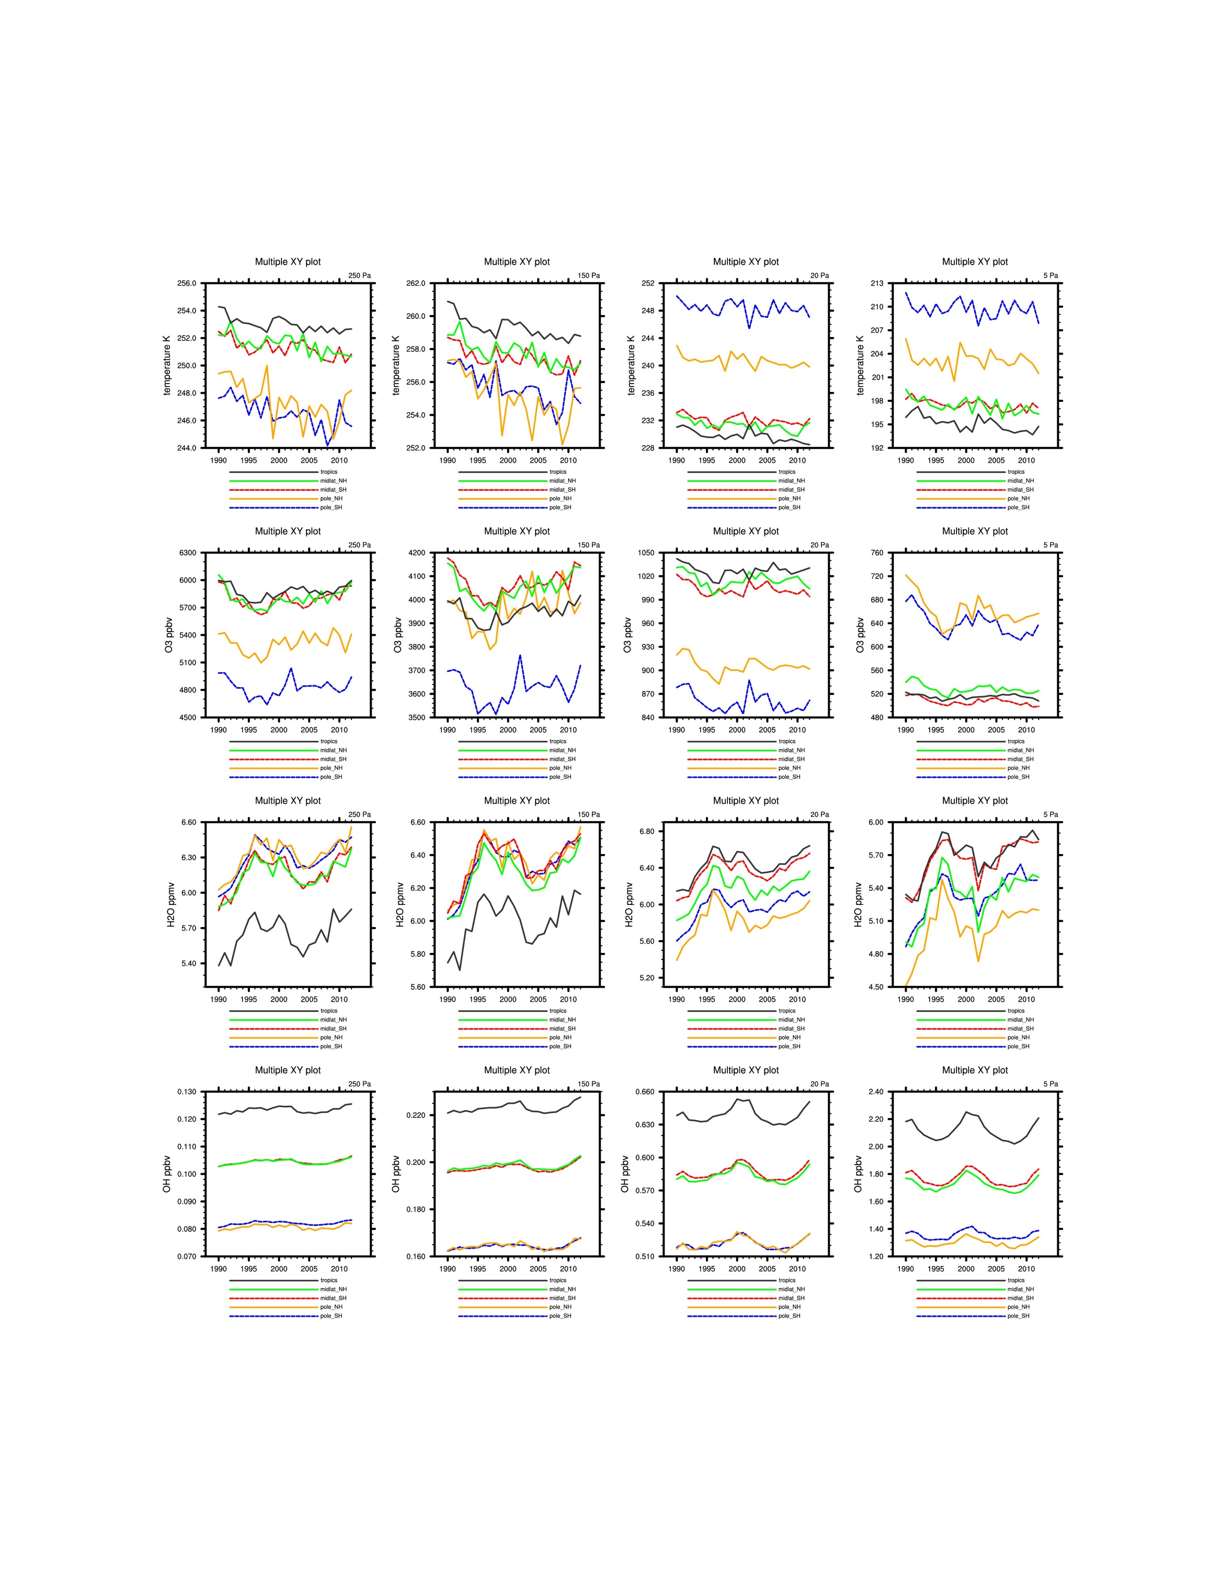

Past trends in CCM EMAC: REF C1SD
2,5 hPa
1,5 hPa
0,2 hPa
0,05 hPa
Temperature [K]
preliminary data
Ozone [ppbv]
Water vapor [ppmv]
Tropics midlat NH midlat SH pole NH pole SH
Courtesy: Martin Dameris

Slide 8
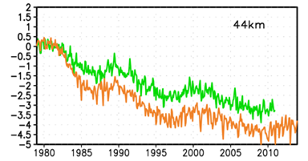
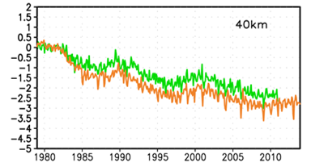
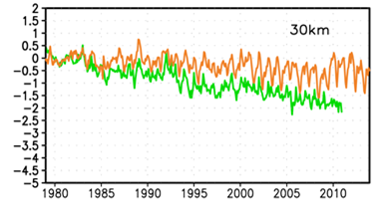
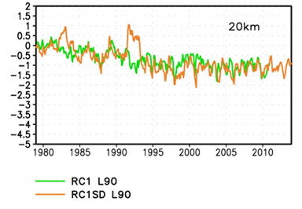

Global mean stratospheric temperature anomalies since 1979
EMAC
40km
30km
Thompson et al., 2012

Slide 9
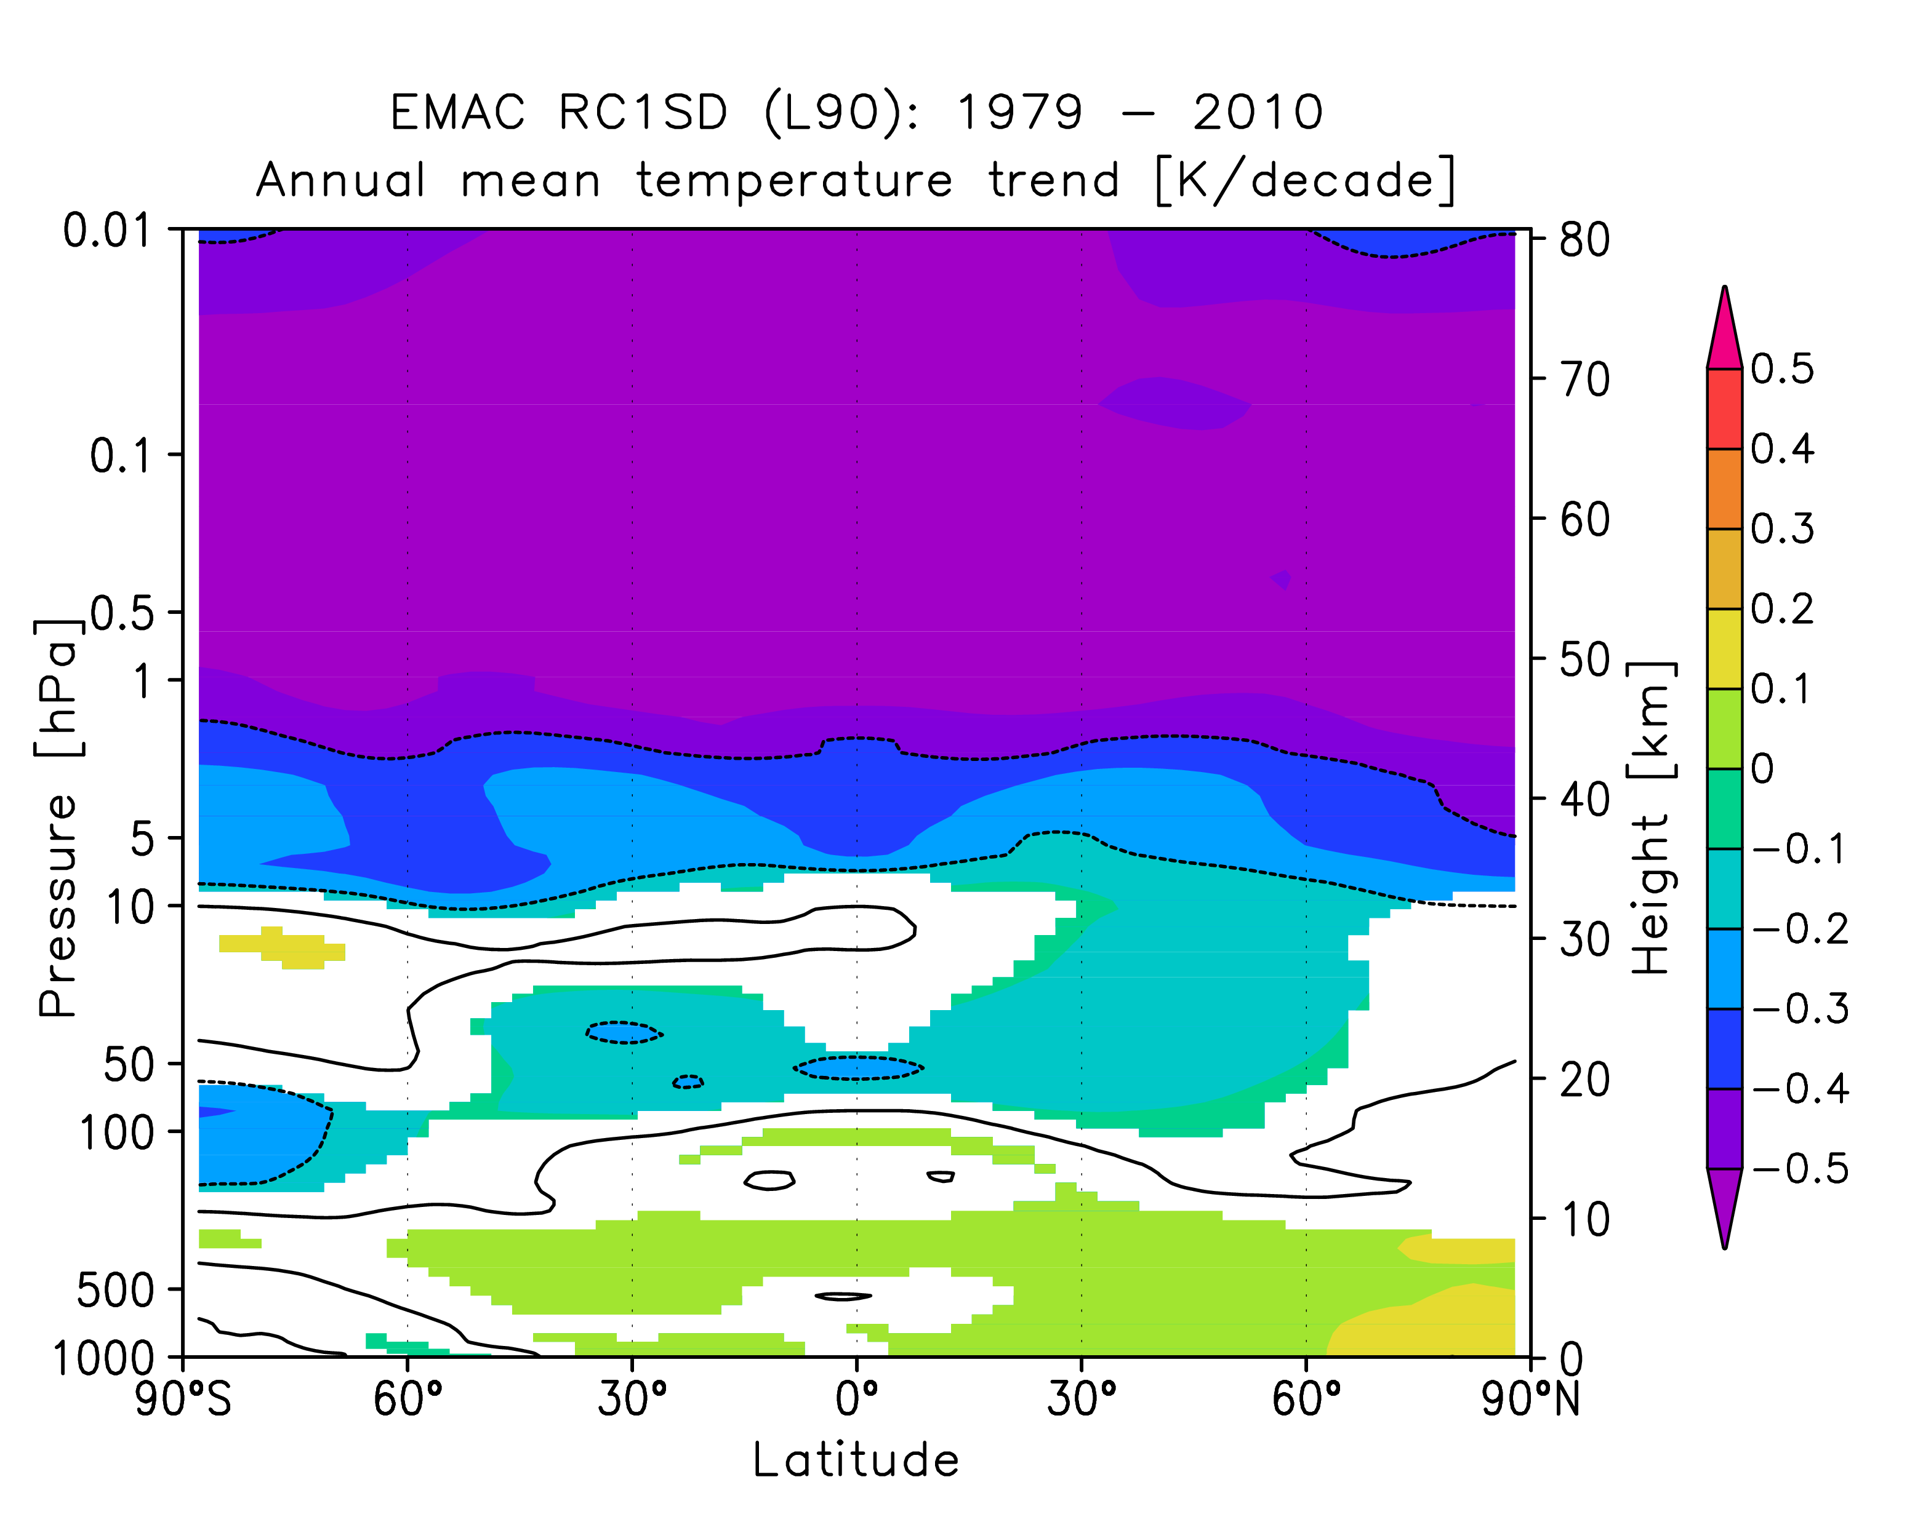
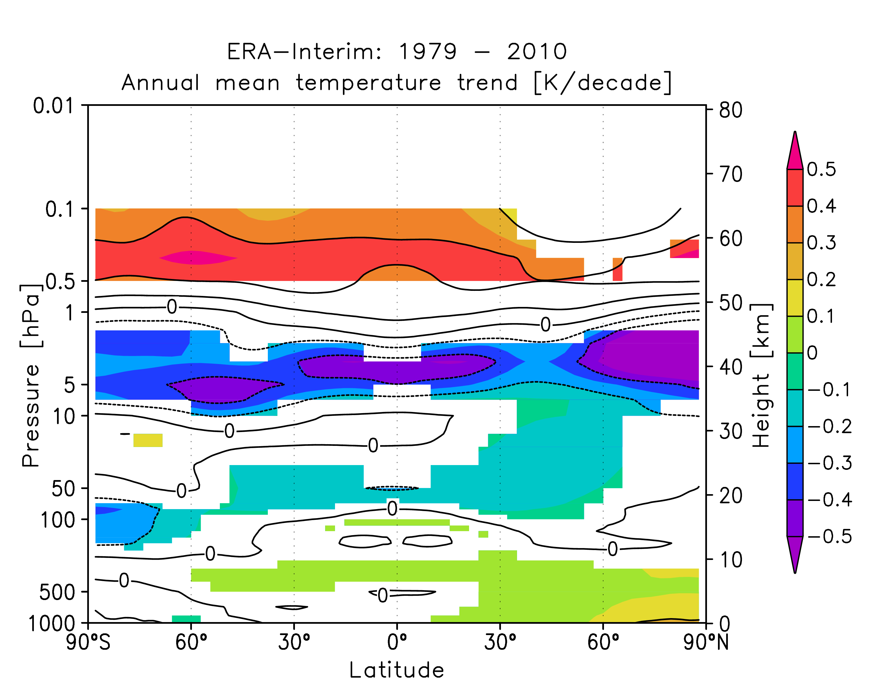
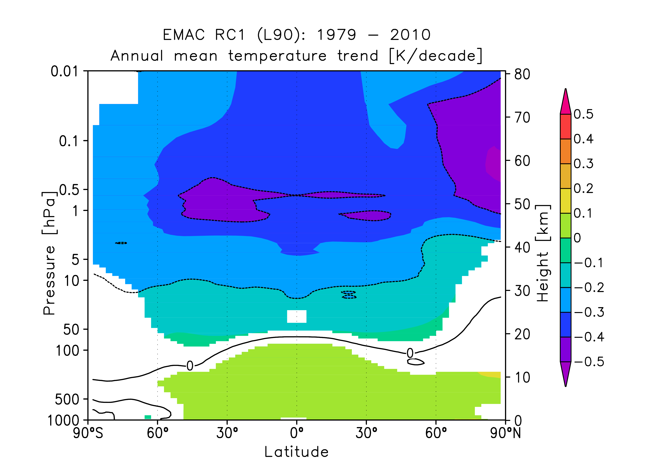
Zonal annual mean temperature trends 1979-2010
ERA-Interim 1979-2010
specified dynamics
free running

Slide 10
Lower stratospheric temperature trends I
Increase in tropical tropopause temperature
GPS-RO data
2001-2012
Wang et al., GRL, 2013
Warming of tropical lower stratosphere?
Wang et al., ACPD, 2014

Slide 11
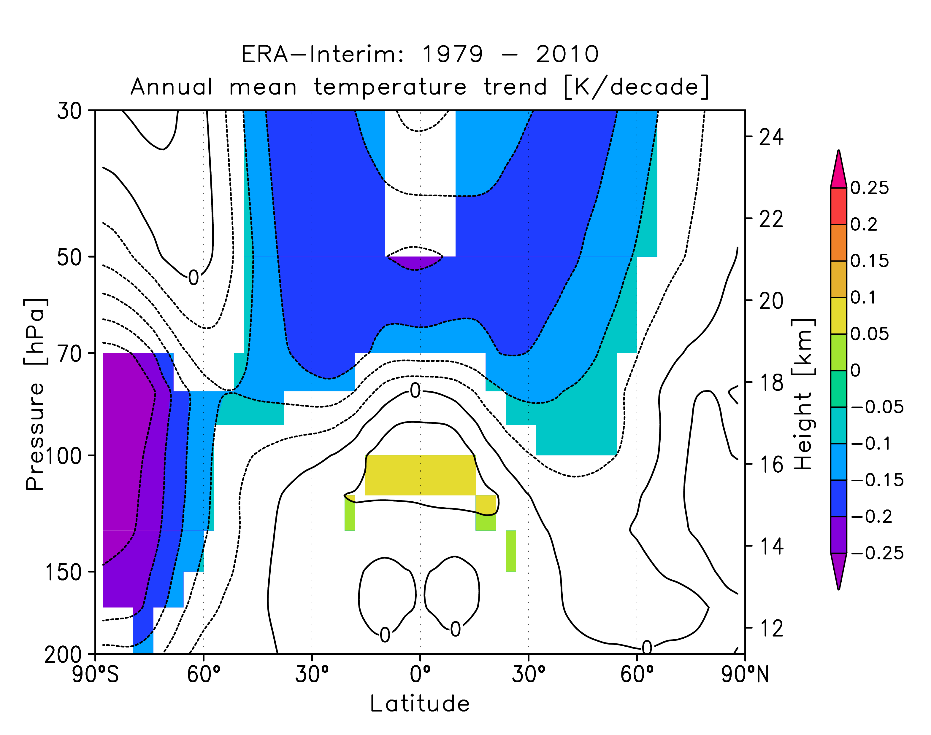
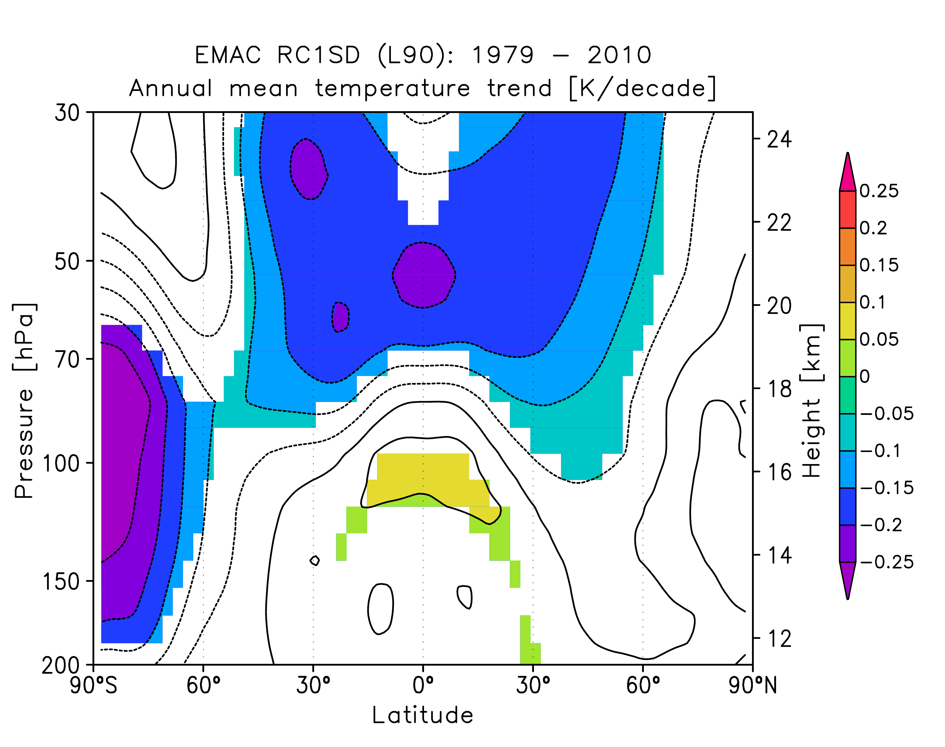
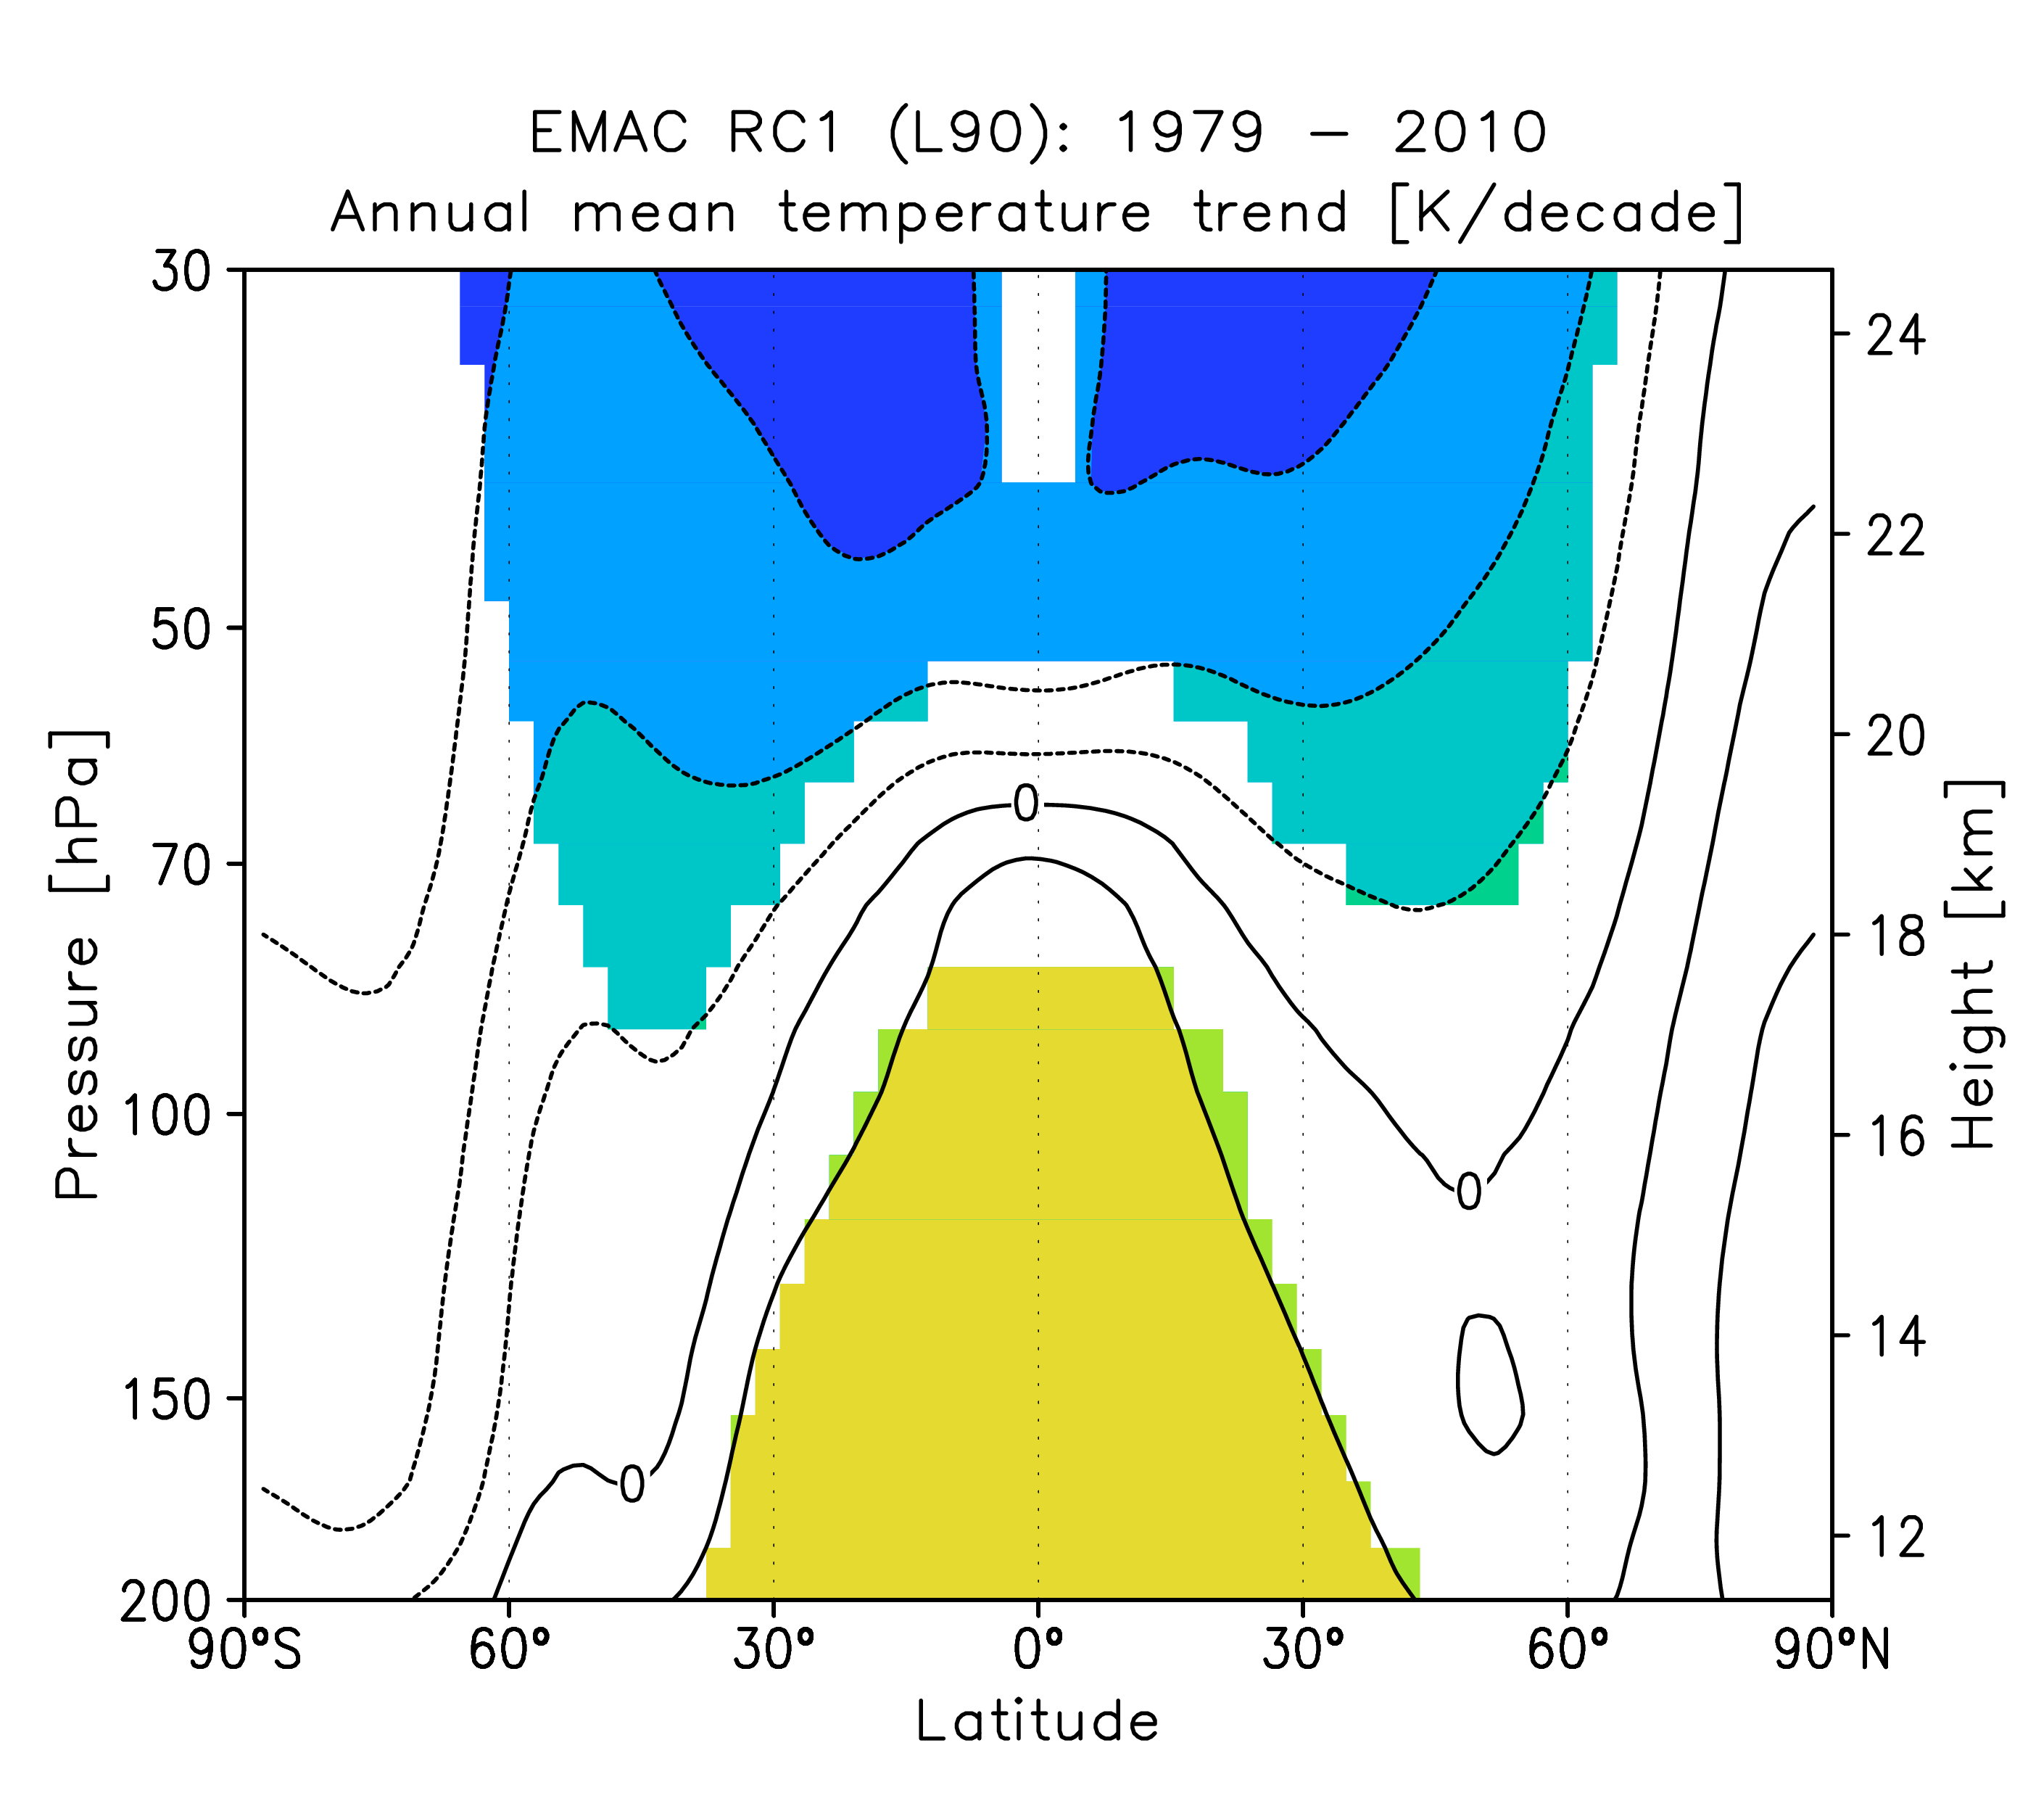
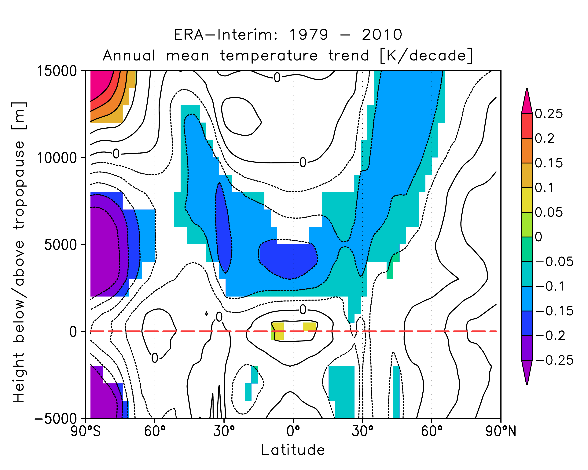
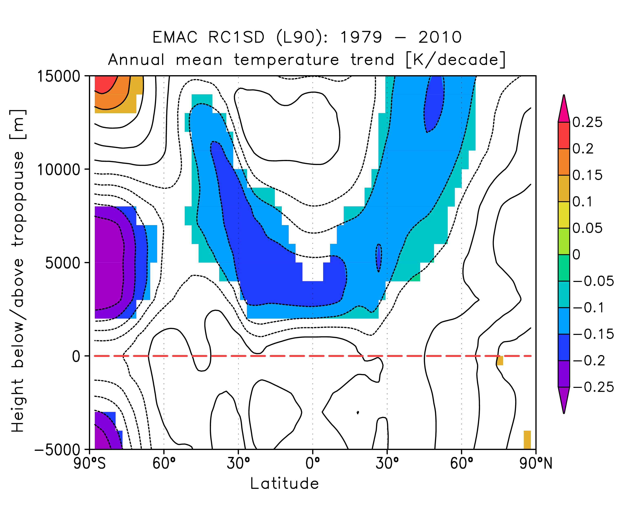
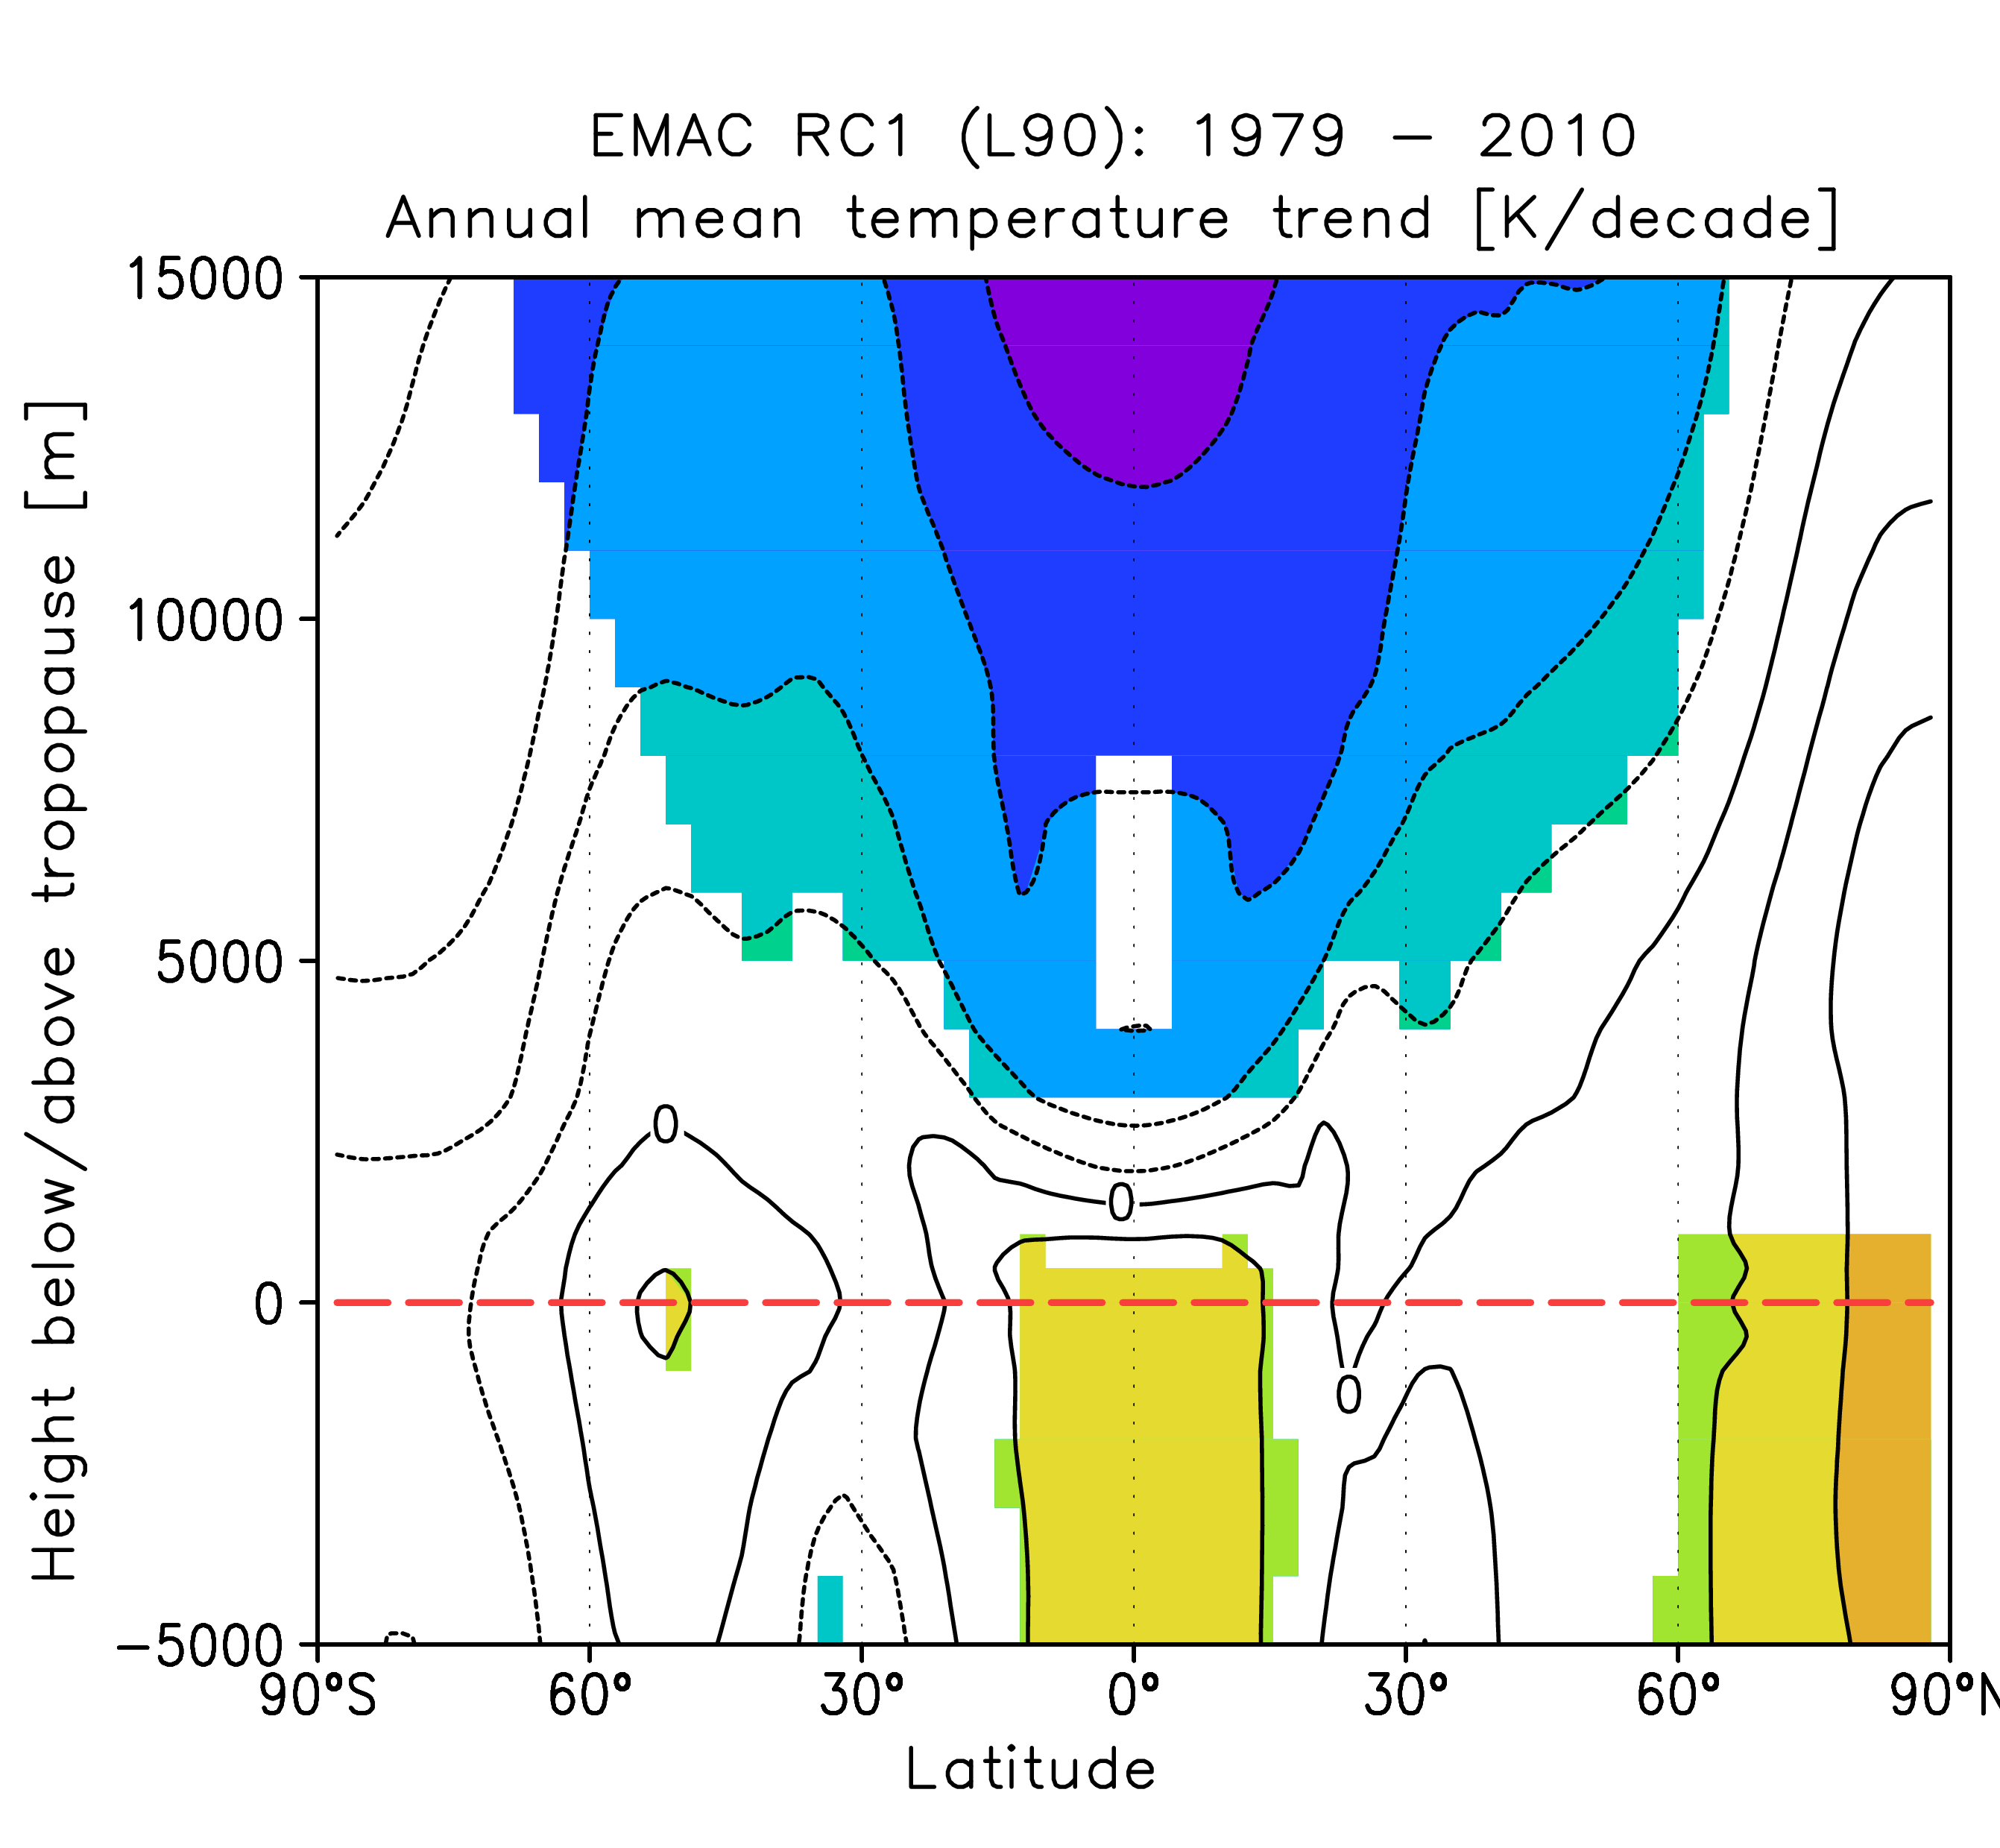
Lower stratospheric temperature trends II
annual mean, in K/decade, 1979-2010
… relative to the tropopause

Slide 12
Attribution of past stratospheric temperature changes
based on EMAC@FUB simulations

Slide 13
Temperature changes 1960 -2000 in EMAC CCM
40-year timeslice simulations for DJF
all forcings
Tropospheric warming of 0.2 K/decade caused by GHG increases
Stratospheric cooling due to both GHG and ODS induced ozone loss; equal contribution at summer stratopause
K/decade, DJF
GHG forcing
Associated cooling in tropical LS due to GHGs related to strengthening of lower BDC branch
ODSs cause SH dipole signal with chemical cooling in LS and dynamical warming above
ODS forcing
Oberländer-Hayn, Meul, Langematz, JGR, in revision 2015

Slide 14
Drivers of future stratospheric temperature changes
based on EMAC@FUB simulations

Slide 15
Temperature change 2000-2095 in EMAC CCM
from EMAC timeslice simulations with specified forcings, DJF, K/decade
both GHG effects dominate the total signal
further tropo. warming / strato. cooling
GHG effect on SSTs → increased BDC → enhanced tropical LS cooling
strat. cooling by radiative GHG cooling
ozone recovery will reduce strato. cooling
tropical SST changes dominate BDC changes
Oberländer, Langematz et al., JGR, 2013

Slide 16
More cold Arctic winters in the future?
based on EMAC@FUB simulations

Slide 17
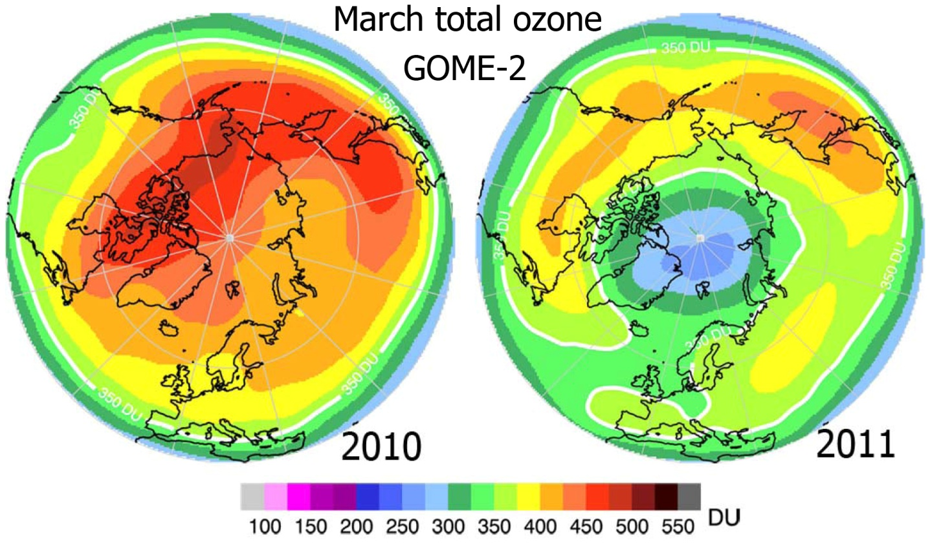
Arctic Ozone
Gome-2 Total Ozone
Unprecedented Arctic ozone loss in March 2011
Comparable to Antarctic ozone hole
Due to
  persistent cold lower stratosphere from early winter into spring
  - early onset of denitrification
  - long-lasting enhanced chlorine activation
  large V_{PSC}
Manney et al., 2011
courtesy Mark Weber, Uni Bremen
Is there a risk that such extreme Arctic ozone-hole-like events will become more frequent in a future with climate change?

Slide 18
Questions
What is the effect of increasing GHG concentrations on the Arctic polar lower stratosphere?
How will the meteorological conditions in the Arctic lower stratosphere change with rising GHGs?
How will ozone be affected?
Radiative cooling
More PSCs
More ozone loss
or
Dynamical forcing
Arctic warming
Less ozone loss

Slide 19

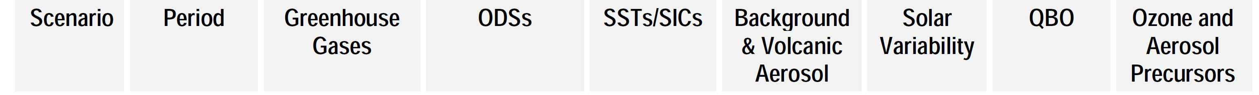
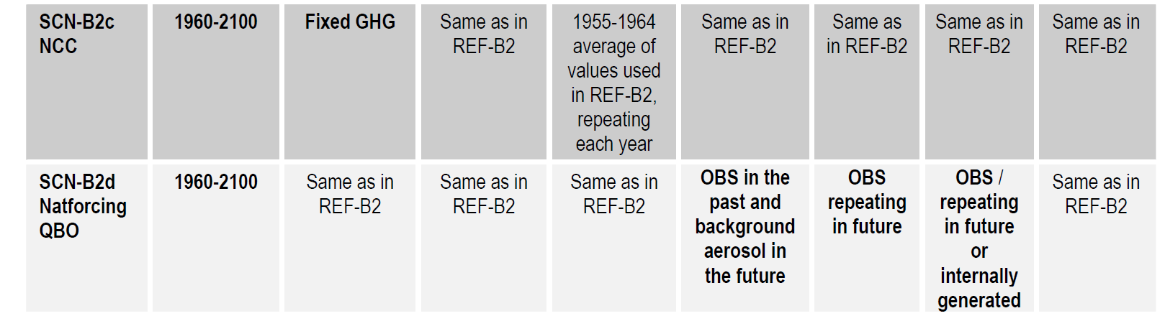
Simulations
transient, 1960-2100
Obs + A1
WMO (2007)
NCC
Obs +
SRES
A1b
Obs + A1
WMO (2007)
REF
timeslices (40 years)
 | R1865 | R1960 | R2000 | R2045 | R2095 | S2045 | S2095
GHGs | 1865 | 1960 | 2000 | 2045 | 2095 | 2045 | 2095
ODSs | 1865 | 1960 | 2000 | 2045 | 2095 | 2000 | 2000

Slide 20
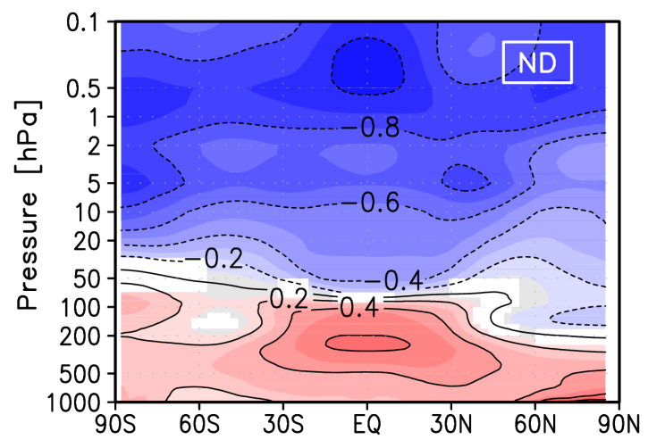


Stratospheric cooling due to GHG increases?
Temperature change 1960-2099
[K/decade]
November/December
January/February
March
Cooling in early winter, but no significant change in mid-winter and spring
Due to GHG increase (as no change in NCC simulation)
Langematz et al., 2014

Slide 21
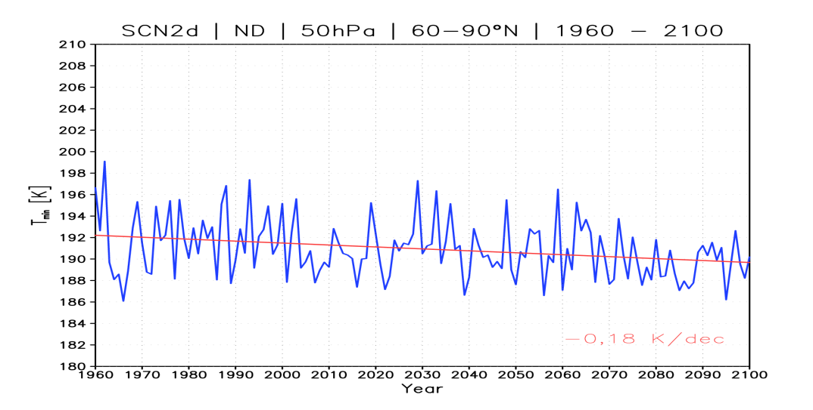
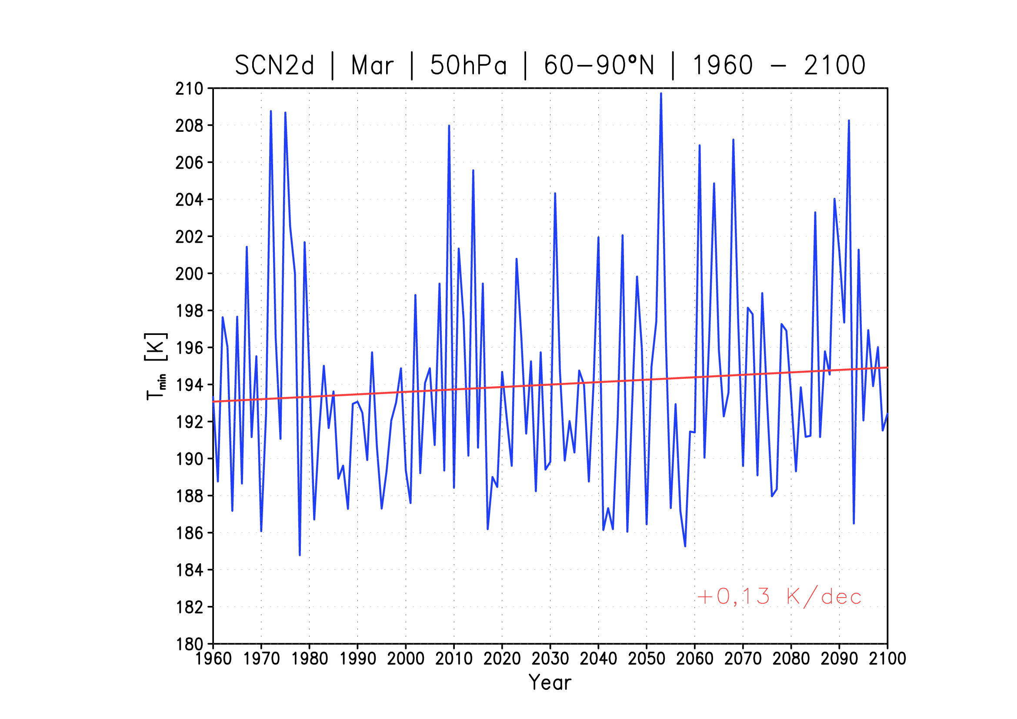
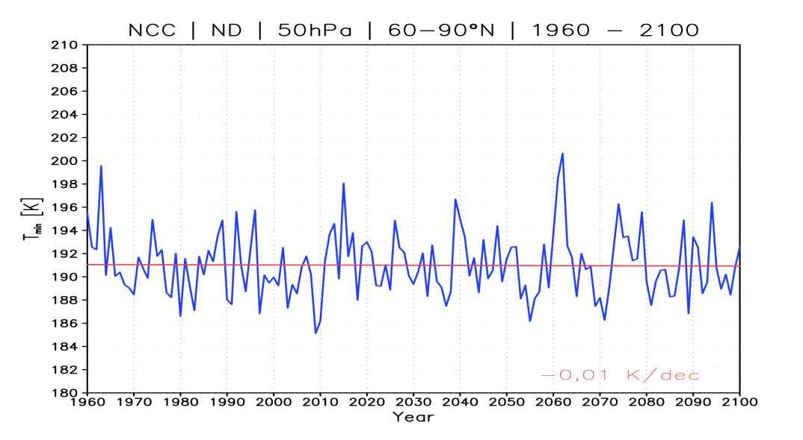
Arctic minimum temperatures 1960-2100, EMAC-SCN2d
REF, November/December
REF, March
T_{NAT}
T_{NAT}
-0.18 ± 0.03 K/dec
+0.13 ± 0.06K/dec
NCC, November/December
Future decrease in minimum temperature only in early winter
T_{NAT}
-0.01 ± 0.03 K/dec
Langematz et al., 2014

Slide 22
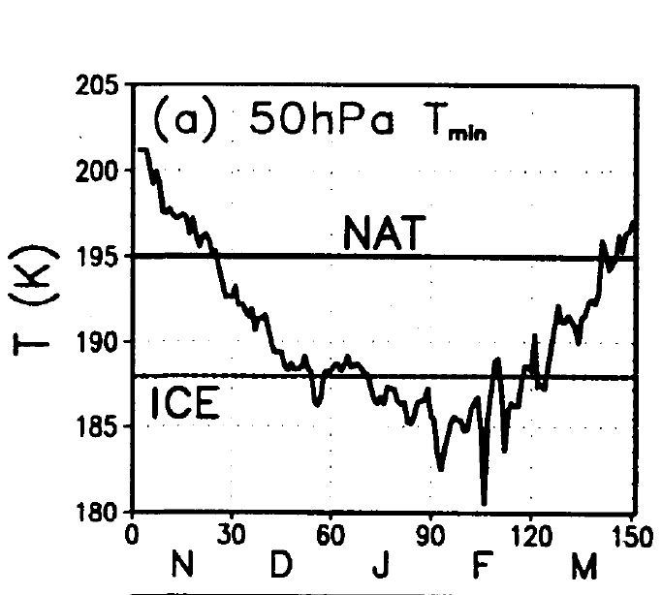
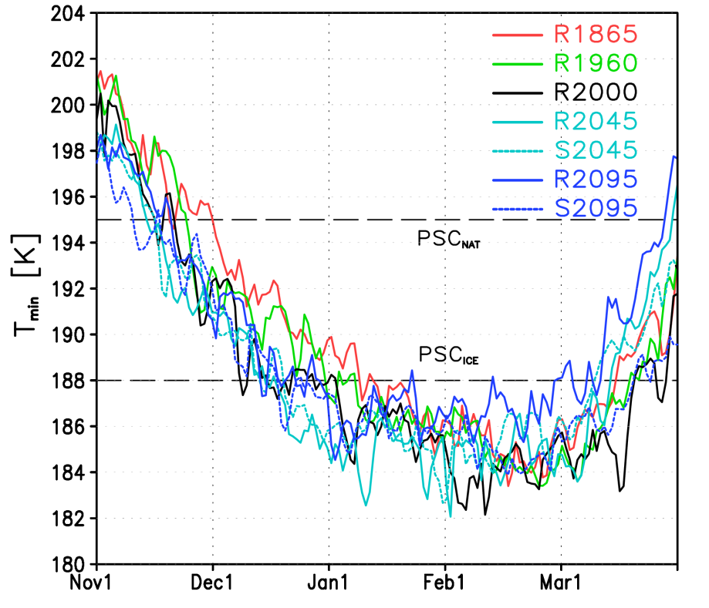
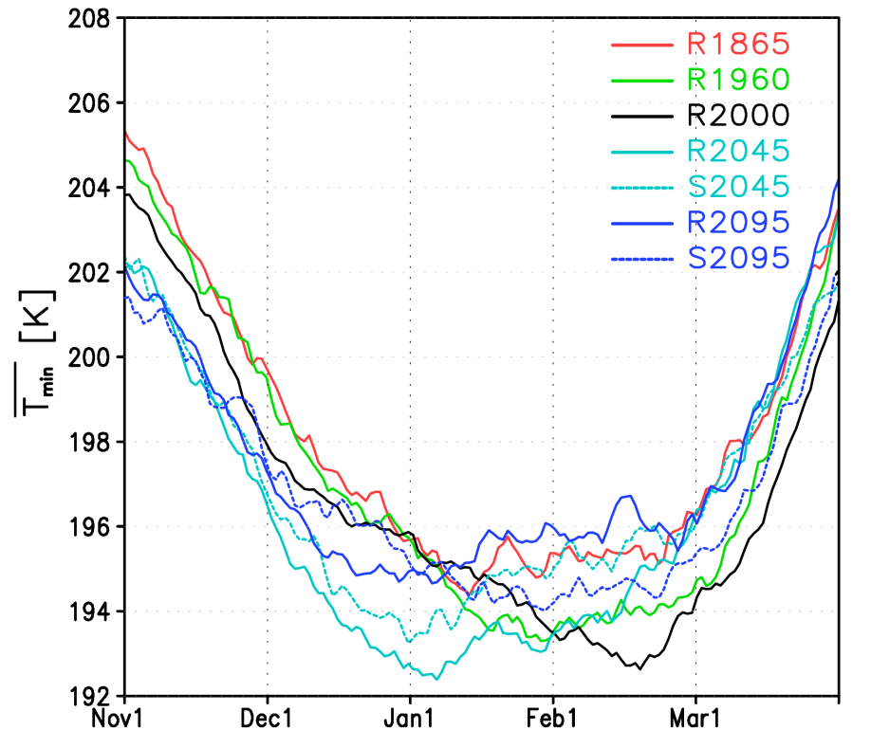
Seasonal evolution of Arctic minimum temperatures
for individual forcings
absolute T_{min} north of 40°N at 50 hPa
multiyear mean T_{min} north of 40°N
Pawson and Naujokat, 1997
Range of T_{min} in EMAC agrees with observations
ODS lead to lower T_{min} in late winter; GHGs in early winter
Langematz et al., 2014

Slide 23
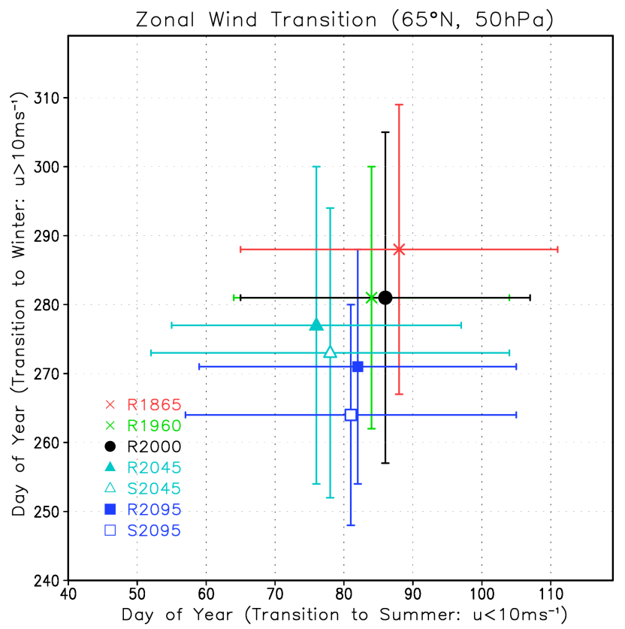
Arctic polar vortex persistence
Arctic vortex duration
R1865 165 days
R1960 169
R2000 159
S2045 172
R2045 172
S2095 183
R2095 185
REF:
spring: -0.18 ± 0.44 days/dec.
autumn: -1.12 ± 0.45 days/dec.
transition to winter
transition to summer
No effect of ozone depletion/recovery on Arctic vortex spring persistence
Enhanced future Arctic vortex duration due to earlier build-up in autumn due to GHGs
Langematz et al., 2014

Slide 24
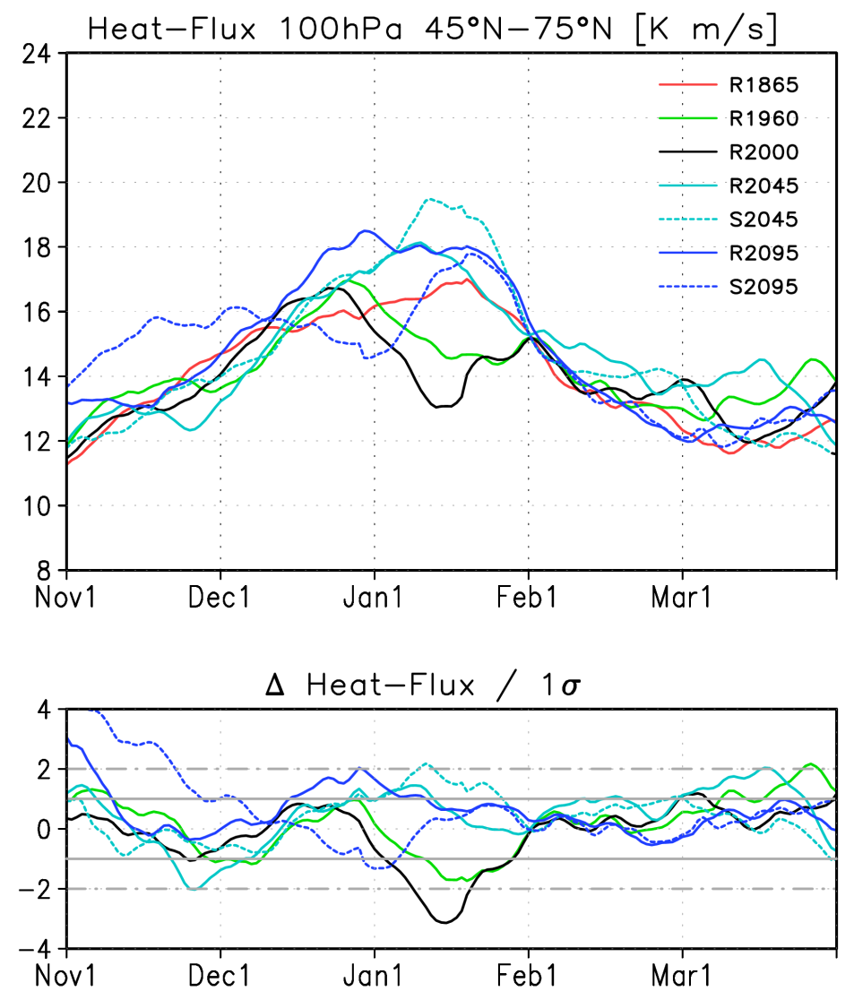
Future Arctic winter temperature
Stronger dynamical forcing of the stratosphere?
100 hPa eddy heat flux
2045
2095
2000
Langematz et al., 2014
Enhanced planetary wave forcing from troposphere in mid-winter due to GHG increase

Slide 25
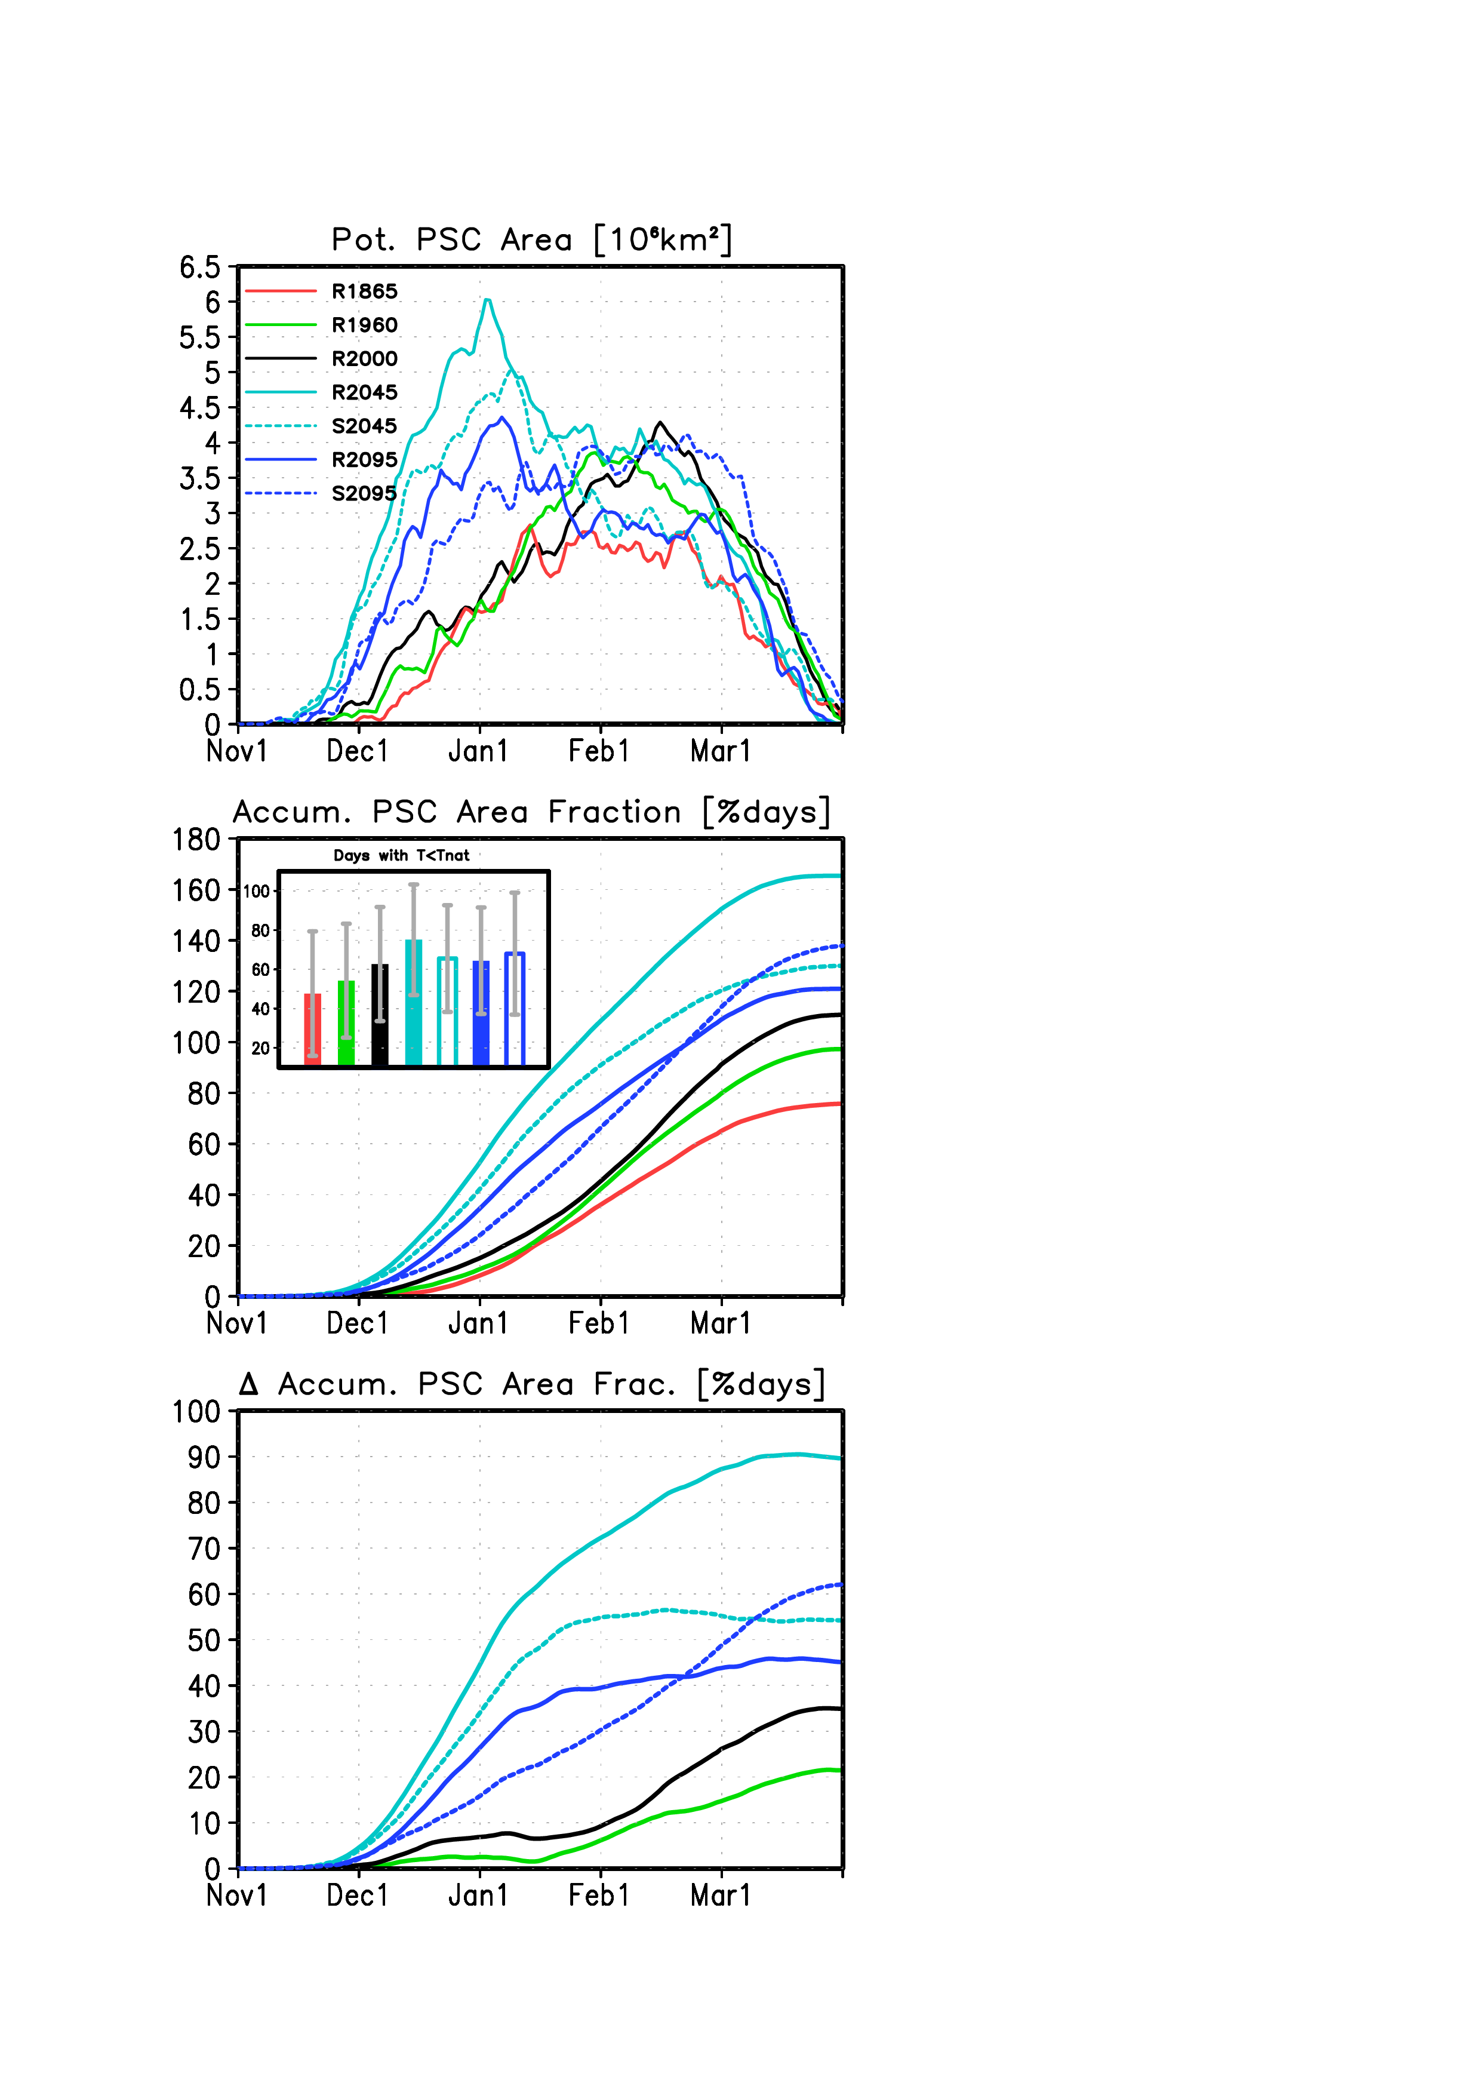
Potential PSC area with T < T_{NAT}
50 hPa, 40°-90°N
2045
2000
2095
1865
Enhanced PSC formation potential in early winter due to GHGs
Langematz et al., 2014

Slide 26
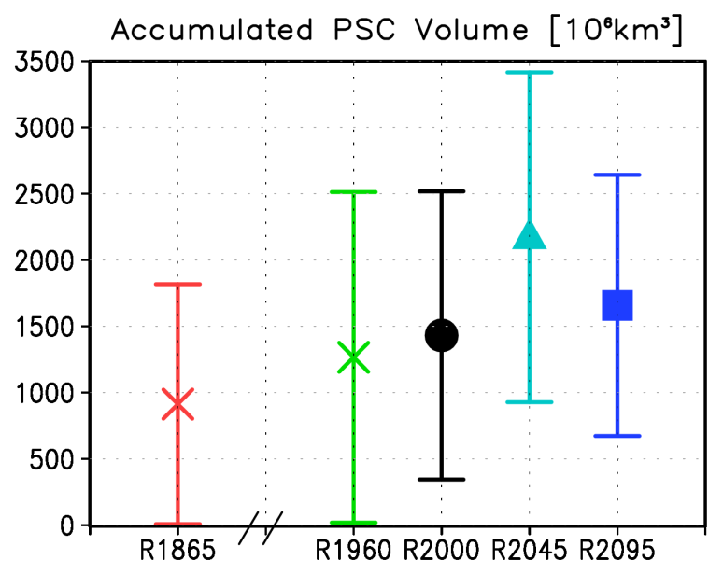
Accumulated potential PSC area fraction
50 hPa, 40°-90°N
Strong increase by ODS in late winter
Strong increase by GHG in early winter
Maximum accumulated V_{PSC} in 2045

Slide 27
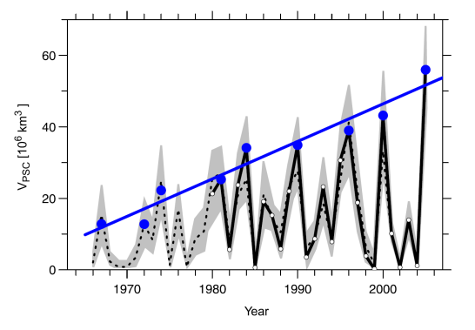
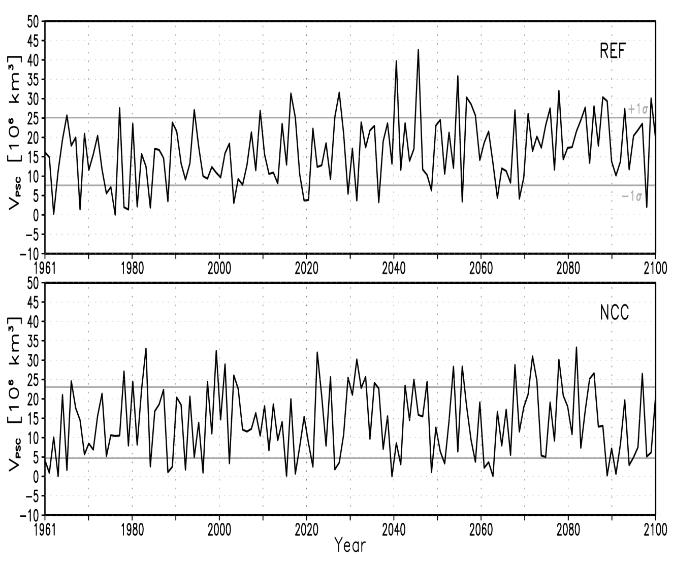
What is the effect on Arctic total ozone?
V_{PSC}
Rex et al., 2006
Maximum V_{PSC} with climate change during 1st half of 21st century
Langematz et al., 2014

Slide 28
Conclusions
CCM simulations are necessary to explain observed temperature changes and disentangle the drivers (anthropogenic, natural, variability and trends, dynamical vs. chemical effects)
In particular:
Tropical UTLS, TTL, (→ BDC)
Arctic and Antarctic stratosphere (→ ozone loss, CCMI project)
Mesospheric cooling
Future projections in support of policy makers (CCMI, IPCC)
New model generation in development: AO-CCMs
(atmosphere-ocean interaction)
Funded by DFG

