Slide 1
Future of the SPARC stratospheric
Temperature Trends Group
The new WCRP/SPARC structure and
SPARC Implementation Plan
Options for this group

Slide 2
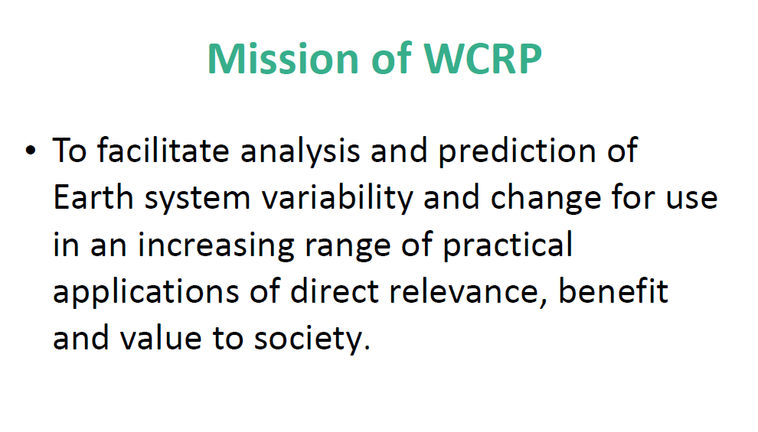
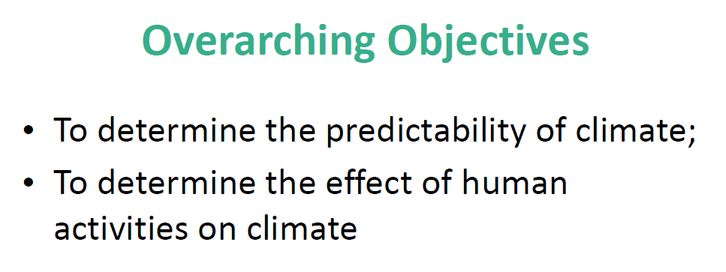

Slide 3
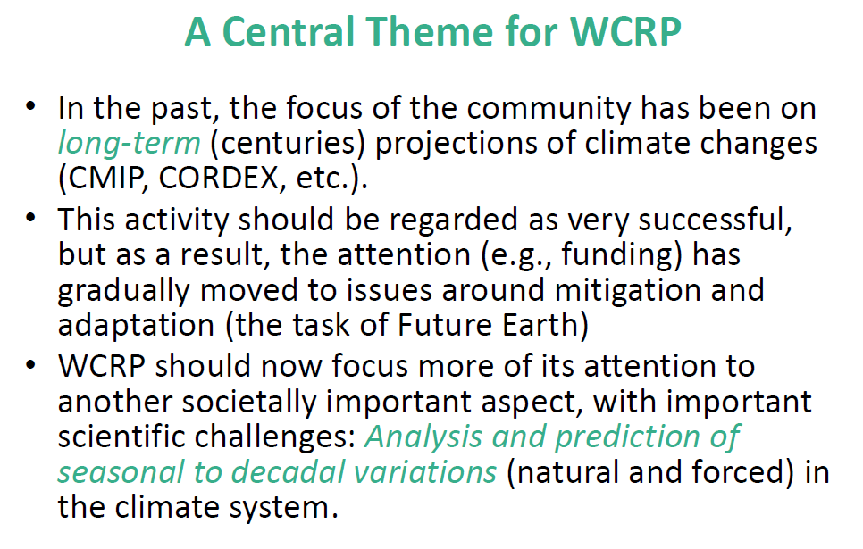

Slide 4
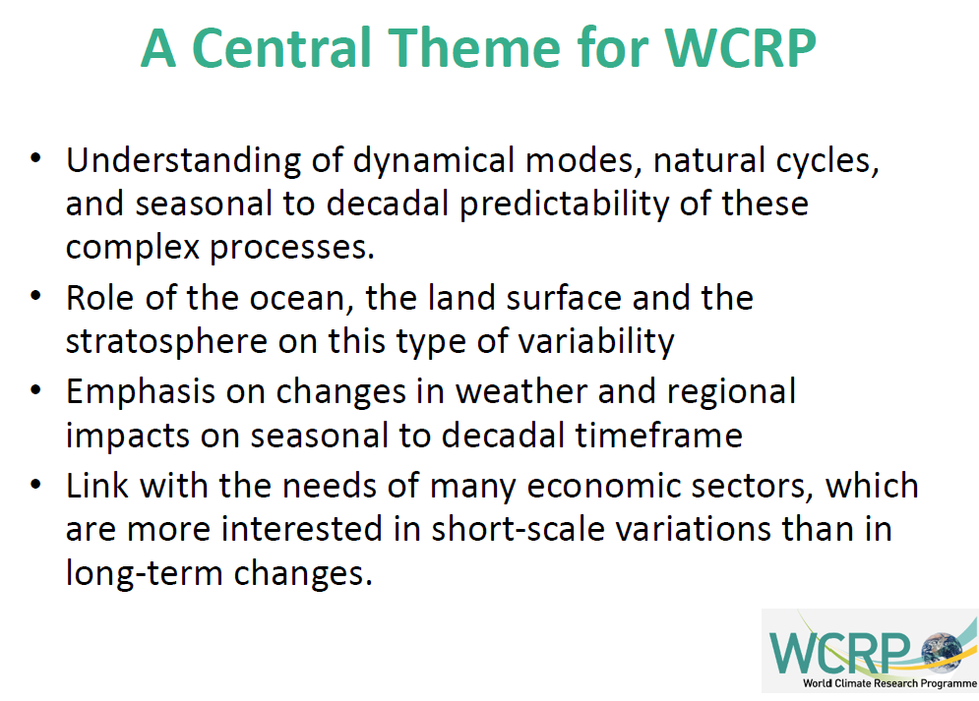

Slide 5
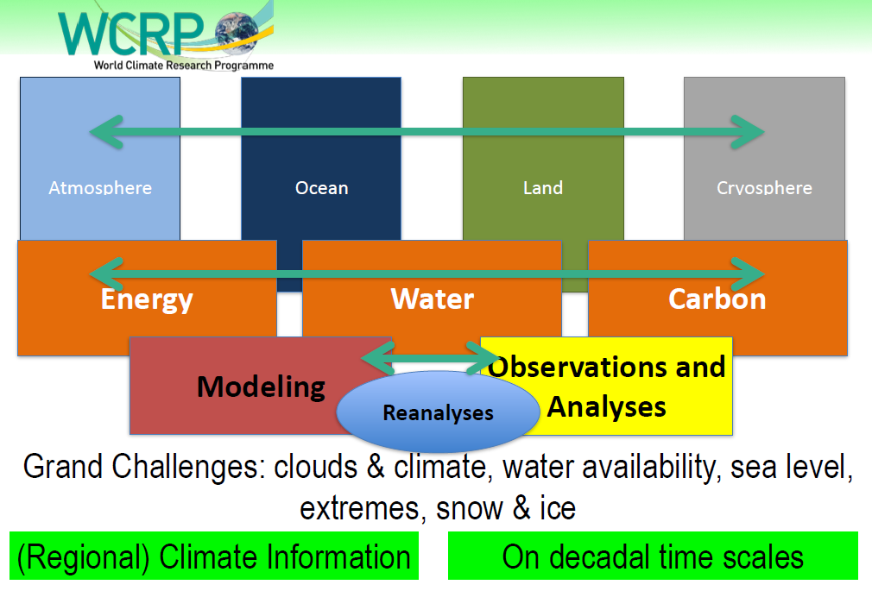
WCRP core projects:
SPARC, CLIVAR, GEWEX, CLiC
SPARC

Slide 6
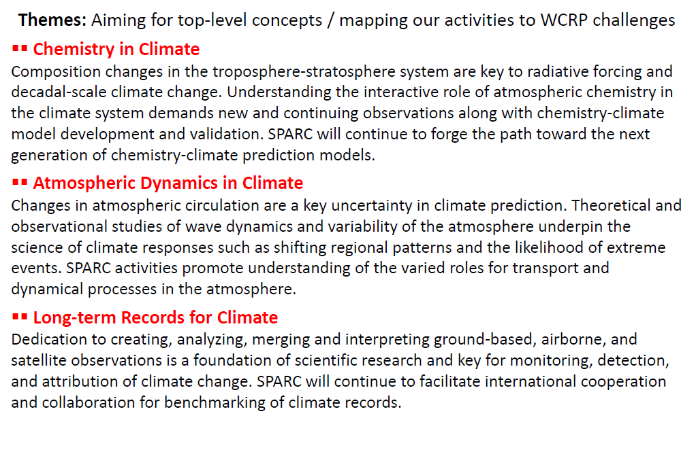
New overarching themes for SPARC

Slide 7
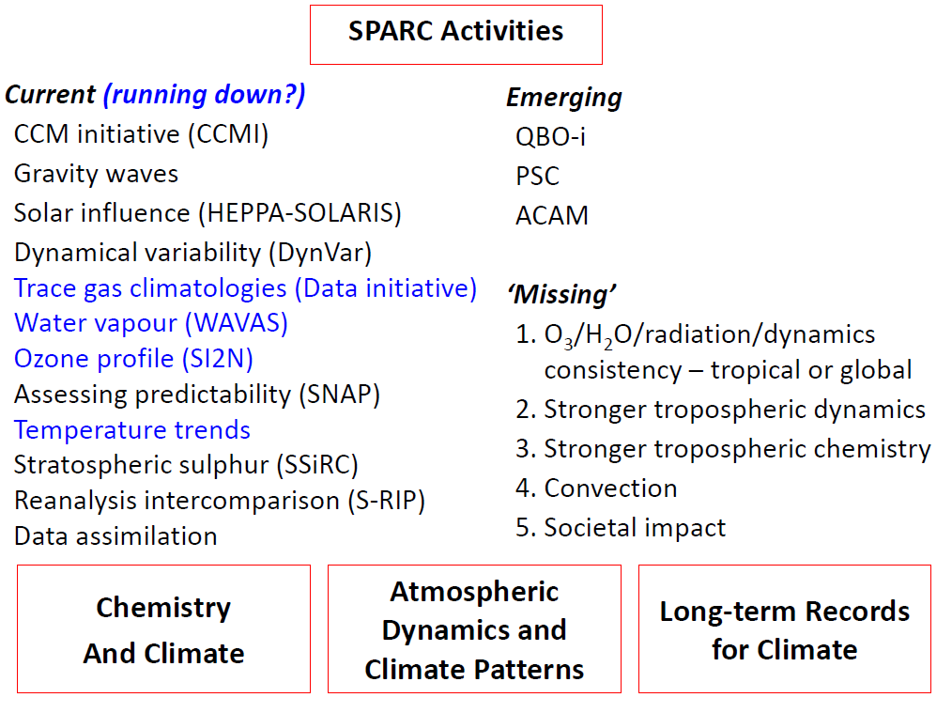
draft from
2015 SSG discussions

Slide 8
Implementation Plan 2015 SPARC Themes
draft for
discussion at
WCRP JSC meeting

Slide 9
Map of SPARC Activities to Themes
Gravity Waves & Momentum Budget
Coupled Chemistry Modeling
Dynamical Variability
Chemistry in Asian Monsoon Region
Solar & High-Energy Particle Influences
Assessing Predictability
Reanalyses Intercomparison
Stratospheric Sulfur

Slide 10
Emerging Activities and Links to Other Programs
Notes:
Possible new additions + SPARC’s role in Grand Challenges
CCl4: regulated gas in Montreal Protocol / cant reconcile reported emissions & measurements / emerging issue that can no longer be ignored / getting mixed group of industry govt and science together

Slide 11
Some options for discussion:
Temperature Trends Group remains as a SPARC Project, with new
leadership (and revised membership?). This should be linked
with ongoing active science goals and outcomes.
Temperature Trends Group ‘sunsets’
Group merges with other SPARC activities into slightly different focus
examples: focus on coupled changes in T, O₃, aerosols, H₂O….
TTL trends
Are there potential other ‘homes’ for stratospheric temperature trends?
Are there other organizational configurations to consider?

