Slide 1
SPARC stratospheric temperature trends group
Some history:
Probably the longest-running SPARC group (since ~ 1995)
Distingushed SPARC alumni; originally co-chaired by Ramaswamy and
Marie-Lise Chanin (+ Karin Labitzke, Alan O’Neill, Keith Shine, ....)
Contributions to UNEP/WMO Ozone Assessments
1998, 2002, 2006, 2010, 2014
Overview/review papers:
Ramaswamy et al (2001) Rev. Geophysics
Shine et al (2003) QJRMS
Randel et al (2009) JGR
Seidel et al (2011) WIREs Climate Change
Thompson et al (2012) Nature
recent focus
on observations

Slide 2
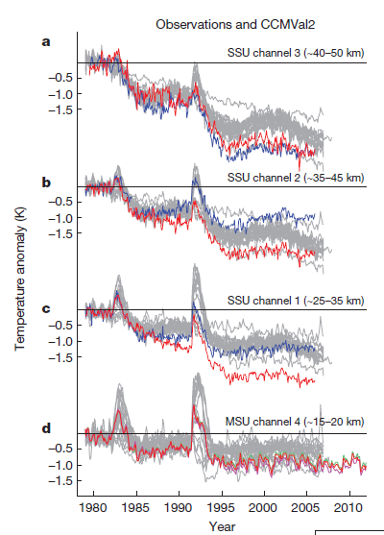
Recent group activities have focused on improved understanding of observations
Homogenized radiosonde data (and comparisons to satellites)
Merged satellite data sets, especially Stratospheric Sounding Unit (SSU)
* SSU is the primary operational satellite data in the middle and upper
stratosphere, but difficult to create a merged climate data record
* focus of meetings in 2011, 2012, 2013
Global temp anomalies
Results from v1 of both
MetO and NOAA SSU data.
v2 results now available;
papers published
models
MetO
NOAA
Thompson et al 2012

Slide 3
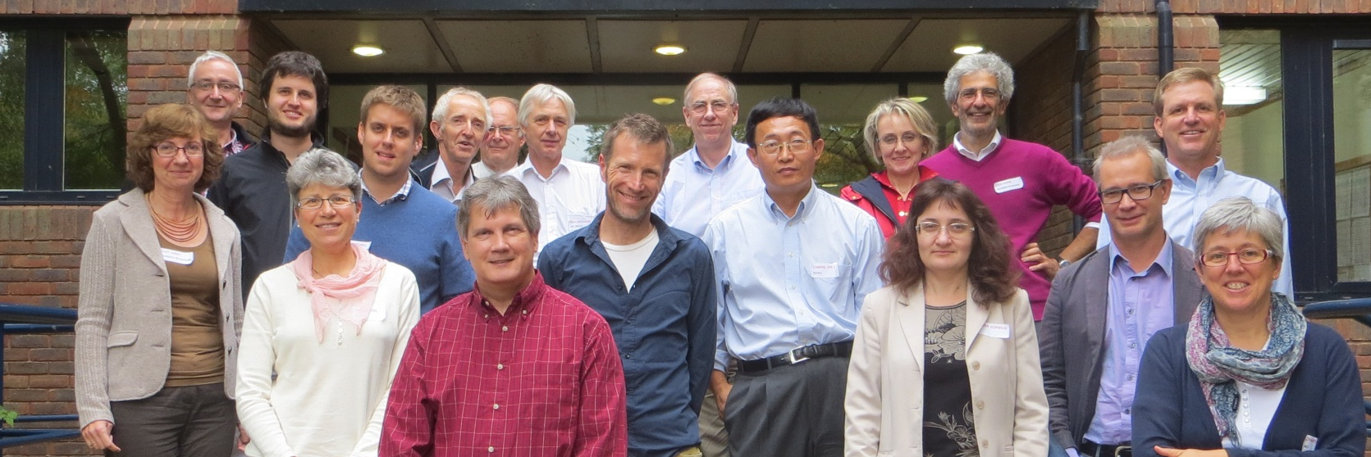
SPARC Trends Group meeting Reading September 2013
Meeting focused on SSU data and reanalyses

Slide 4
Some points:
SSU satellite data now processed by two separate groups, and uncertainties
are better understood. New climate data records are available.
SSU ends in 2006. Several groups are exploring extending SSU using AMSU,
MIPAS, SABER and other satellite data sets.
Observational records for stratosphere have been improved.
Reanalysis data are continually improving, but still a need to understand
the fundamental observations.

Slide 5
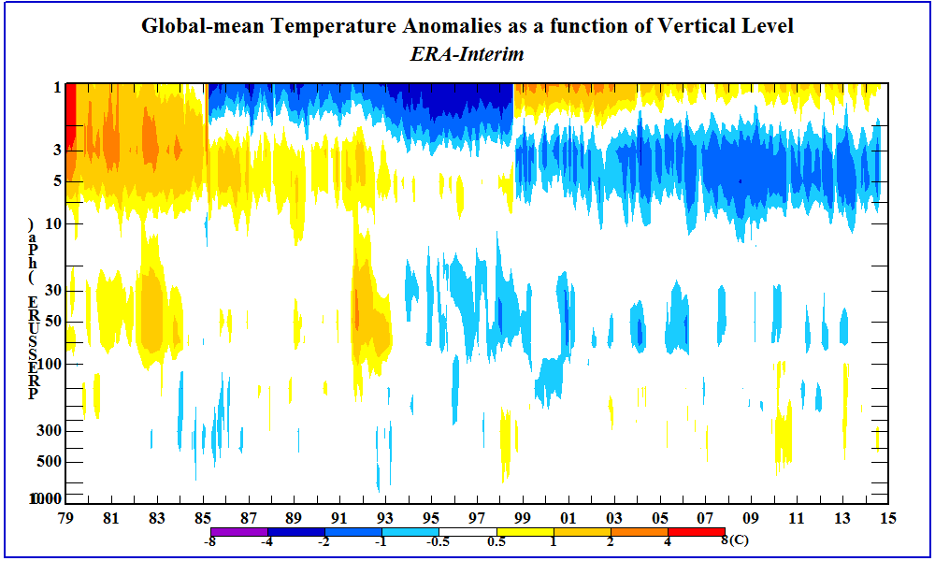
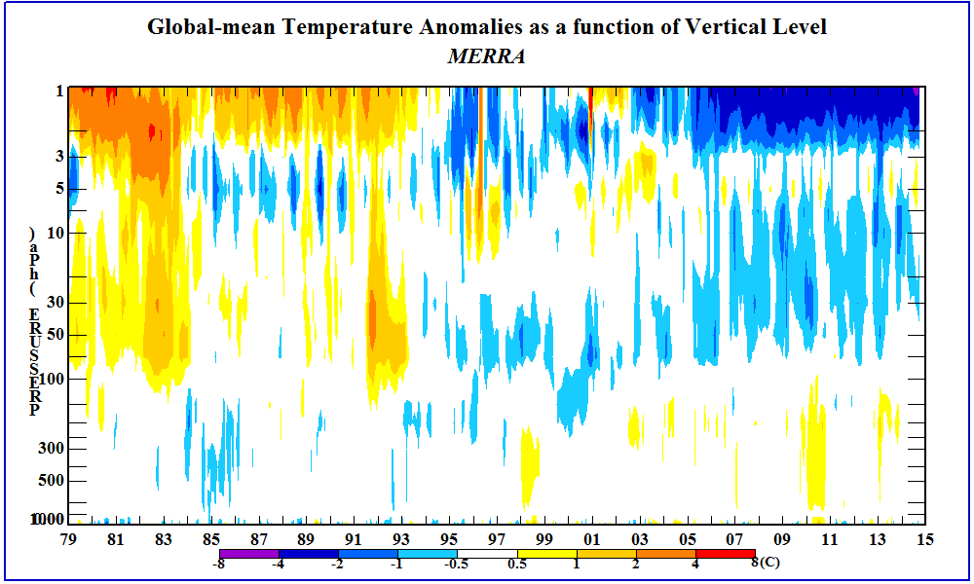
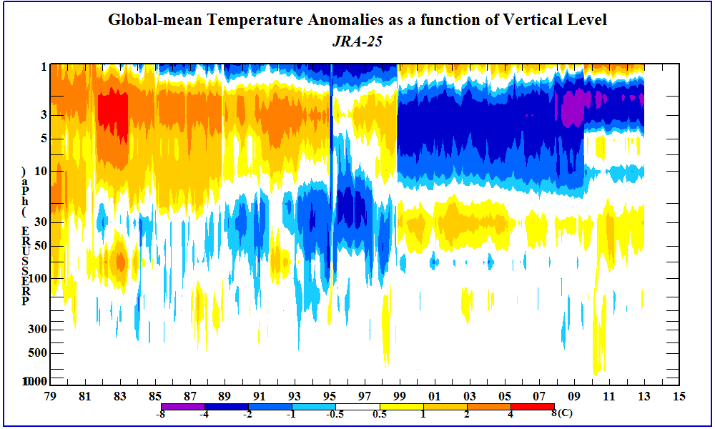
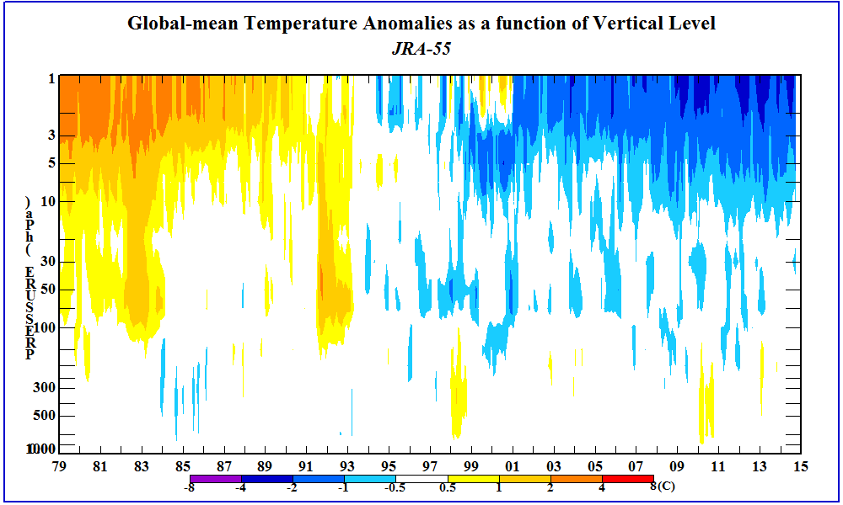
Global temperature anomalies from reanalyses
older generation
newer generation
0-50 km
ERA interim
MERRA
JRA-25
JRA-55
1979
jumps due to satellite changes
from Craig Long

Slide 6
What’s next for the SPARC Temperature Trends group ?
Short term (this meeting):
revisit comparisons of models and observations (are there any
outstanding issues that deserve a group focus? )
Longer term: ???
Part of the focus of this meeting is to help determine future structure and plans
Is there a need for this group going forward? How does it fit into evolving
SPARC/WCRP goals, plans and other activities?
How should membership and leadership evolve?
What are some alternative options?
Focused discussions this afternoon and tomorrow

